Slide 1
The Debt!
The Elephant in the room.
Or Cut the check!
This Photo by Unknown Author is licensed under CC BY-SA

Slide 2
We are not just talking about Slavery!

Slide 3
The Case
B. Unjust distribution of wealth and justice
Black Codes
Jim Crow laws both North and south
The New Deal
Housing discrimination
Loan/financing restrictions or usury
Limitation Education access
Implicit Bias and structural racism
Codification legitimizes behavior and attitudes.
A. Black People Built America
Cleared the land and produced the crops
Raised the food and the children of white families
We have fought in every war
Developed the land expropriated from the Native Americans.
Produced the wealth for both the new world and the old. Cotton was King/ Tobacco was second.

Slide 4
Justice
1857 The Dred Scott decision the U.S. Supreme Court's ruling, Scott was not a citizen and could not sue in a federal court.
1863- Emancipation Proclamation did not free all slaves in the United States. Rather, it declared free only those slaves living in states not under Union control.
Thirteenth Amendment: prohibits slavery and involuntary servitude except as punishment for crime
Reconstruction (1865–1877)
Freedmen’s Bureau: was established in 1865 by Congress to help millions of former black slaves and poor whites in the South in the aftermath of the Civil War.
Compromise of 1877-withdrawal of federal troops from the South in 1877
Black Codes/Jim Crow: Confederacy adopted Black Codes, laws for former slave laws. These laws were intended to limit the new freedom of emancipated African Americans. Vagrancy laws allowed blacks to be arrested for minor infractions. A system of penal labor known as convict leasing. Black men convicted for vagrancy would be used as unpaid laborers, and thus effectively re-enslaved.
Plessey VS Ferguson-1896 Supreme Court rules in favor of “Separate and Equal”?
King Cotton: American cotton production soared from 156,000 bales in 1800 to more than 4,000,000 bales in 1860 (a bale is a compressed bundle of cotton weighing between 400 and 500 pounds).
World Economy: By the late 1850s, cotton grown in the United States accounted for 77 percent of the 800 million pounds of cotton consumed in Britain. It also accounted for 90 percent of the 192 million pounds used in France, 60 percent of the 115 million pounds spun in the Zollverein, and 92 percent of the 102 million pounds manufactured in Russia.
Forty Acres and a Mule Sherman issued Special Field Order No. 15. The order reserved coastal land in Georgia and South Carolina for black settlement. Each family would receive forty acres. Later Sherman agreed to loan the settlers army mules. Six months after Sherman issued the order, 40,000 former slaves lived on 400,000 acres of this coastal land.

Slide 6
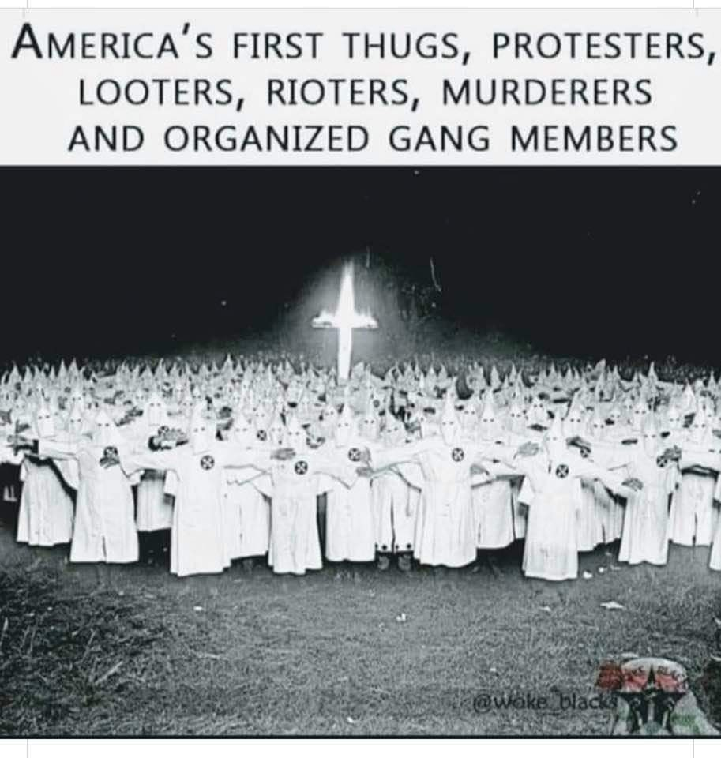
Massacres are the violence inherent to white supremacy unleashed in full force. Taking untold scores of Black lives, these massacres have largely been erased from the public consciousness.

Slide 7
Healing and Repair
United Nations Outlines 5 conditions for full reparations:
Cessation, assurances, and guarantees of non-repetition.
Restitution and repatriation: To make whole
Compensation
Satisfaction: An apology?
Rehabilitation: Health and Psychological services
The National Coalition of Blacks for Reparations in America (“N’COBRA”), “reparations is a process of repairing, healing and restoring a people injured because of their group identity and in violation of their fundamental human rights by governments, corporations, institutions, and families.”

Slide 8
Forty Acres and A Mule #1
General William Sherman concluded that each Black family should receive 40 acres. Sherman signed Field Order 15 and allocated 400,000 acres of confiscated Confederate land to Black families.
Thaddeus Stevens’s argument for slave reparations was simply that the slave holders had committed serious harmful transgressions against the slaves, who consequently had rights for reparation against their masters that could plausibly be satisfied by some of their masters’ land.
Thus Reconstruction (1865-1875) after President Abraham Lincoln’s assassination, President Andrew Johnson reversed Field Order 15 and returned land back to former slave owners.
This is the promise!

Slide 9
Precedent!
Reparations—a system of redress for egregious injustices—are not foreign to the United States.
Native Americans have received land and billions of dollars for various benefits and programs for being forcibly exiled from their native lands.
For Japanese Americans, $1.5 billion was paid to those who were interned during World War II.
Additionally, the United States, via the Marshall Plan, helped to ensure that Jews received reparations for the Holocaust, including making various investments over time. In 1952, West Germany agreed to pay 3.45 billion Deutsche Marks to Holocaust survivors.
Black Americans are the only group that has not received reparations for state-sanctioned racial discrimination, while slavery afforded some white families the ability to accrue tremendous wealth.

Slide 10
Myths, Cheap Shots, and Rationale
We’ve done so much for you; look at your life here compared to Africa.
Why should American taxpayers, who never owned slaves, pay for the sins of ancestors they don't even know? And what about those whose ancestors arrived here long after slavery ended?
Governmental bodies, like corporations, have a continuing existence. Governments are liable for the judgments issued against them and, unfortunately, they have to satisfy those judgments using taxpayer money. The new immigrants take their new government subject to the liability existing at the time. We all take America with the good and the bad at the same time.
Are the people who are claiming innocence actually are innocent? As Professor Ogletree has recently phrased it, "while black folks were sitting at the back of the bus; generations of white immigrants got to go straight to the front." It is debatable how much privilege some immigrants, particularly those from southern Europe, Asia, and the Spanish Americas, received. (Read The Case for Reparations by Ta-Nehisi Coates - The Atlantic)
Affirmative Action benefited Black Americans
Affirmative action programs were not designed or targeted for Black Americns
White women were the primary beneficiary of the programs not Black people (Source: Affirmative Action Myth Busters)
Why don’t you pull yourselves up by your bootstraps?
What bootstraps?

Slide 11
Claimants
Foundational Black American/American Descendants of Slaves
1807-End of international slave trade-
African Americans are the product of an Ethnogenesis that happened here in the US. We are American. We are not “from somewhere else”. African Americans are the product of an Ethnogenesis that happened here in the US. We are American.
We are not “from somewhere else”. 450,000 Africans arrived in the United States over the course of the slave trade, all before 1807. Almost all of the 42 million Black Americans today are descended from those people.
An individual would have to provide reasonable documentation of at least one ancestor enslaved in the United States and
They would need to demonstrate they have identified as black, African American, Colored, or Negro on established legal documents for at least 10 years prior to the onset of the program
We are from the US in ways that only Native Americans can also say.

Slide 12
Respondents
Indian Treaty of 1866
Roles Governments Domestic and Foreign
International major corporations
Insurance companies, i.e., Lloyds of London (insured slave ships and slaves).
Shipping companies

Slide 13
Reparations Considerations
Foundational Black American become a protected class Foundational Black American is any person classified as Black, who can trace their bloodline lineage back to the American system of slavery. To be designated as a FBA, at least one parent must come from a non-immigrant background in The United States of America. Use 1870 census first census after slavery or 1900 census (which would give place of birth.)
Massive education program: Why, How, Who
Free Health services: Psychology service, Drug rehab
Tax exempt status
Business grants for business starting up, business expansion to hire more employees, or purchasing property for descendants of enslaved Black Americans
Down payment grants and housing revitalization grants for descendants of enslaved Black Americans
Financial Literacy
Individual payments for descendants of enslaved Black Americans/
College tuition to 4-year or 2-year colleges and universities for descendants of enslaved Black Americans
Student loan forgiveness for descendants of enslaved Black Americans
All programs written in a specific plain language
H.R.40 - 116th Congress (2019-2020): Commission to Study and Develop Reparation Proposals for African-Americans Act

Slide 14
Thank You!
https://www.phillbriscoe.com/paradigm-blog/
Phill.briscoe@ebonyknight.net

