Slide 1
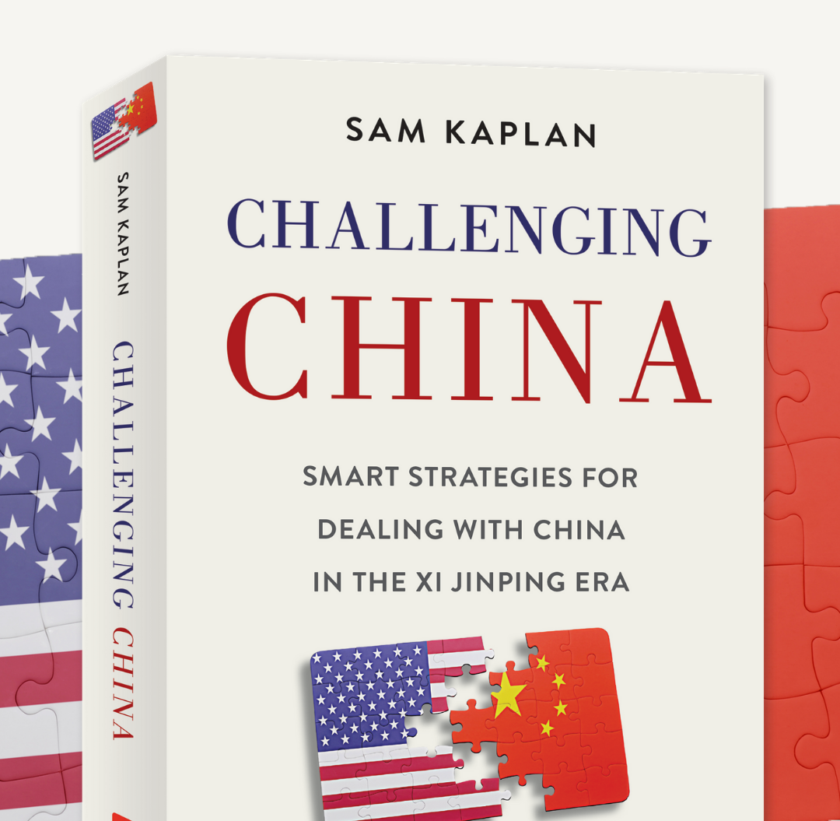
How to Deal with One of the Four Most Important Issues In The World
While referencing Dolly Parton, LeBron James, Bruce Springsteen and the movie Die Hard
Notes:
I’m going to talk about one of the four most important issues in the world: what to do about a more authoritarian, more expansionist China. If you want to know what the other three issues are, pre-order my book, Challenging China, which goes into much, fun-loving detail about this question, and I’ll email you the answer. And please, feel free to ask questions or make comments at any point during this presentation. Let’s have a conversation. Do not wait until the end to ask questions or make a comment. Raise your hand or put something in the chat room. And, Tom, if I don’t see one, just interrupt and let me know.
I’ve been working with China in one or another for basically my whole career. First back when I worked on foreign affairs and trade issues for a congressman back in DC, then in various business capacities and now in higher education.
Like many people working with and dealing with China, I became more and more concerned in the two thousand thirteens. Which brings me to:

Slide 2
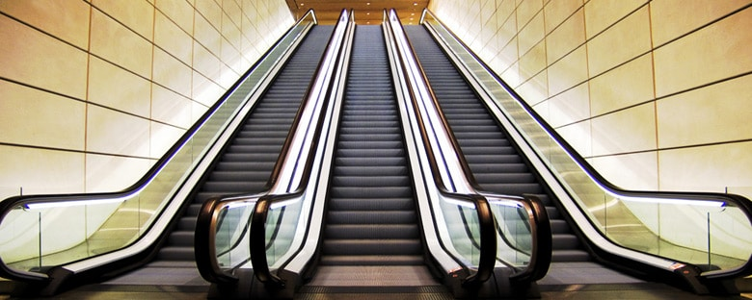
The Great Escalator Incident of 2015
Notes:
The Great Escalator Incident of 2015
I was part of the host committees that organized the visit of Xi Jinping in 2015 to Seattle and president Hu Jintao in 2006. The differences in the two visits reflected the changes taking place in China.
When Xi came there was a large gala dinner at the Westin Hotel in downtown Seattle. I was more or less in charge of it. There a set of escalators in the lobby of the hotel that Chinese security wanted turned off for the duration of Xi’s stay there. That would be against the fire code and against the law and they were told no and security measures were in place to ensure Xi and all the other dignitaries safety. In the afternoon before the dinner but during some Xi meetings I find myself walking by the escalators—and yep, they were turned off. Nearby I saw the head of the secret service who I had been working with. He said, “the Chinese security themselves physicaly turned them off and Secret Service decided it wasn’t worth fighting and would let them have their way for a half hour. China was much more assertive, wiling to buck law, common sense and the secret service.
In 2006, during Hu’s visit, they asked for suggestions on what to do and when to do it, to avoid rush hour, and advance teams could make decisions.
With Xi in 2015, they told us what to do, did things when they wanted, Seattle traffic be damned and no decisions were made until Xi’s inner circle came 5 days before the trip
China was quickly becoming a different place. It has become more oppressive, more closed and more expansionist. That’s a bad combination for the world

Slide 3
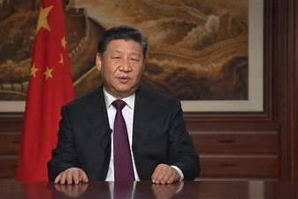
Xi’s Secret Speech
“To dismiss the history of the Soviet Union and the Soviet Communist Party, to dismiss Lenin and Stalin, and to dismiss everything else is to engage in historic nihilism, and it confuses our thoughts and undermines the Party’s organization on all levels.”
Notes:
Right after Xi became president during a tour of south China he gave a public speech that many interpreted favorably and people started opining he would be a reformer. But during that same tour he gave a secret speech to party members where he talked about the lessons the party needed to learn from the fall of the Soviet Union and the Communist Party of China must take all measures to ensure the same thing didn’t happen there. That speech made clear that rather than reform there would be just the opposite.
Over the next seven years, Xi gave many speeches and if you read them carefully, and please don’t many are 3 hours long full of crazy communist party jargon, Xi made clear that China aims to supplant the liberal world order and make the world safe for authoritarianism.

Slide 4
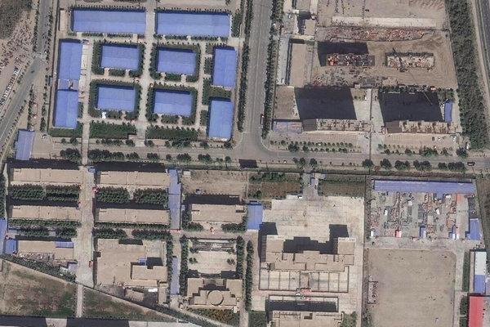
China’s Human Rights Abuses
Twenty prisoners live in one small room. They are handcuffed, their heads shaved, every move is monitored by ceiling cameras. A bucket in the corner of the room is their toilet. The daily routine begins at 6 A.M. They are learning Chinese, memorizing propaganda songs and confessing to invented sins. They range in age from teenagers to elderly. Their meals are meager: cloudy soup and a slice of bread.
A satellite image shows an internment camp in Xinjiang.
Notes:
Human rights have deteriorated measurably over the last decade.
Most famously in Xinjiang, in the western part of China, the Xi government is committing what many would call genocide. Indeed Biden’s new secretary of state has called it exactly that. They have swept up more than 1 million Uyghurs—an ethnic Muslim minority group—into concentration camps where they are forcibly reeducated. This summer came credible reports that the government is forcibly sterilizing Uyghur women so that they cannot have children. It is one of the greatest human rights abuses of the 21st century. This week came reports of systematic rape of Uyghur women prisoners

Slide 5
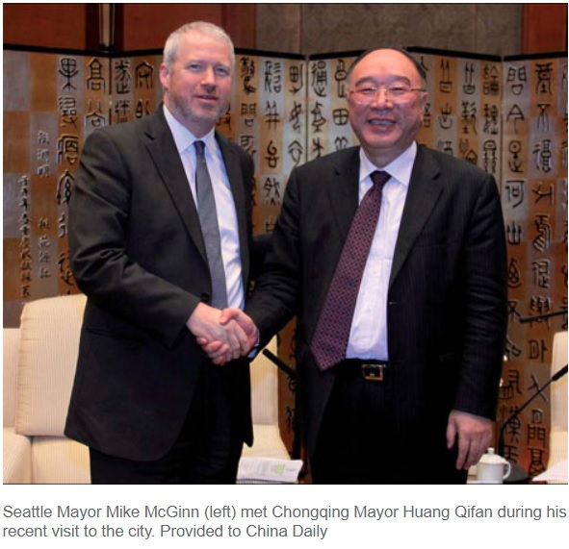
Xi’s Corruption Crackdown/Consolidation of Power
Notes:
When Xi became president he instituted a corruption crackdown. Tell Chongqing story organizing Mayor of Seattle’s visit and Wang Lijun, the police chief of Chongqing who was connected to Bo Xilai. Want defects to consulate
“sweeping up some 2 million officials of both high rank and low.” Begun shortly after he took office, President Xi’s anti-corruption campaign has been expansive and ongoing. In 2013, there were 172,000 investigations, 330,00 in 2015, and 527,000 in 2017. Among the high brought low are seven at the Politburo and Cabinet level. But the campaign has swept up a broad swathe of national, provincial, and local leaders throughout China. Richard McGregor calls it a “generational clean-out.” While there was plenty of corruption to clean out, the campaign also served the second purpose of solidifying Xi’s grip on power.
more than 200 lawyers in China involved in human rights issues were questioned and detained after Xi became president. In 2015, what became known as the “709 Crackdown” named for the date it started (July 9), with a crackdown on human rights lawyers and human rights activists around the country. More than 250 such people were arrested, many still in jail and detained.
In December 2019, China announced new censorship rules that took effect on March 1, 2020. During the early stages of the coronavirus crisis in Wuhan, doctors starting to alert each other about the dangerous new virus were labeled “Internet Users”

Slide 6
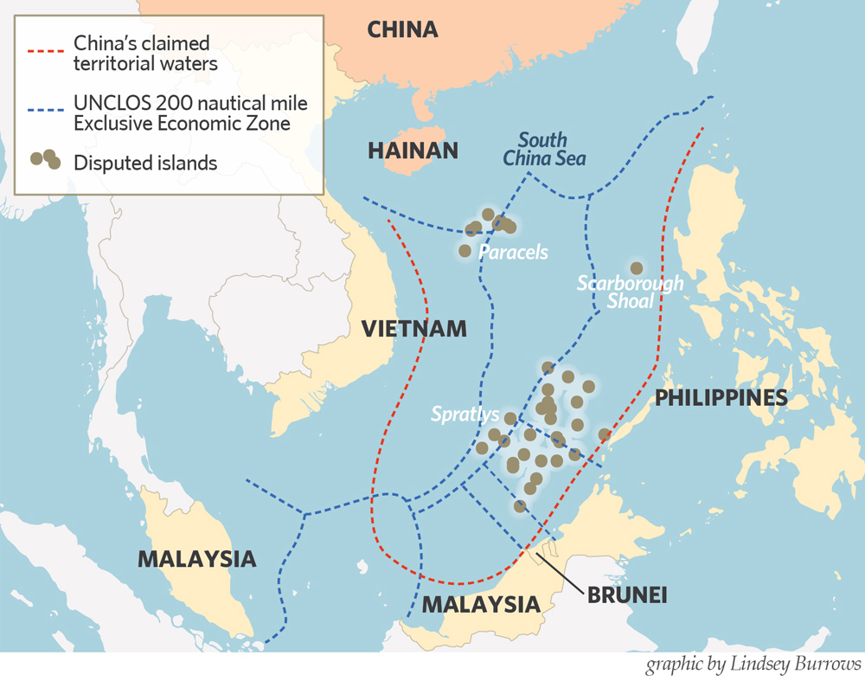
China is more Expansionist
Notes:
So China is more authoritarian than it was have also become expansionist.
And I don’t just mean geographically in terms of trying to take over land, though they are doing a bit of that. Here for example, is a map of the South China Sea where China is claiming large swathes of territory. The blue line shows exclusive economic zone that countries can have based on rulings by the United Nations Convention on the Law of the Sea. The red dotted lines are China’s unliteral based on now international law claims. To give a little perspective, they are claiming territorial waters more than 1000 miles from their borders. That’s like Portland claiming Chicago is part of its city.

Slide 7
China is more Expansionist
International Telecommunications Union: The World’s Most Boring Sounding Organization (but it’s important)
Notes:
But China’s expansionism is really more than geographic. They are attempting to change the post World War II/post Cold War liberal world order into one they can control. They are trying to make the world safe for authoritarianism
One example of this is The United Nations International Telecommunications Union (ITU) sounds like the kind of organization created to help insomniacs. But, China is actively using this organization to propagate facial recognition technology standards on the world. You see, the ITU, which is the oldest global international organization, originally called the International Telegraph Union, has responsibility for creating standards for global telecommunications technology. They are changing these standards to make it easier to use government surveillance technology to spy on citizens. They are also exporting to and helping developing country governments use this technology to repress their own citizens. Perhaps UN International Telecommunications Union is not so boring after all.

Slide 8
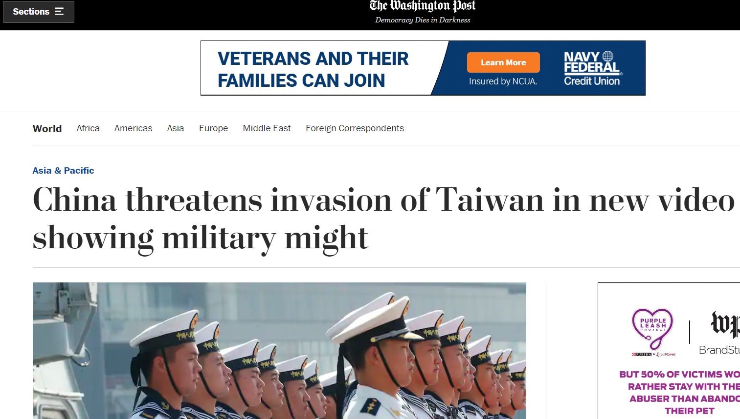
China is more Expansionist
Threats Against Taiwan
Notes:
China has also become more vocal about Taiwan and about invading it. It has flown fighter jets into Taiwan airspace, been more vocal about military plans to invade Taiwan. And in the People’s Daily last week—the main government run newspaper—they printed a commentary included a rarely used in the People’s Daily phrase that means “don’t say I didn’t warn you 勿谓言之不预也” (wu4 wei4 yan2 zhi1 bu4 yu4 ye3) The specific wording was used in editorials (社论) by the paper in 1962 before China went to war with India and before China invaded Vietnam in 1979,

Slide 9
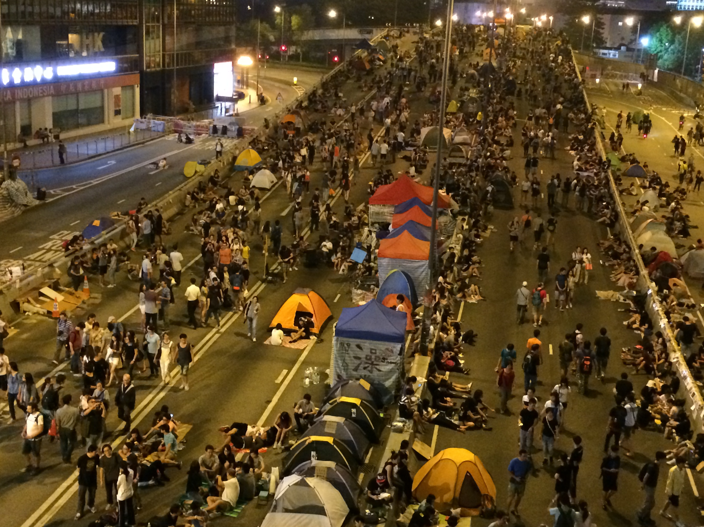
China is more Expansionist
And Repressed Hong Kong
Sam’s personal photo of Hong Kong “Umbrella” protests
https://twitter.com/CGTNOfficial/status/1284447825804185606?s=20
Notes:
China has also cracked down on Hong Kong.
The UK colonized Hong Kong but reached an agreement with China to turn it back over in 1997 but with the stipulation it would operate under a Basic Agreement that preserved certain freedoms in Hong Kong. It was what was called a one-country, two systems arrangement.
But as China became more authoritarian and started instill its norms in Hong Kong, protests grew in Hong Kong especially beginning in 2014 during the “Umbrella” protests. I happen to be there for work during 2014 and took this photo and talked to some of the young protestors.
Earlier this year there were more protests and Hong Kong cracked down on them violently. Then China passed a National Security Law which prohibits free speech and assembly in Hong Kong and even by people like you and me talking about freedom in Hong Kong here and elsewhere around the world. I could easily break this law during this Zoom session

Slide 10
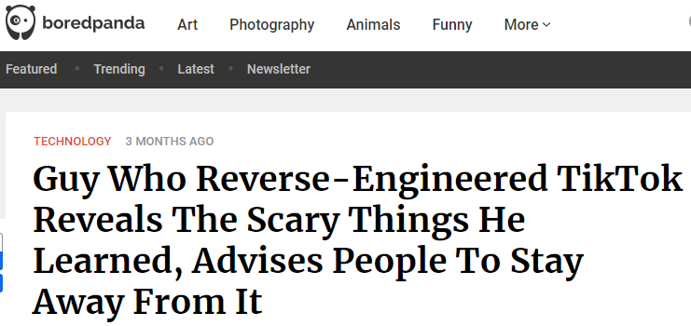
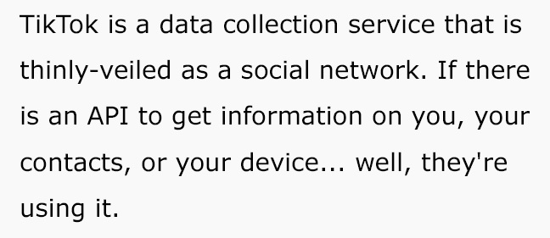
China is more Expansionist
Complicated Questions
Notes:
Unlike the Soviet Union during the Cold War, China has companies with worldwide impact.
The Trump Administration tried to force TikTok to be sold to an American company. Whether this is a good idea or a bad idea or done in the must judicious manner is up for debate. The concern is real, however. And the concern is that China’s government can hoover up large amounts of data from unsuspecting Americans and use it as a way to spy. That’s why the military has been preventing soldiers from using TikTok for a few years now.
And TikTok grabs huge amounts of data in ways that other services, including Facebook and Twitter, do not. A software guy recently reverse engineered it. And as you can see from this screenshot, TikTok grabs as much data as it can off your phone, including tracking your keystrokes. It’s problematic and whether the Trump administration approach is a good one or not, I expect there to be attempts at more rigorous regulation on such platforms in the future

Slide 11
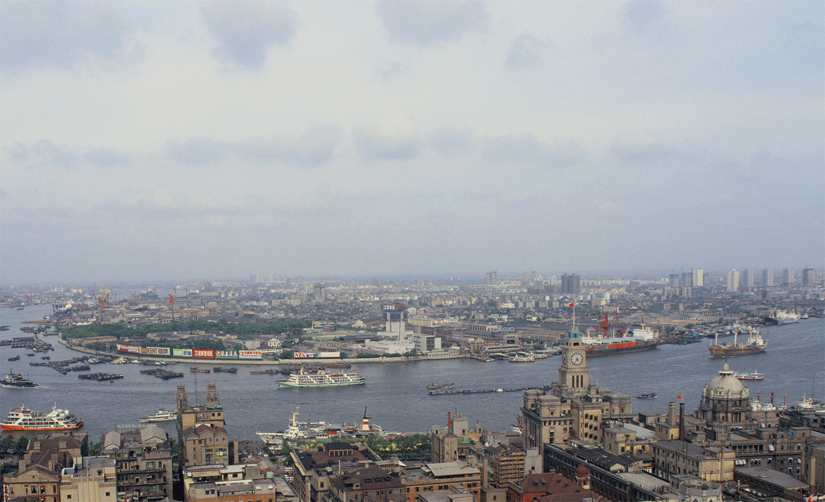
China’s Stunning Success
Notes:
Even as China became more oppressive, its economy continued to grow. This is a photo of the Pudong area of Shanghai. Back in the early 1990s it was essentially farmland. But today looks like a modern Manhattan or Tokyo
Since China opened up in 1979 and especially since the 1990s, China has been one of the great economic successes of human history

Slide 12
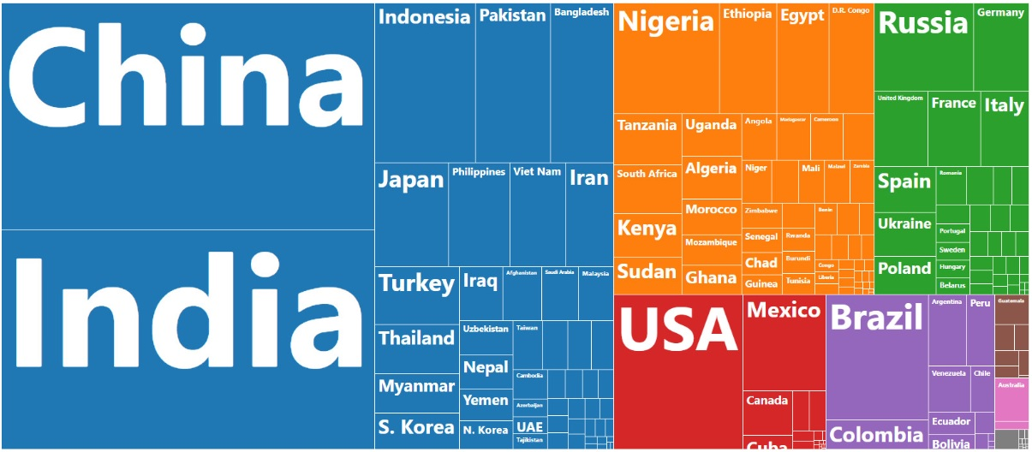
China’s Stunning Success
The World’s 7.5 billion people in one chart, Visual Capitalist
Notes:
That’s partly because China is huge so they are achieving things at a scale not seen previously. Here you see a representation of their population. China and India are about the same size although in the next few years India will become more populous than China. They may already be since China may be miscounting their population. China miscounts and mispresents a lot of data, including economic data

Slide 13
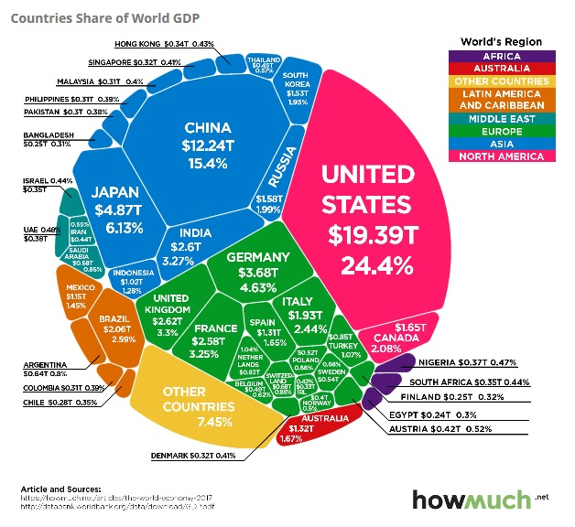
China’s Stunning Success
Notes:
But, China’s economy has become much bigger (though exactly so is not entirely clear). But it is the second largest economy in the world behind only the United States. This gives it great geopolitical leverage

Slide 14
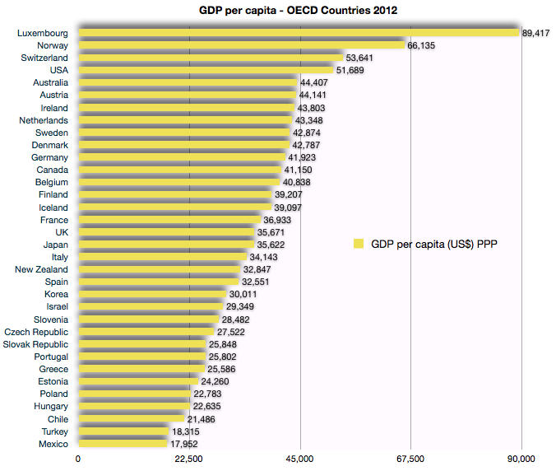
China’s Stunning Success
China is 73rd
Notes:
But in per capita terms, China is far behind the U.S, European countries, Japan, South Korea, Taiwan and many other places.
But its GDP per capita is much lower than other Asian tigers such as Korea and Taiwan at similar time periods of development
But their GDP per capita increased from a very low level 30 years ago

Slide 15
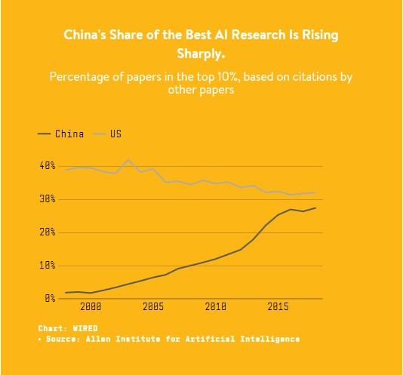
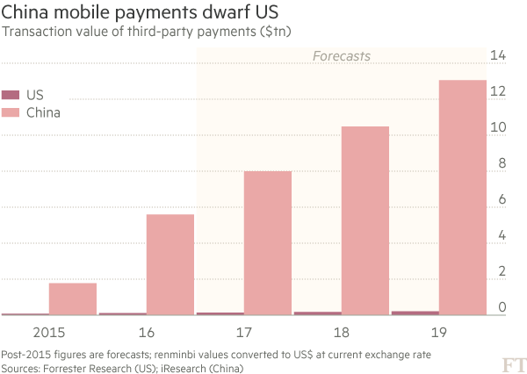
China’s Stunning Success
China is now a technology innovator
Notes:
A myth about China is they are only a copycat economy. That they merely steal intellectual property. In fact, while they do steal intellectual property, they are also a great innovator. Two things can be true at the same time. They are well ahead of the U.S. and other countries in mobile payments, for example and have been for some time. You can buy just about anything on your phone without entering credit card numbers or using cash in a store or all the ways we do currently here.
They are also working on artificial intelligence using large amounts of data they collect to do so
And they are making great strides in biotechnology. A few years ago I met with the CEO of a biotech company in Shenzhen (in the south of China near Hong Kong) that is the largest repository of sequenced genomes in the world. BGI. They were recently featured on 60 Minutes for their trying to collect data from Americans and for their nefarious activities in Xinjiang against Uyghurs. Innovation can be used for both good and bad purposes.
Chinese companies are innovators but they still steal: Tell story of businessman working with meeting with potential Chinese investor. Investor picked up small medical device and was examining it. He wanted to hold onto it but businessman quickly took it back. He was worried about IP theft. And rightly so. You can get a patent for your technology but likely have to work with Chinese partners to do so. Someone I’ve worked with has a former IP regulator on staff. Lots of espionage. Tell about FBI coming to see me and asking that I keep an eye out for it. I am most certainly not Bourne.
They are also innovators in surveillance technology as we’ll talk about later, including creating and using gait recognition technology, that is, recognizing someone by the way they walk.

Slide 16
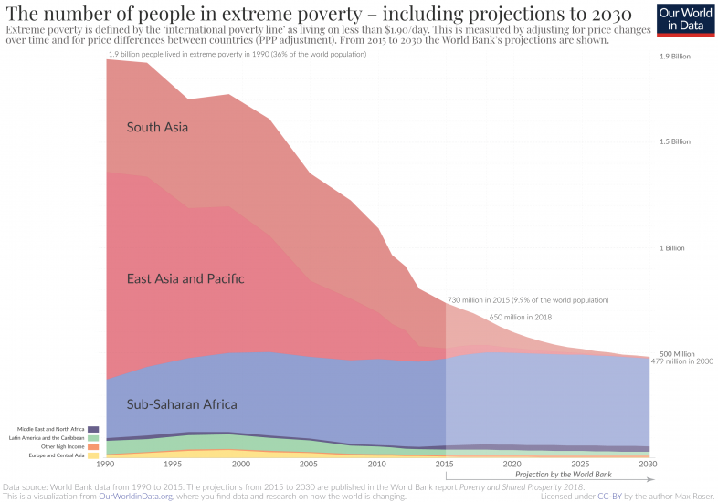
China’s Stunning Success
It has helped the world
Notes:
All this economic success means that China is the great poverty alleviator in the history of the world. They brought more than 700 million people out of extreme poverty over the last forty years. In fact, more people have risen out of poverty around the world than at any other time in history. China is a big reason for that.

Slide 17
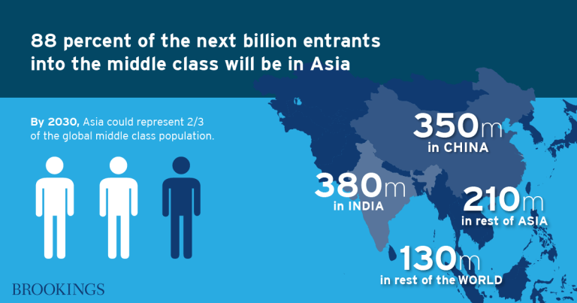
China’s Stunning Success
It has helped the world
Notes:
China, and Asia, have become more and more important to the world economy over recent decades. Their increasingly large middle class will have big impacts on the world economy and on geopolitics.

Slide 18
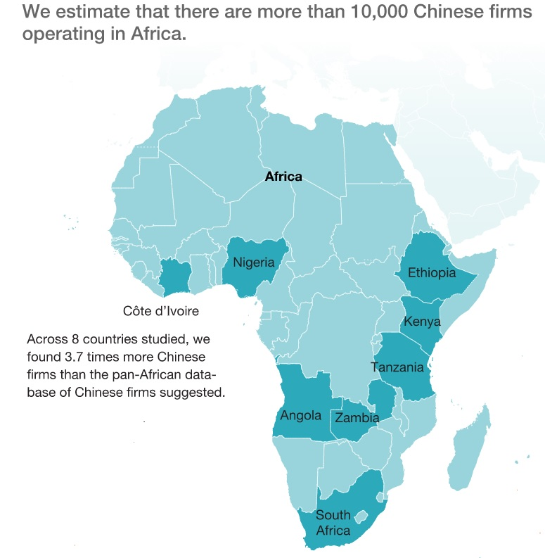
China’s Stunning Success
It has helped the world
Notes:
They are also changing other parts of the world. Some people complain about China providing unsustainable loans to Africa and other developing countries and then using the loans as leverage to extract things from this country. And that is true and does happen.
But separately, there are thousands of individual Chinese business people in Africa making investments, setting up factories. As China has become more expensive due to its economic success, these Chinese business people, not the government, set up factories in Ethiopia, Kenya and other parts of Africa where they make clothing, shoes and other items. This is providing a chance for these countries to develop their manufacturing capabilities and grow and develop as Japan, South Korea, Taiwan and China did.
Tell story of factory in Vietnam I toured
So China’s economic success is important and been beneficial to the world in many ways.

Slide 19
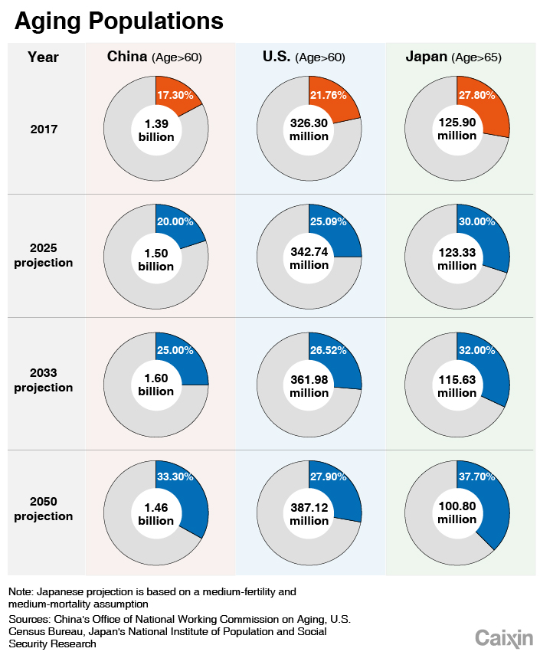
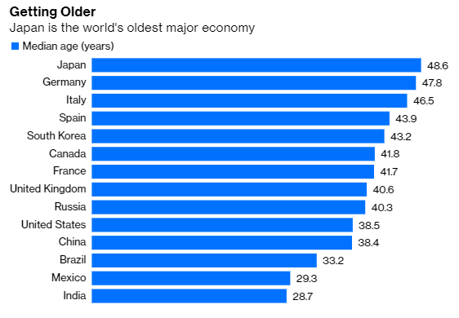
But China Has Challenges
Notes:
China now faces economic headwinds:
They have aging demographics. There are too many Chinese that look like Tom and me and not enough that look like our children.
Under current trends, China’s population in the next 20 years will be older than the United States. It is one of the reasons why they’re economy has slowed and will not grow at the rate it has previously
China’s working age population is already declining. Trends for birth rates have gotten worse in the last few years, not better so their demographic situation is actually worsening.
Their productivity lags far behind advanced countries. It’s true their annual productivity increases are larger than developed countries but each year these increases have been decreasing.
China sustained high GDP growth rates for years. We argue in our book that the era of high GDP growth in China is over. Because of Covid catchup, they may achieve good growth this year, but after that their GDP growth will be much similar to America’s and Europe’s than their last three decades of growth.

Slide 20
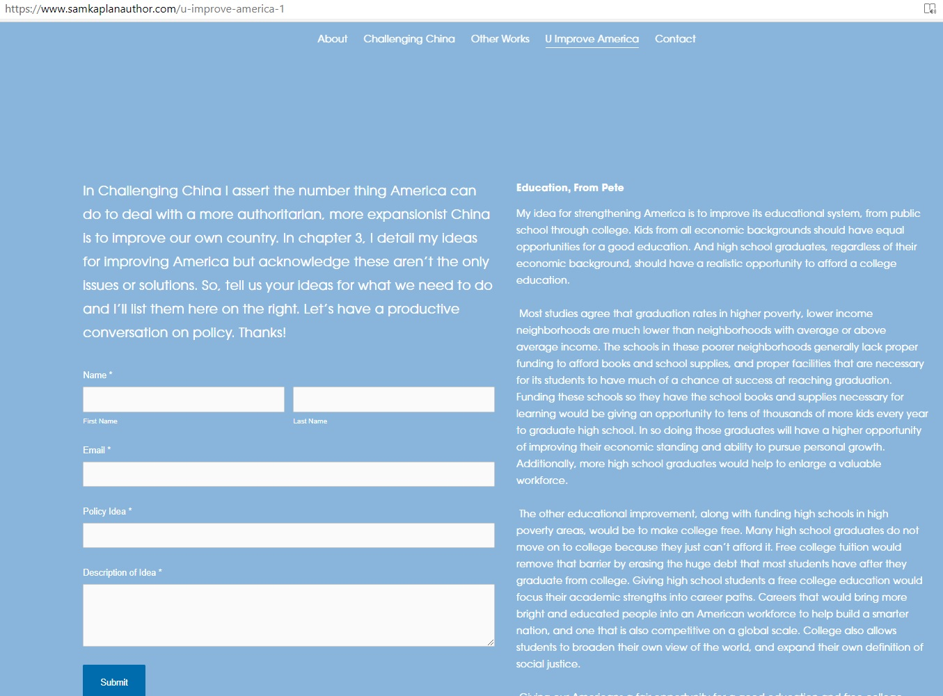
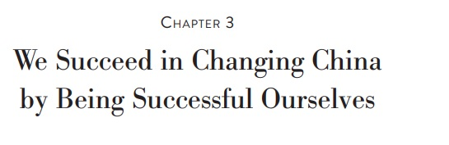
What to Do?
Notes:
So China is more authoritarian and more expansionist. And they have achieved great economic success given them much leverage in the world economy and in geopolitics but they face great economic challenges going forward and will no longer have a fast growing economy.
What do we do about it.
In my book I recommend a number of policies to deal with China. But, I also assert the most important thing we can do to deal with a more repressive, expansionist China is to improve our own country. I identify four big policy issues we need to address. But I also admit that I’m not omniscient and don’t have all the answers. In fact, the website I recently created for the book provides an opportunity for you to give your recommendations on how to improve America. Feel free to go to samkaplanauthor.com to send in your ideas.

Slide 21
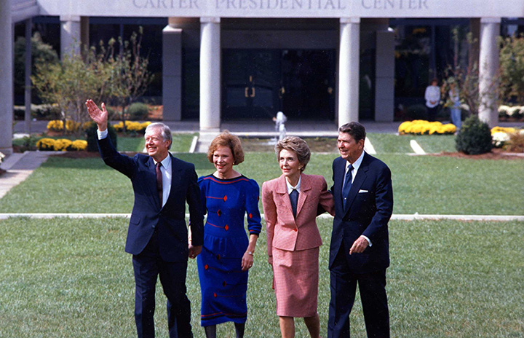
What to Do?
Promoting Human Rights is Underrated: We Bring Jimmy Carter and Ronald Reagan Fans Together
“This is not cultural imperialism, it is providing the means for genuine self-determination and protection for diversity. Democracy already flourishes in countries with very different cultures and historical experiences. It would be cultural condescension, or worse, to say that any people prefer dictatorship to democracy.”—Ronald Reagan
Notes:
I also recommend moving human rights more to the forefront of our foreign policy with China. In my book I explain how Jimmy Carter made human rights a larger component of U.S. foreign policy and how Reagan, after some missteps, also utilized it effectively. If we can bring Carter and Reagan fans together, as Biden likes to say, there’s nothing we can’t accomplish.
Human rights is, of course, a moral issue, but it is also the most treacherous landscape for China to traverse. They are committing genocide. They also fear their own citizens which is why they must censor the Internet and most other aspects of society. That, remember is a sign of weakness, not strength.
Whenever human rights are raised China will say two things: a) that it is an internal matter and b) that who is America, with its racial inequality problems, to lecture China or anyone else about human rights abuses?
On the former, as we write in our book, “Determining the rate of a capital gains tax is an internal affair. Debating the best route for a new high-speed rail line is an internal matter. The torture of Zumuret Dawut is a matter for the whole world.”
On the latter, Biden and other public officials can preface every Chinese human rights statement with “We have issues to deal with but that does not excuse imprisoning over 1 million Uyghurs and forcibly sterilizing them.”

Slide 22
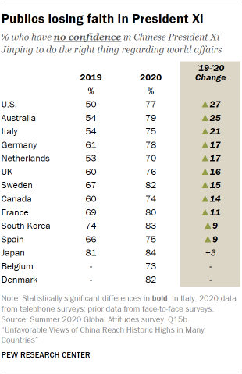
What to Do?
Multilateralism: Better to Hang Together
Notes:
The U.S. has issues with China. But guess what? So do many other countries. On the economy, China’s market is not just closed to American companies in many sectors, but to all countries.
China’s aggressive expansionist policies are affecting other countries even more than the U.S. Think about Vietnam in the South China Sea, for example. Or note that when Sweden’s journalists organization decided to give an award to a Swedish citizen—Gui Minhai, who had been arrested and is in jail in China for writing stories about China, China’s Ambassador threatened Sweden: ““We firmly oppose representatives of the Swedish government attending such an event, and if they decide to stick to what they are doing, we will have no choice but to take counter-measures…I believe some individuals in Sweden should not expect that when they hurt the interests and sentiments of China, things will just move on naturally.” China’s line about internal affairs only applies within their borders.
The last four years, the U.S. made creating alliances against China more difficult by applying tariffs not just on China but on nearly all of our allies in Europe, Canada, Japan and elsewhere. The Biden Administration has said it will make rebuilding alliances a priority. But it won’t be easy. For one thing, it is a different world than four years ago. The rest of the world moved on from America, creating their own alliances, whether a TPP without America or new supply chain alliances created by Japan, India and Australia.
Plus, commercial interests will be difficult to overcome.
A new survey of German companies in China shows they are doubling down rather than pulling out. Among the findings: - 96% have no plans to leave in the next year - 72% are planning further investments - 77% expect CN market to develop better than others

Slide 23
A New World
“For the United States, its world status and influence are gradually declining, and its international reputation has been severely weakened.”--Wu Xinbo, the Dean of Fudan University’s Institute of International Studies
“the world is in a state of great changes unseen in a century” Xi Jinping in 2018
Notes:
As you can see from these two quotes, China believes America is in decline. They’re not the only ones. Many countries feel that way. The attempted insurrection of January 6 only reinforced this belief for many around the world.
Where once America was seen as a beacon of democracy, a place where anyone could find success, instead we have people in fur hats invading our capitol building, a less than robust response to Covid-19, and more important in that regard, one that did not include taking leadership to help squash it around the world, much less in the university district of Seattle.
The world adjusted to America’s retreat from world leadership. China, of course, has become more assertive but as noted new alliances are being formed around the world, Europe entered into an investment agreement with China, Vietnam and Japan’s defense ministers are consulting with each other.

Slide 24
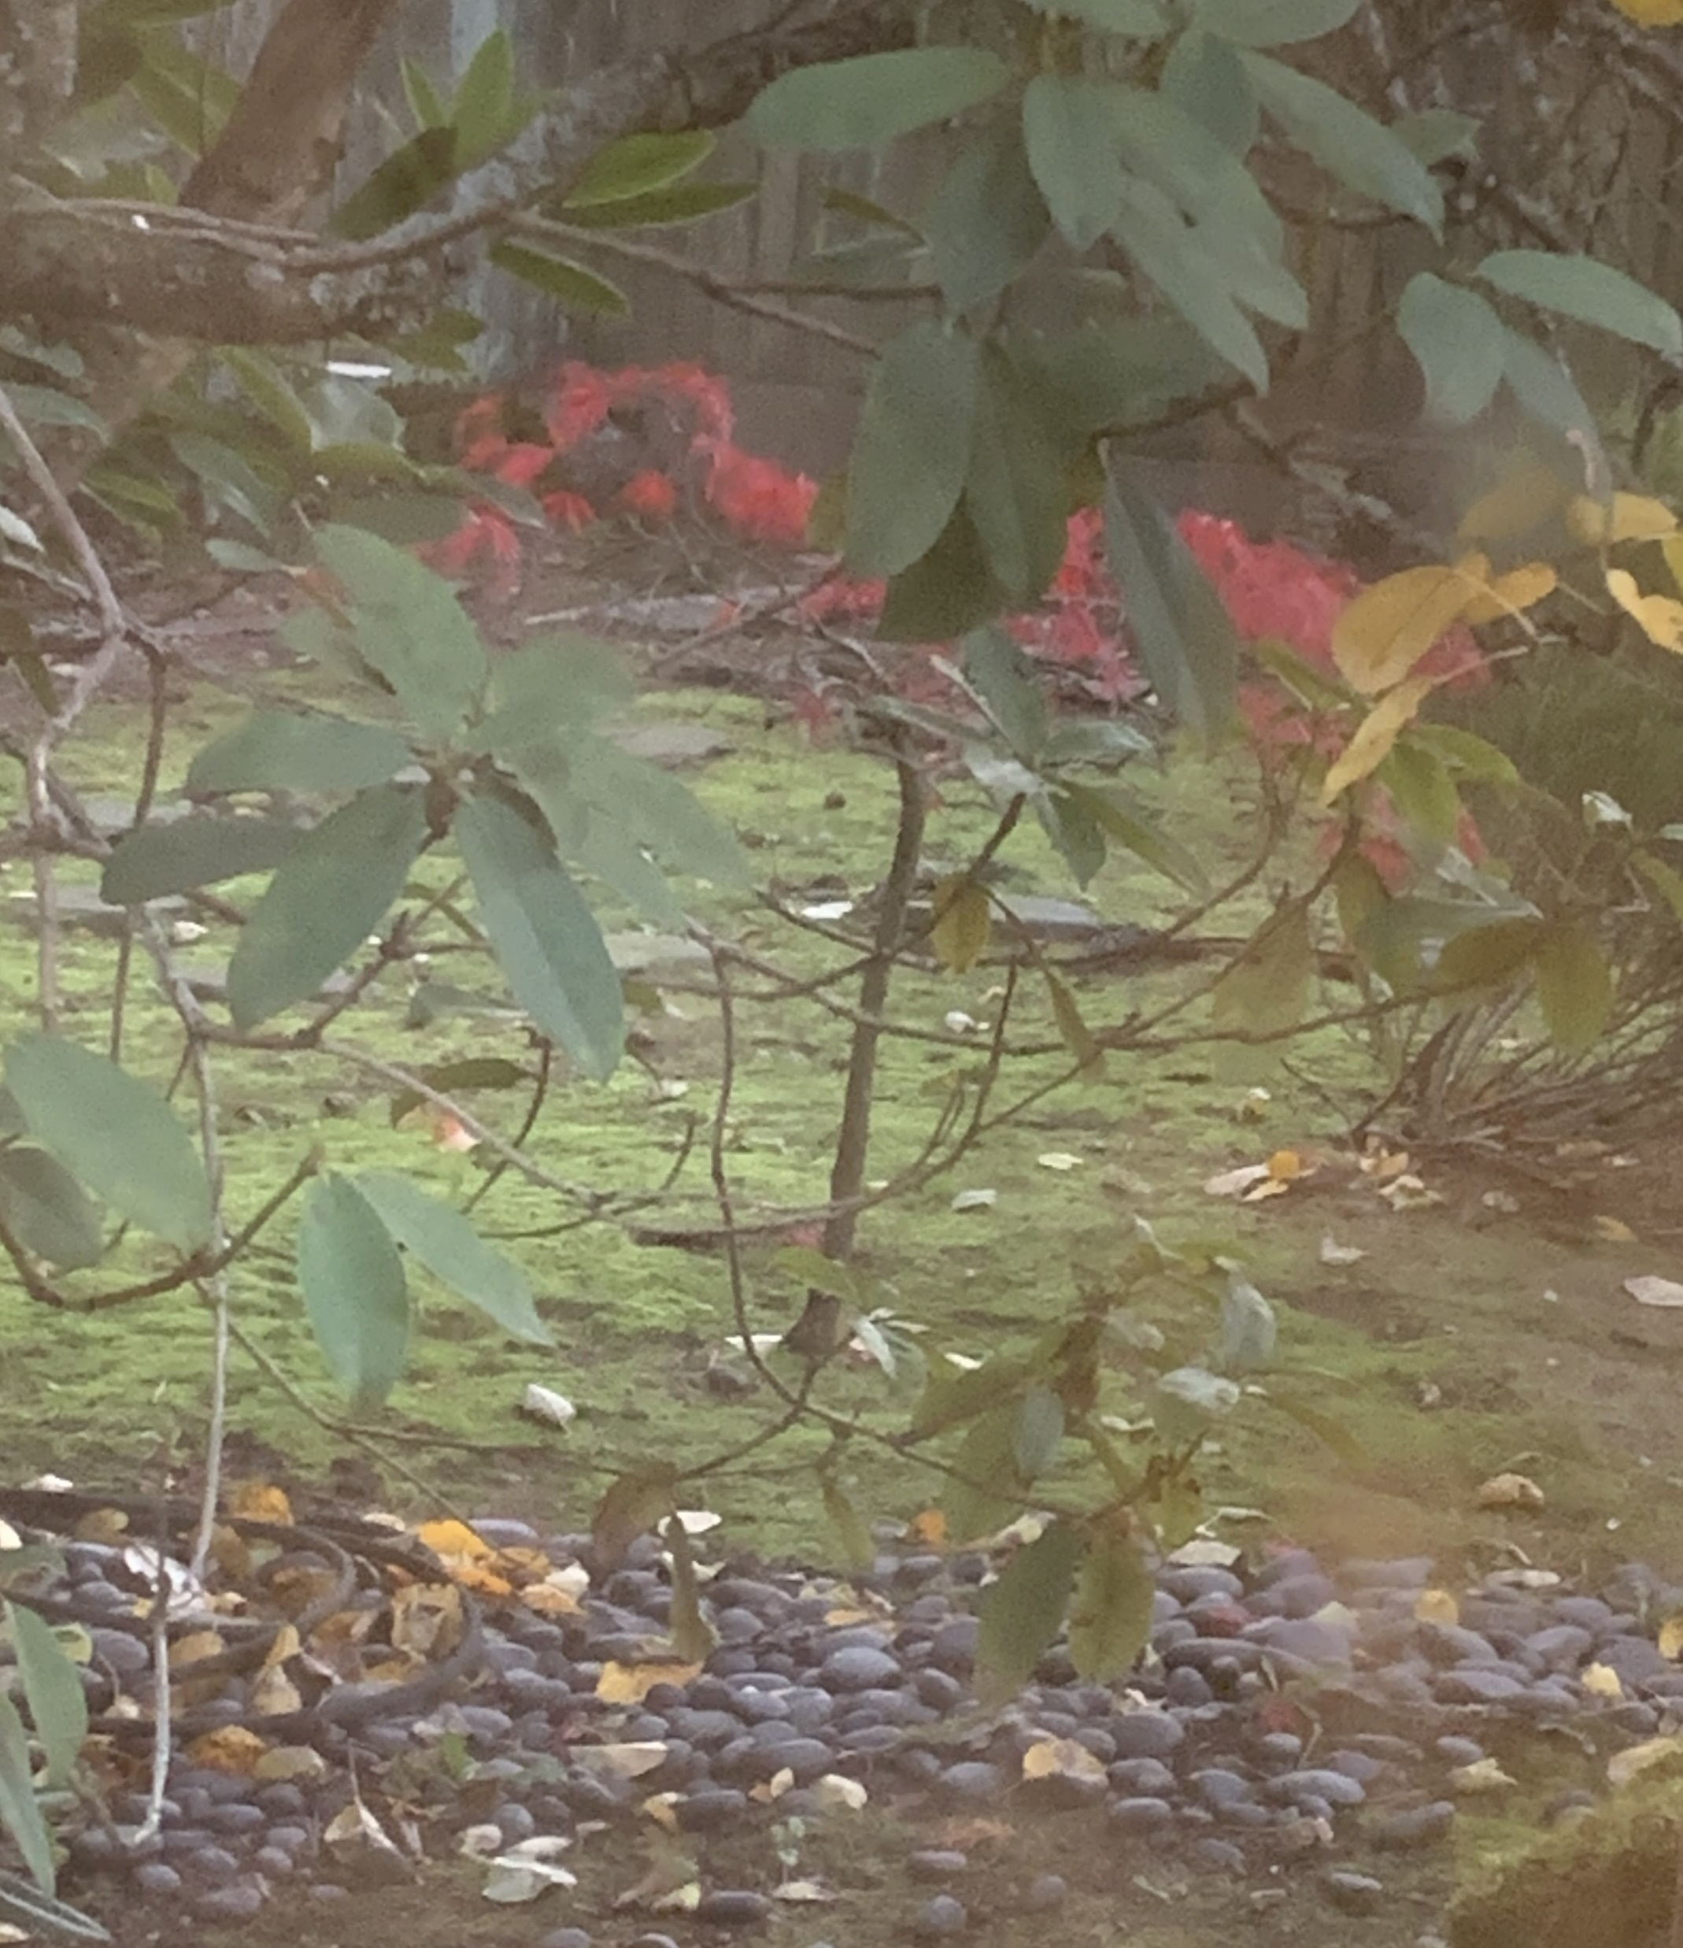
A Tree Grows in Beijing
Notes:
From epilogue
Talk about my tree in old house
Talk about Biden operating in new world
Talk about our continued challenges here and whether Biden can solve them
A necessary first step was electing someone other than Trump
China, as we saw, has challenges too. They may want to be able to transplant a tree too
Whether you supported Trump or were against him, it’s important to recognize that he not only changed America but the world. America pulled back from leadership.

Slide 25
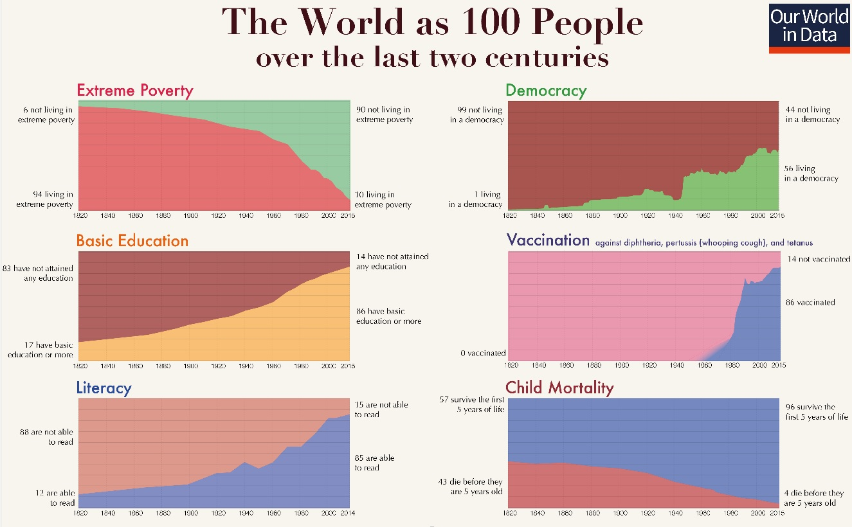
Tough Year but for 70 Years World Improved
Notes:
2020 has been a tough year with Covid-19 and other problems. No doubt about it. But it’s important to look at the big picture. The last 70 years have been ones of remarkable progress.
We saw earlier the remarkable reduction of poverty. But poverty has fallen in the U.S. during that time as well although it’s almost never remarked upon. And this is true for all races and ethnicities.
More people have access to education than ever before. Literacy is at all time highs. Child mortality rates are down. Vaccinations are up.
And speaking of vaccinations, Covid-19, as bad and destructive as it has been on health, social and economic factors, is driving amazing innovation. We appear to be on track to develop a vaccine in record time. And this vaccine development isn’t just great because of Covid-19. This new mRNA technology has applications for treating cancer, other viruses such as HIV and even the common cold. It is driving medical progress.
The last few years have seen some setbacks around the world but if stop and examine what helped us be successful the last 70 years, and what steps we need to take to continue and to evolve and improve upon that success, there is no reason the next 70 years can’t also bring amazing amounts of progress.!

