Slide 1
The Bukobero Community Health Centre
Bududa District , Uganda

Slide 2
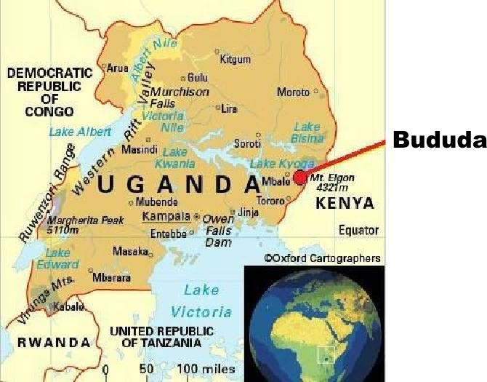
What and where is it?
A new Health Center III being built by the Bukobero Community in the Bududa District of eastern Uganda.
Will provide maternity care, laboratory services, pre-and post natal care, childhood vaccinations, HIV-AIDS services, and primary health care, plus more.
The health center will directly serve the 8,000 to 10,000 people in Buwali Sub County where it will be located. Plus many people from the surrounding sub counties.
It is expected that 80 people a day will use the facility.
Notes:
Faced with the lack of health care facilities, in 2018 the community came up with a radical idea. Build their own. Much organization has gone into this project. A Governement registered Community Based Organization and Cooperative have been started.

Slide 3
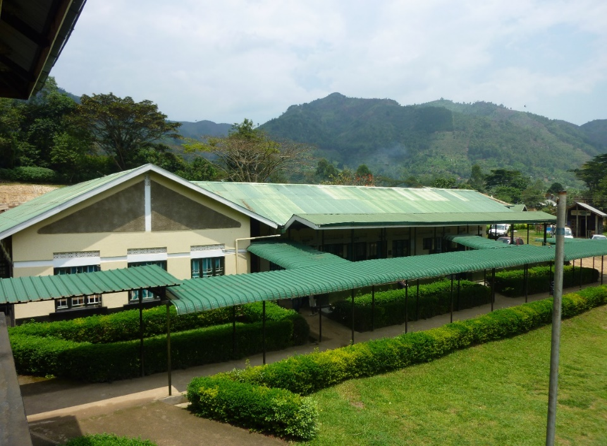
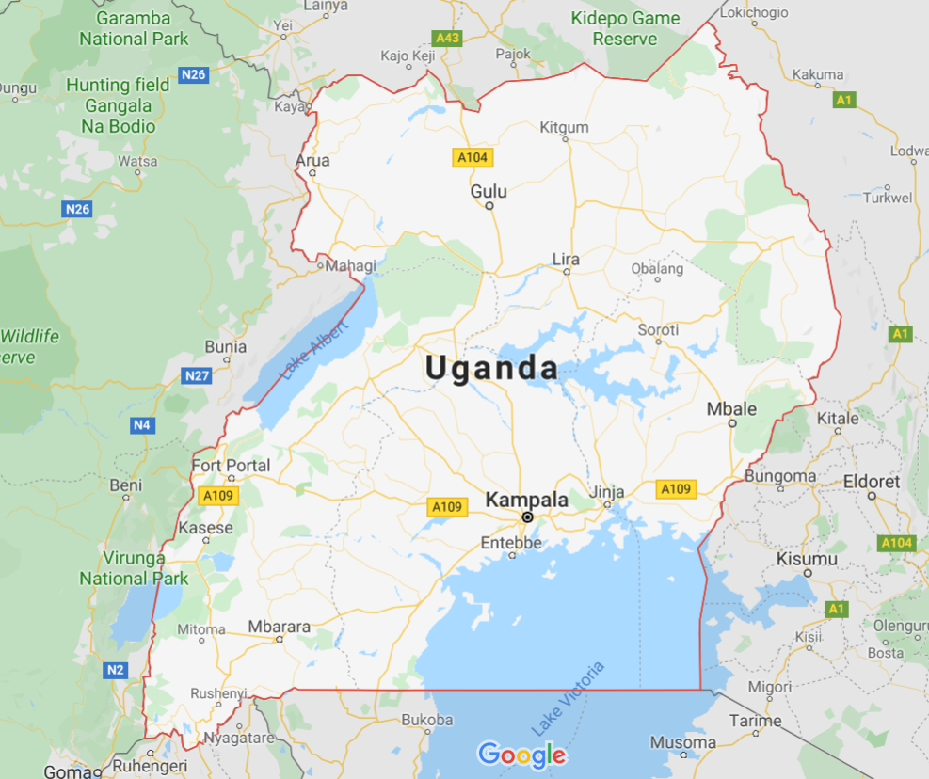
First, a little about me…
After retiring from the WA State Dept. of Ecology in 2015, I realized a life-long dream of working in Africa.
For almost three years, I worked in The Bwindi Community Hospital in southwest Uganda near the border with the Congo.
Managed a program that provided care to people living in extreme poverty
Asked to help with the Bukobero Health Center in Bududa District.
Bududa
Bwindi

Slide 4
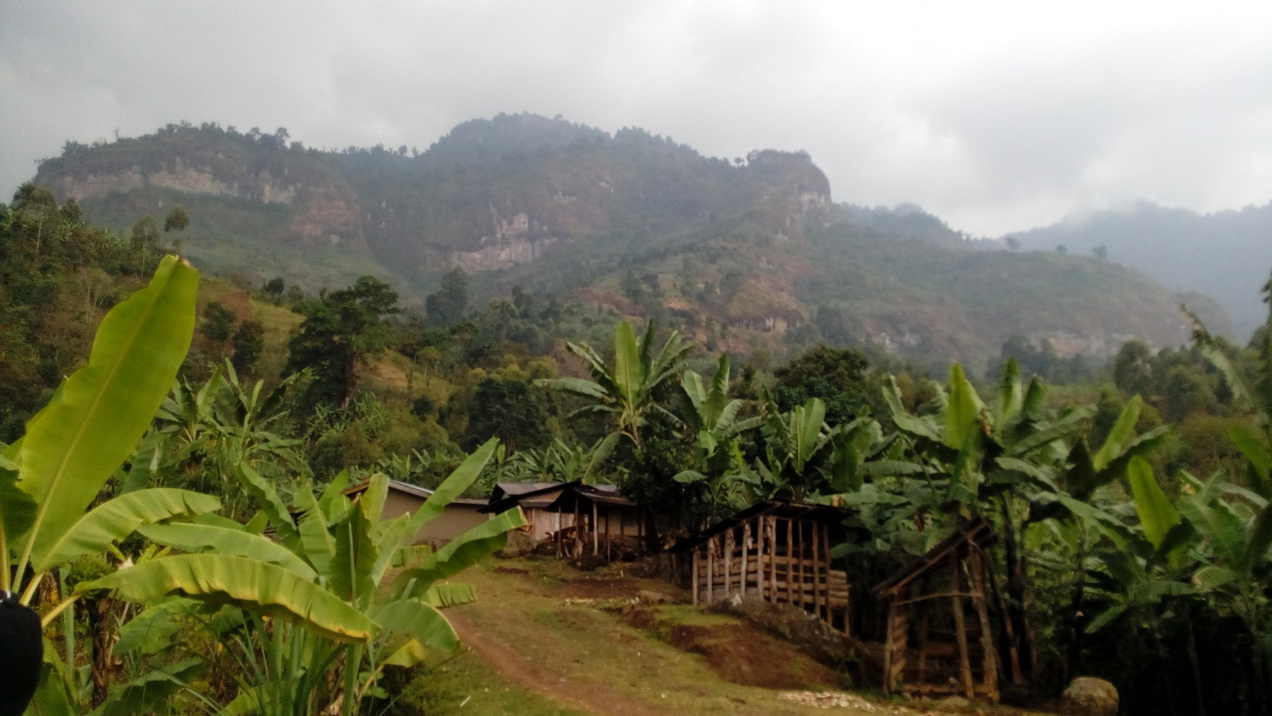
The Bududa District
In the foothills of Mt Elgon; on the border with Kenya
Remote and beautiful
70 to 100 inches of rain a year
Grows very high quality coffee
Plagued by mudslides
No health facility for 8-10 kilometers from our site

Slide 5
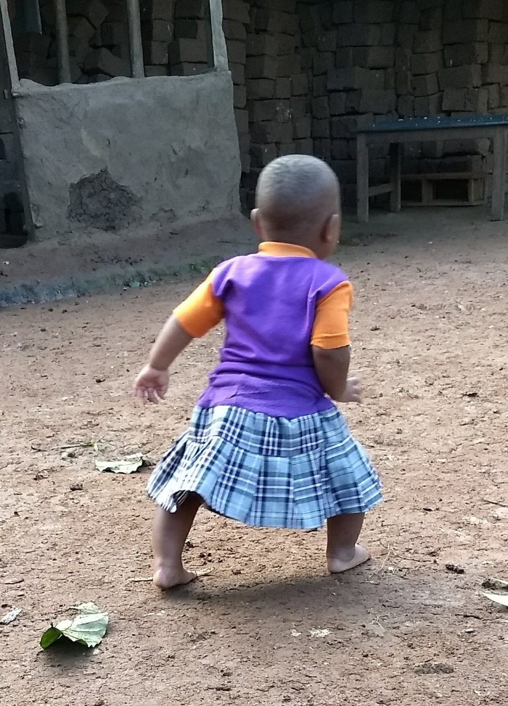
The Need One of the poorest regions in Uganda
43% of people live in extreme poverty or below the equivalent of $1.90 a day.
One of the highest birth rates in Uganda, 6.8 births per woman.
Only 24% of deliveries are attended by medical personnel.
49% of children are stunted from chronic malnutrition.
Currently, people must walk 8-10 kilometers to reach health care. This is almost impossible during the rainy seasons.
Gift Namasopo
Notes:
The statistics are daunting.

Slide 6
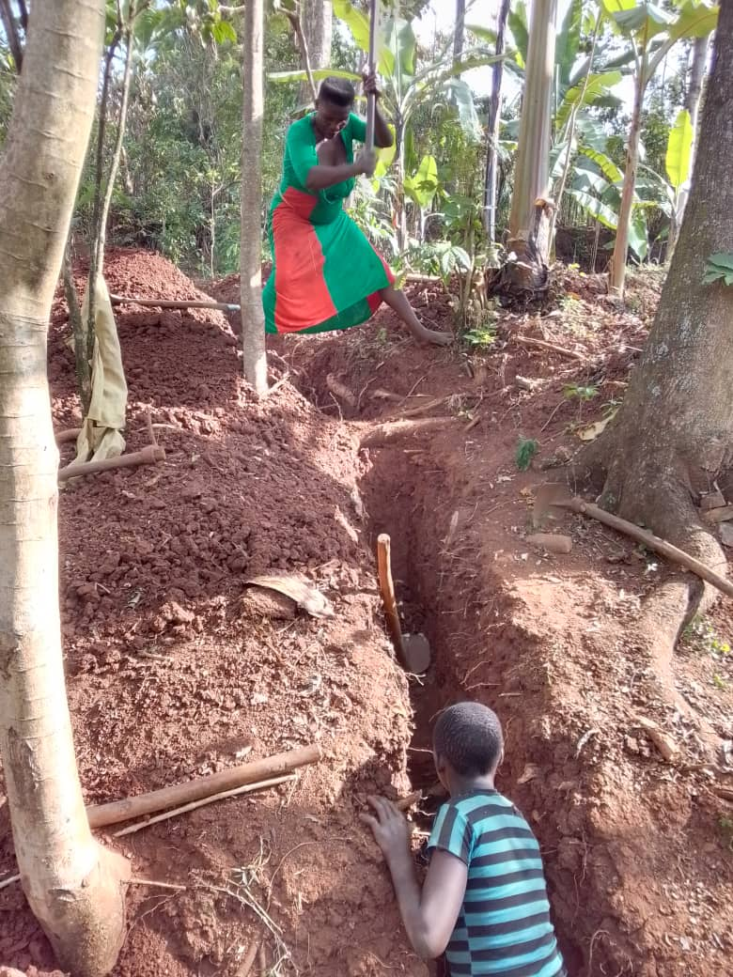
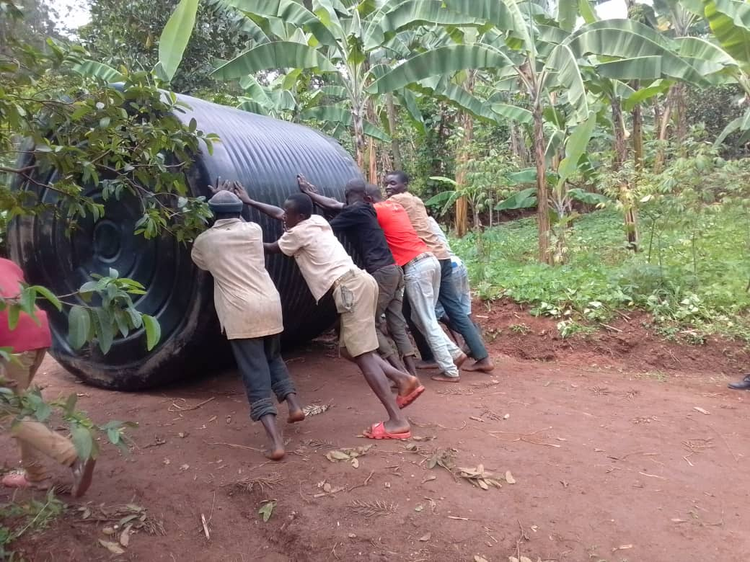
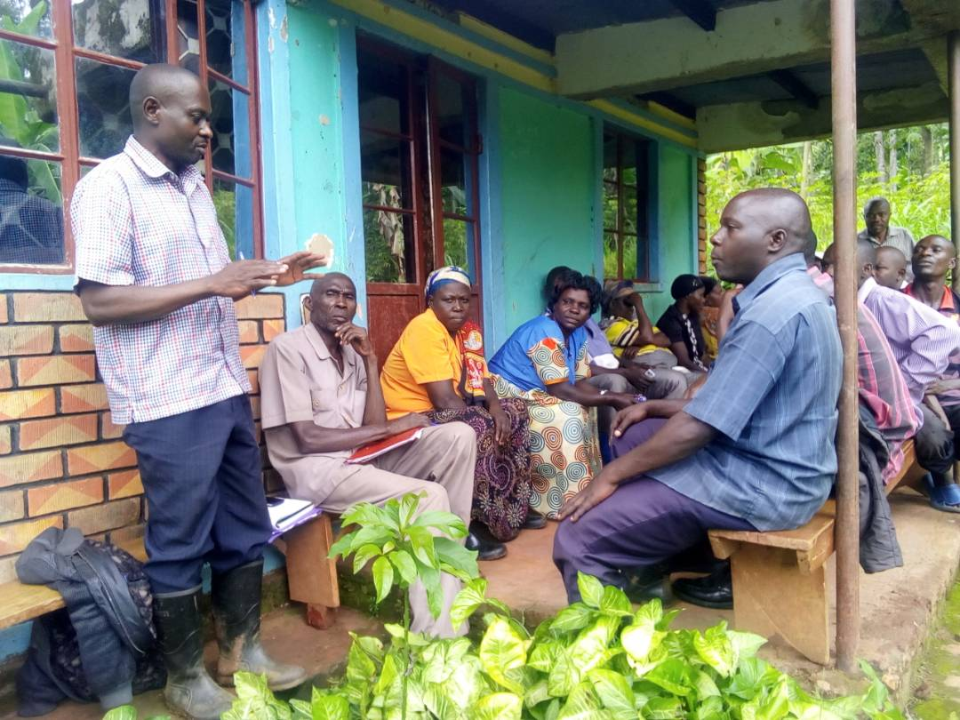
The Bukobero Community
Resilient
Committed
Capable

Slide 7
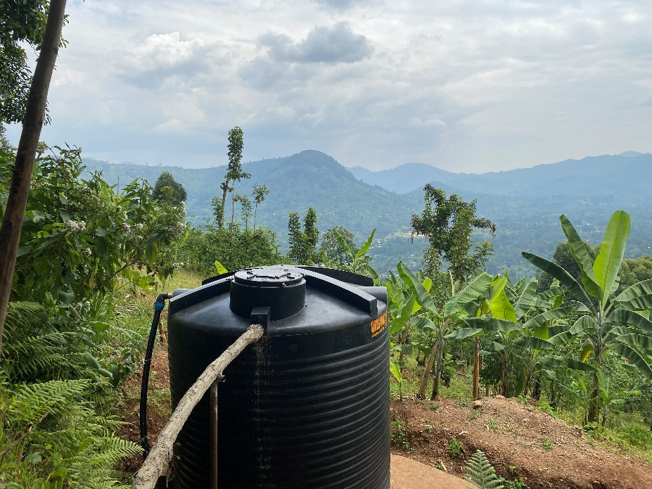
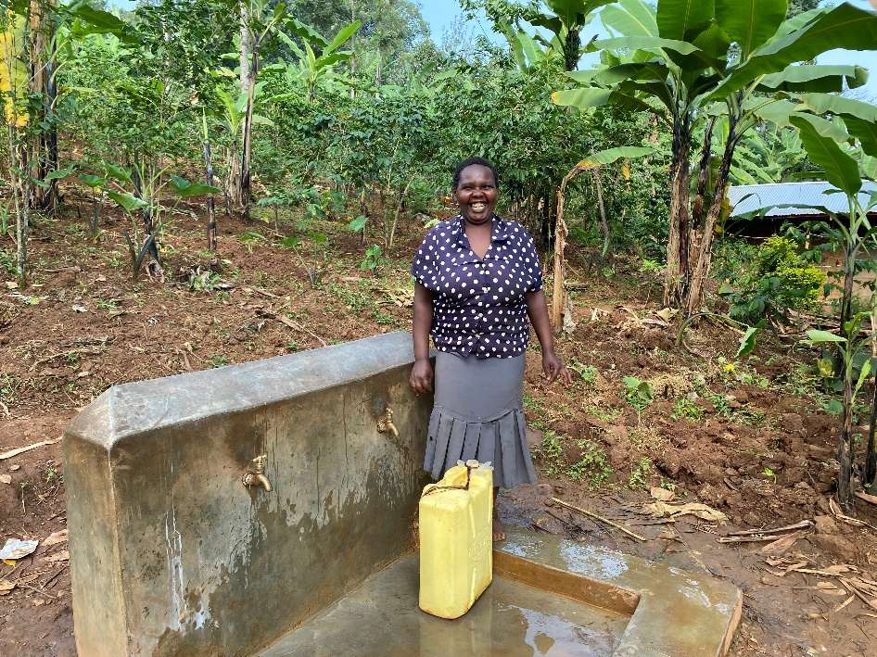
What has been accomplished?
Community Based Organization (CBO) was set up in 2018.
Land cleared and graded.
Blue prints and site plans drawn.
All government approvals acquired.
30,000 liter water system installed.
$175,000 raised.
Construction starting October 2022

Slide 8
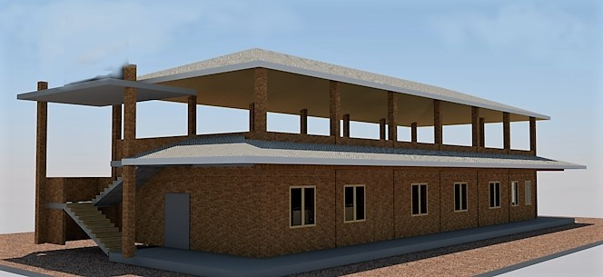
The Bukobero Community Health Centre
A new vision of a health facility - some of the innovations will include:
Owned by the community
Electronic recordkeeping
Solar power
Mental health/alcohol services
Long term plan for sustainability
Brick making
Honey production

Slide 9
District Grant Application
Sanitation Facilities
Septic System
Toilets/showers
Laundry and cooking facilities
$29,000
Notes:
I will be asking for $7,000 from University District Rotary and hoping for four additional clubs to support with $2,000 each. Asking for a $10,000 District match

Slide 10
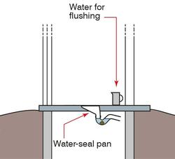
Sanitation Facilities
Two-chambered septic system
Small constructed wetland
Two female showers/pour flush toilets
Two male showers/pour flush toilets
Laundry and cooking facilities
Designed by two Seattle-based civil engineers with years of experience in water-sanitation systems
Constructed by an experienced team of Ugandan architects and structural engineers

Slide 11
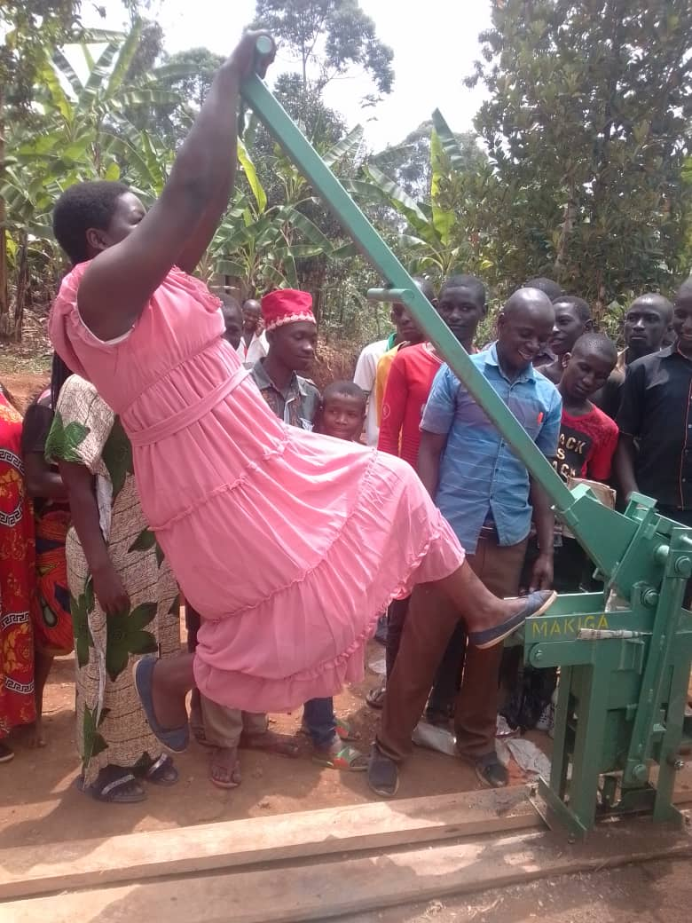
Community Engagement and Contribution
80 volunteers helped install the 700-meter gravity feed water system
Rotary sponsored soil-stabilized brick making training
Will be making bricks for the toilet/shower blocks
Construct the rain water tank
Unskilled labor for construction

Slide 12
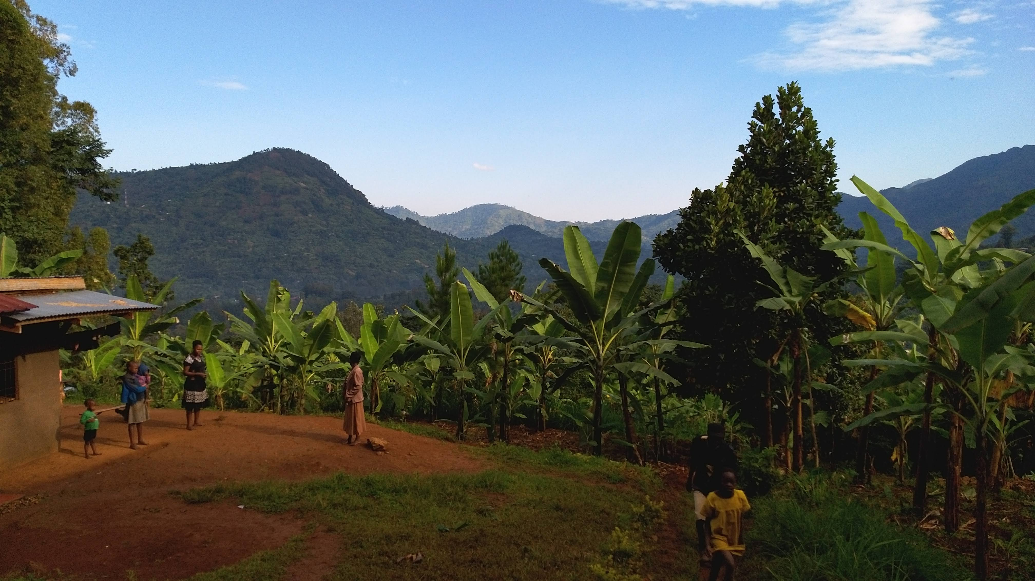

Slide 13
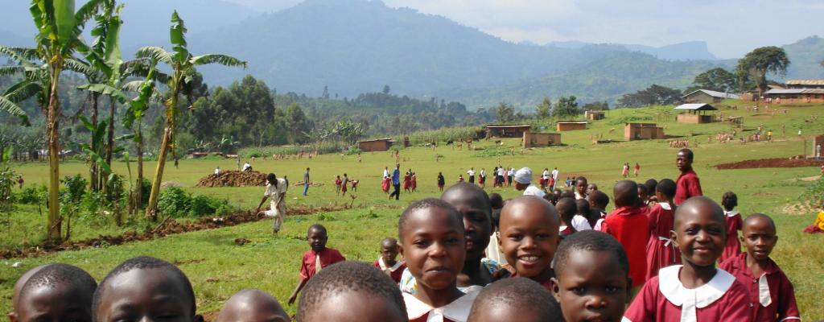
Thank you!
www.bukoberocommunityhealthcentre.com
Sheila Hosner
Breadpudding@aol.com

