Slide 1
GENEALOGY TOOL BOX
University Sunrise Rotary presentation
October 20, 2022
By Helen Barton

Slide 2
Documentation Aids
Pen and paper
Family Group Records
Four or six Generation Ancestry Chart
US Census Sheets

Slide 3
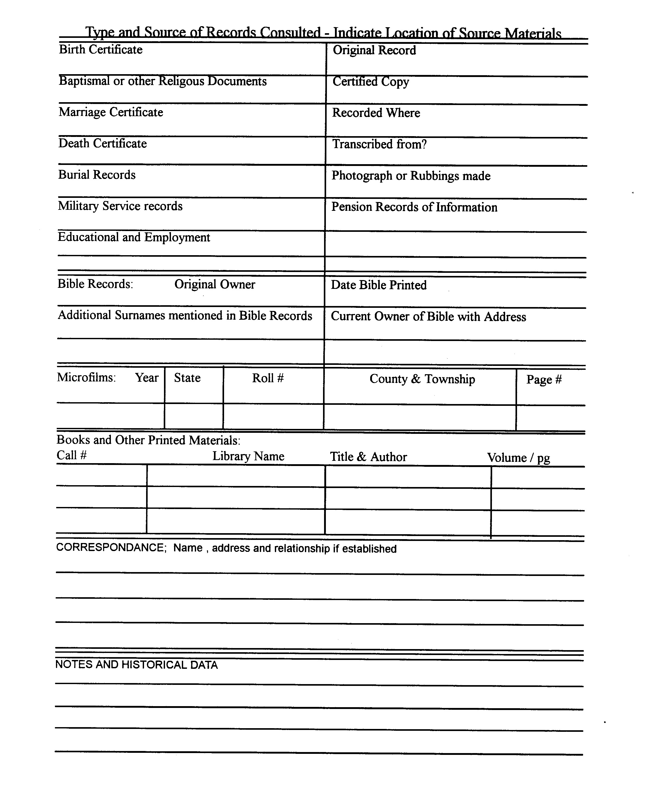
Family Group Records

Slide 4
Four or six Generation Ancestry Chart

Slide 5
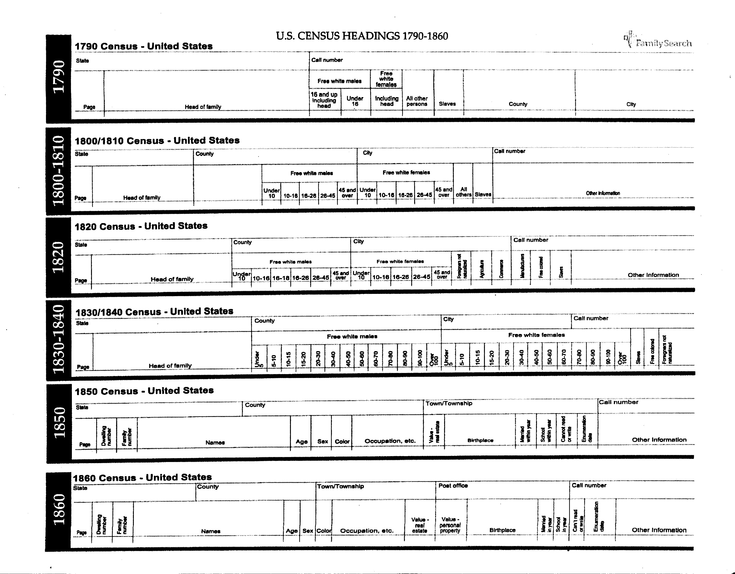
US Census Sheets

Slide 6
Documentation Aids Continued
Computer programs
Legacy (Recommended) https://legacyfamilytree.com/
free or paid versions
lessons and Seminars in how to use.
Legacy FamilyTree Webinars
Input family data and print out looks similar to hand written sheets shown above
Family TreeMaker https://www.mackiev.com/ftm/
Many others: Reunion, etc.

Slide 7
Research Locations
At Home-Family Stories, Friends, Photos,
Books
Libraries-Public and Private- Fiske
On-line Computer Research Sites
Washington State Archives https://www.sos.wa.gov/legacy/genealogy.aspx
Specific Surname Research Groups [Ex. Barton; Smith, Williams etc.]

Slide 8
Genealogy Repositories
Ancestry — https://www.ancestry.com/
[subscription $$ depending on level of use] Good Teaching aids available.
Search option: All Collections; Census & Voter Lists; Birth, Marriage, Death; Immigration & Travel; Public Member Trees; Military; more options. Most valuable to me Census look ups.
PM Tree: found missing 3rd great grandmother from Bavaria, Germany in NE & Franklin Co., MO
Downsides: Can’t get/or send messages to former members who aren’t current on membership fees.
DNA testing

Slide 9
Genealogy Repositories Continued
FamilySearch Library- https://www.familysearch.org/en
[free to use. Password required] [Good Teaching aids available]
The Church of Jesus Christ of Latter-Day Saints (not Mormon) have collected records worldwide
Family History Centers everywhere. Salt Lake City-all database use free. Miles of microfilm, Microfiche, Books, Images, Research Aids, Family Genealogies, Family Trees, Research wiki, Catalog.
Using the Catalog Searches
Search by usual Surname, Title, Author, Subject, Keywords
Place Search: United States, Pennsylvania, Westmoreland, Greensburg [extremely valuable]
Search pulls up token history of area, lists all sources: Cemeteries, Church Histories & Records, Directories, History, Land and Property, Newspapers, Obituaries, Probate, Schools, Vital Records. How many sources in each Category.

Slide 10
Genealogy Repositories Continued
American Ancestors (NEHGS) https://www.americanancestors.org/
Valuable for New England Based ancestors [subscription $$ depending on level of use]
Recently Free limited use for new individuals.
FOLD3 (Military & pension records) — http://www.fold3.com/
Subscription All types of military records. [subscription $$ depending on level of use]
Henry Barton’s 1812 Pension files
Find A Grave — https://www.findagrave.com/
Owned by Ancestry
[free to use. Password required]

Slide 11
Working with Records
Census Records
Work backwards from here
Only available 1950 and older [72 years]
1950-1850 Head of household and all others listed
1890 records destroyed
1840 through 1790 only lists head of household (tick marks for other male & females by age)
Birth records (know it is in a repository, ask and ask again and again).
Marriage records (Bogus marriage)
Death records (secondary source)
Land Records (sale of land by heirs, gave list of all family members & spouses)
Military records - Complete pension files; Virgil White synopsis)
Notes:
Every state has their own layers of bureaucracy regarding who is allowed records and how to obtain them.

Slide 12
Trust but Verify
Validity of Records
Use an open mind about what the record says.
Primary and Secondary Sources.
Ancestry.com has a section of Individual Family Trees.
Christine’s Schultz marriage to Leo Coleman aka Lemuel Coleman
Notes:
We would hope that everything we find online in a repository is true, but it is not always. Treat the info you fine with a grain of salt until you can corroborate it.

Slide 13
Record ALL Your Sources
Capture all Source material data
If you don’t you will be guaranteed not to find it again
Records without sources = MYTHOLOGY
Records with sources = Have validity
Notes:
We would hope that everything we find online in a repository is true, but it is not always. Treat the info you fine with a grain of salt until you can corroborate it.

Slide 14
DNA Analysis
Can get tests done through various companies:
Family Tree DNA https://www.familytreedna.com
Ancestry https://www.dna.ancestry.com
23 & me https://www.23andme.com
My Heritage https://www.myheritagedna.com/
Living DNA https://www.livingdna.com/en-us
National Genographic 2.0 https://genographic.national geographic.com/
DNA Analysis Types: Proteins found only in cell nucleus.
Y Chromosomal DNA (males only) (XY)
Mitochondrial DNA (mtDNA)
Autosomal DNA (atDNA or auDNA)
Notes:
No discussion of Genealogy is complete without a discussion of the “new kid on the block.”

Slide 15
DNA Analysis Continued
DNA Analysis Type: Y Chromosomal DNA (males only-XY)
Male lines (Surname—father’s, father’s, father’s line …all the way back)
Inherited virtually unchanged-not recombined or mixed up.
Narrow but deep ancestry.
Any two people whose Y-DNA chromosome match have an ancestor in common.
The more generations have passed since ancestor was alive, the more likely the Y chromosome will differ from one another.
Can predict a man’s likely surname, but not who his father is.
Could help connect with a correct lineage if there is a question.
Surname groups
Notes:
No discussion of Genealogy is complete without a discussion of the “new kid on the block.”

Slide 16
DNA Analysis Continued
DNA Analysis Type: Mitochrondrial DNA (mtDNA)
Females only (XX)
DNA found only in mitochondria of cell
A male inherits his mother’s mtDNA, but is not passed on to next generation
Inherited from mother virtually unchanged, is not recombined or mixed up
Mother’s mother’s mother’s line
Narrow but deep ancestry
Any two people whose mtDNA chromosome match have the same ancestor in common.
Not used as much as Y or Autosomal
Notes:
No discussion of Genealogy is complete without a discussion of the “new kid on the block.”

Slide 17
DNA Analysis Continued
DNA Analysis Type: Autosomal DNA (atDNA or auDNA)
Male and female
DNA contained in 1-22 pairs of autosomes, does not look at sex chromosomes
Inherited 50% from mother; 50% from father
Broad but shallow ancestry – about 5 generations back.
Most recent common ancestor (MRCA)
Second most popular test for genealogical purposes
Notes:
No discussion of Genealogy is complete without a discussion of the “new kid on the block.”

Slide 18
How do I report an error?
Good luck with that!
Document the discrepancy in your own records so you can revisit it later if necessary.

Slide 19
Questions?

