Slide 1

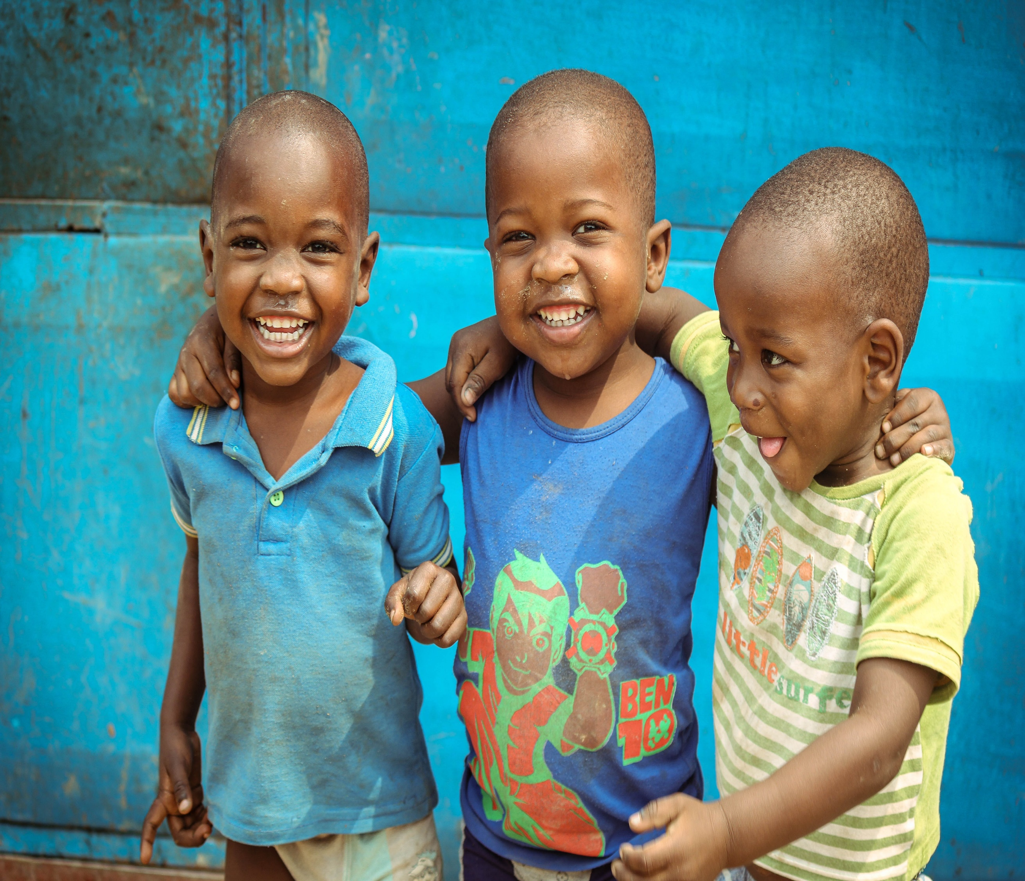
Saving Lives:
Mobilizing Rotarians
to Eliminate Malaria
Insert Picture
Rotary Club of
University Sunrise
Jenny Andrews
Executive Director, Malaria Partners International
Notes:
Thank you, NAME
30 year + member of Rotary
Involved in International Service since first polio trip to Ethiopia in 2005
Trip changed the trajectory of my career and I knew I was meant to work in Global Health.
Since then, I’ve traveled to Africa many times both with Rotary and the global health organization, PATH, where I worked prior to joining MPI
I am very happy to be here today to talk with you about Malaria Partners International.
MPI is a Rotarian founded and run organization – not officially affiliated with RI but led by the same principles.

Slide 2

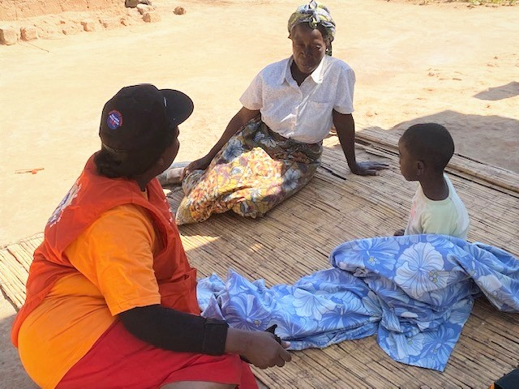

Preventable & Treatable…..But Deadly
247+ million cases per year
627,000+ deaths
94% in Sub-Saharan Africa
Mostly young children
Ibusam aut experspici bero magnisti aut moluptatem ationseque optatem oluptur sit rest maximoluptur santo invenia con eatis cusam, officipsam que maxim que conse num voluptatus maxim sunde et am repro velestrum ant facest, tet ut que optiat lam secepelis ellabor enditio nsereic ipsunt, sitis imusa sinciunt.
Etur maximaio inis sed qui nimporupit ullenim fuga. Neque volorerovid ma der- ferro occupture volupta dit ut que eos et dolore por autecum qui quam, oditem is venisitaque pliatus dolecus cienduci ulpa ium nos consequ aturion perum quunt iduciis eum quatis dent aut pelesequis eatatiorum ipsam ipsam harum is et oc- cusame di none cum volorpos reiunt voluptas aliquae poruptat re cus rem fugit, net qui omnimus eture ea con eati quossunt, nihictia vereped igenihil moloratet et
Notes:
Malaria is the greatest killer of humankind in the history of the world. Devastating to communities – parents can’t work – kids can’t go to school – reinforces the cycle of poverty –
Most people in the US not familiar with malaria – used to have hundreds and in some years thousands of cases – wiped out by DDT
Very much a modern-day reality in Africa and parts of Asia – sickens millions of people, causes deaths in young children
I met this little boy and his grandma when I was in Zambia in May. He was very ill with malaria with a high fever, nausea, body aches and chills. When we arrived at his home on a very hot day, he was asleep under a blanket and hadn’t eaten in days. The Community Health Worker you see here in orange, tested him for malaria and was able to treat him on the spot, outside his own home.

Slide 3
Malaria Transmission Cycle
Insert Picture
Notes:
Malaria is a parasitic disease and the malaria parasite is transmitted by the bite of the female anopheles mosquito.
She got the parasite by biting a human who already has malaria. She then transmits the parasite to other people as she continues to feed on human blood.
Once in the body, the parasite hides away in the person's liver where it multiplies for about 2 weeks. At that time, it’s released into the bloodstream and latches on to red blood cells sucking out the insides and killing the cells.
And since RBCs carry oxygen, when a person has malaria, their RBC count plummets, and oxygen deprivation makes them exhausted. That, and the other symptoms of malaria, including fever, chills, muscle aches, diarrhea, mean that, even when malaria is not fatal, people with malaria are incapacitated for weeks.
Malaria keeps people in a cycle of poverty.
As tragic as this is, there is hope on the horizon because around the world, tens of thousands of Rotarians are mobilizing to eliminate malaria using a proven three-pronged approach.

Slide 4
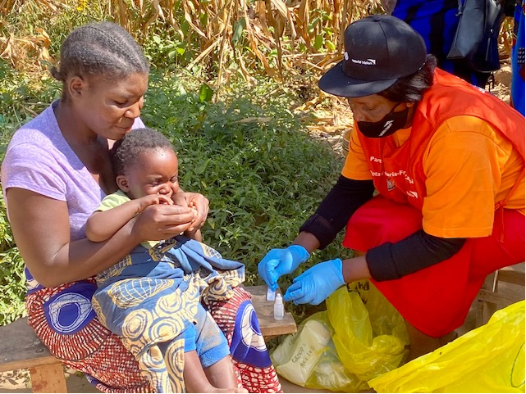
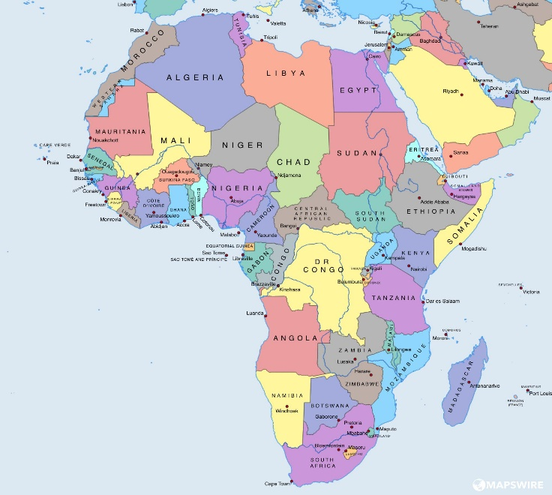
Our Impact
4,257
Community Health Workers Trained, Equipped & Sustained
2,128,500
Lives Protected Against Malaria Disease and Death
$131,000
MPI Funding for Small Grant Projects
21
Countries With
MPI – Funded Malaria Projects
Notes:
MPI has grown significantly and how has board members from 9 Rotary clubs throughout the US since it was founded in 2014
Affiliate organizations in Uganda and Zambia, and, as of December 2021, a West African Affiliate headquartered in Gambia that covers the ten countries in Rotary district 9101
Our niche is training Community Health Workers to test and treat malaria right in their own communities and, to date we have completed 3 global grants and we have another $1.2 million global grant in Uganda in the planning phase
MPI also provides small incubator grants to RCs in endemic countries, and we currently have 25 small grants in process.
All of this is good news but if you only take away one thing from today’s presentation, know that the thousands of Rotarians that have joined the malaria elimination effort are already – today – protecting over 2 million Zambians from malaria disease and death.
So, how are we doing it?

Slide 5
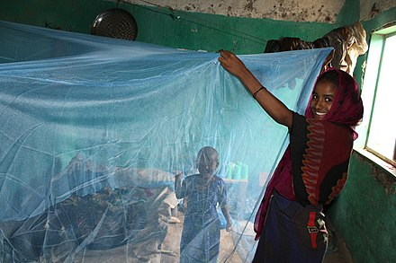
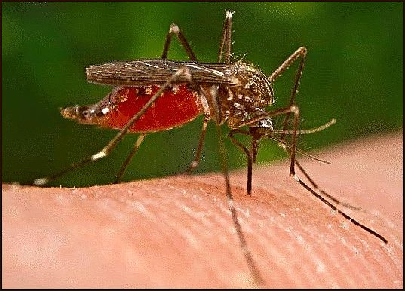
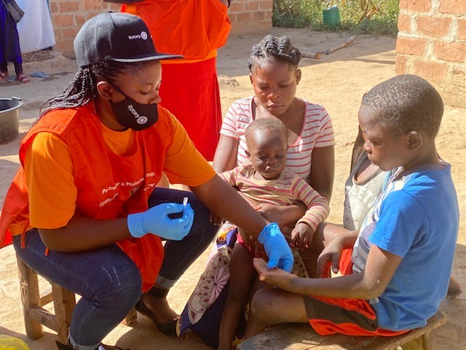
Getting to Zero
Vector Control
Education/
Sensitization
Community Health Workers
Insert Picture
Insert Picture
Insert Picture
Notes:
Vector Control: means controlling mosquitos through use of Insecticide Treated Bed Nets, Indoor Residual Spraying, and Environmental cleanup to eliminate mosquito breeding sites
Education: to make people aware that mosquitos are the source of malaria and to teach them what they can do to prevent the disease – mango story
Community Health Workers: Most important component of our work is training Community Health Workers who test and treat patients quickly, in or near their own homes.
CHWs – all volunteers
Trained and equipped CHWs go door-to-door identifying people with malaria symptoms and testing them to see if they are infected with the parasite.
When person is diagnosed with malaria, the CHW tests family members and neighbors within a certain radius - so that, if they too are infected, they can be quickly treated to eliminate the malaria parasite reservoir.
And now I’d like to share an exciting development in our work that took place last year.

Slide 6
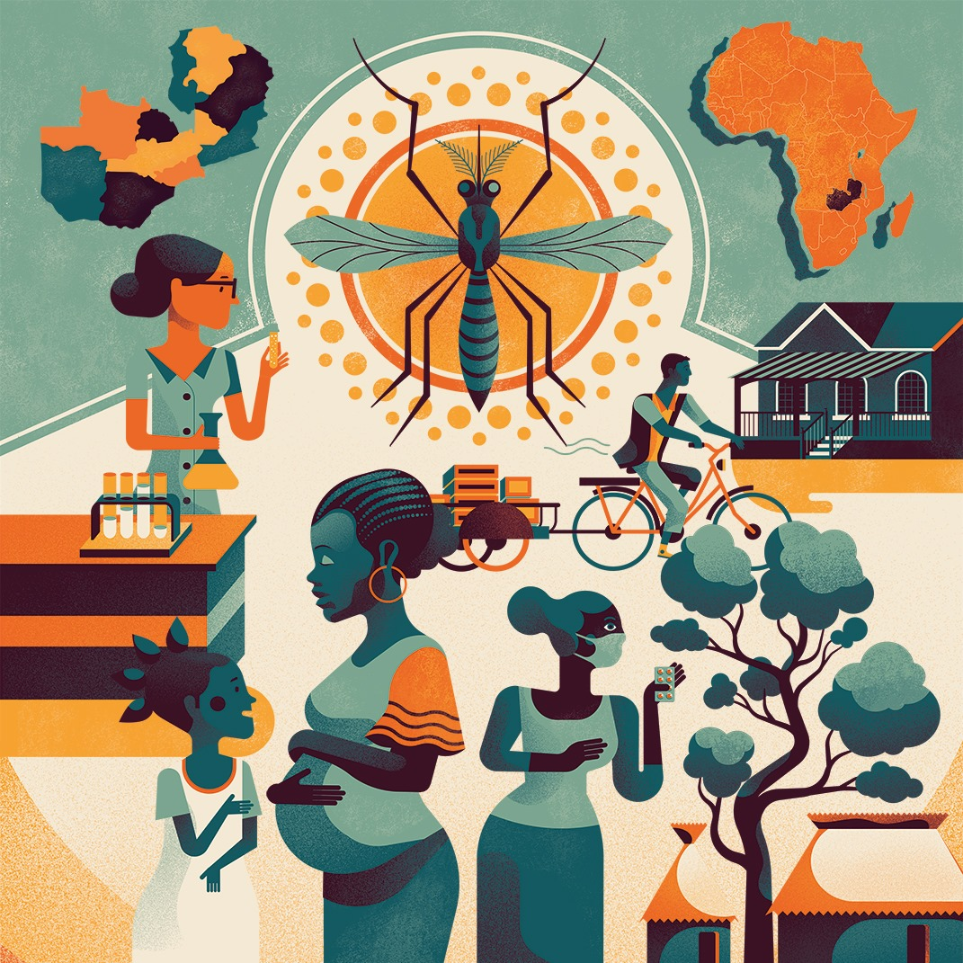
Rotary’s First
Program of Scale
Grant awarded to:
Partners for a
Malaria-Free
Zambia
Notes:
In 2019, Rotary announced a new type of grant called “Programs of Scale” a $2 million grant which was intended to take a proven GG project and scale it.
71 Rotary clubs from around the world applied and after an intensive 8-month vetting period, MPI and its partner, the Rotary Club of Federal Way, were awarded the first Programs of Scale grant for our project “Partners for a Malaria-Free Zambia”.
But it got even better because Malaria Partners International was able to bring two additional partners to the table, World Vision and the Bill & Melinda Gates Foundation, each of which also contributed $2 million making this a $6 million three-year program to reduce malaria significantly in two provinces in Zambia.

Slide 7
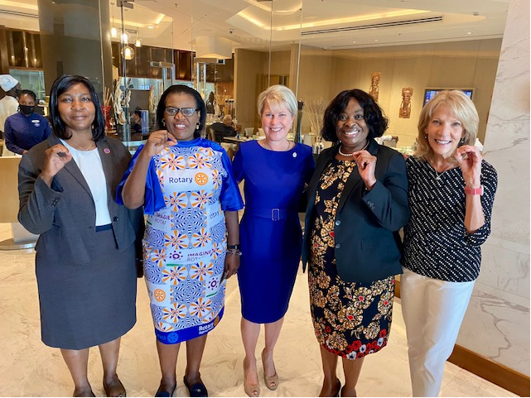
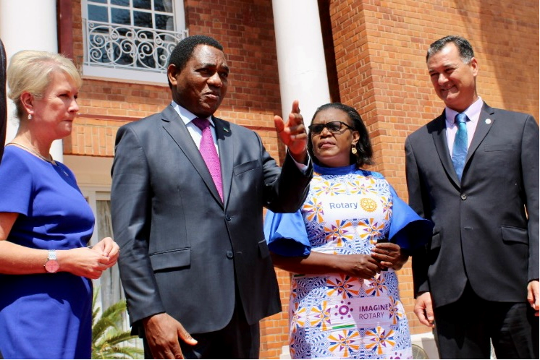
Rotary International President Jen Jones’ August 2022 Visit to
Partners for a Malaria Free Zambia
“Write a Quote or Something Else Here!”
Insert Picture
Zero Malaria Starts With Us
RI President Jen Meets with Zambian President
Notes:
Just last month we were honored to have Rotary International President Jennifer Jones spend 10 days with us in Zambia, visiting the program and meeting the Community Health Workers and the families who have benefitted from Partners for a Malaria-Free Zambia.
While in Zambia, President Jen was able to personally meet with the President of the Country to share how Rotarians are taking the lead in malaria elimination in his country.
His Excellency Hakinde Hichelema spent 90 minutes with a contingent that included President Jen, her husband Nick and our very own Martha Lungu, director of Malaria Partners Zambia pictured her in the Rotary dress.
President Jen is 100% behind the Rotarians leading the charge to eliminate this deadly but completely preventable and treatable disease.
This second phot on the screen shows Dr. Elizabeth Chizema, Director of Zambia’s End Malaria Council, Martha Lungu, RI President Jen, Dr. Nanthalile Mugala, PATH’s Chief of Africa and me.
SO, WHAT IS NEXT??

Slide 8
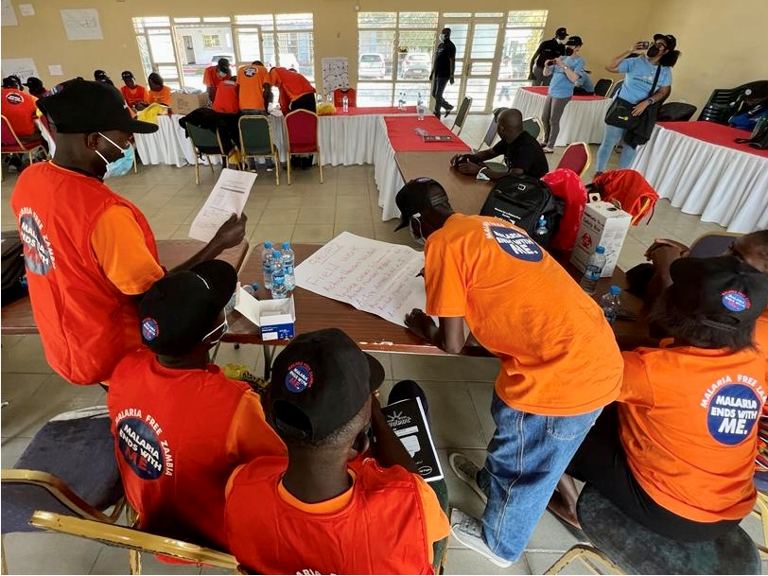
Uganda VHT Training Project
Train, equip & sustain 1,700+ frontline health workers
Improve malaria awareness
Build community health infrastructure
Notes:
We are currently working with the Rotary Club of Oklahoma City on another Global Grant – this one for $1.2 million.
The Uganda Village Health Teams Project – essentially the same thing as Community Health Workers
Builds on the success of our work in Zambia and on the Programs of Scale - further proof that throughout Africa and Asia, Rotarians are mobilizing to end this disease and build a healthier future for millions.
This will also be a collaborations among Rotary, World Vision and the Gates Foundation with each organization contributing $400,000 for a $1.2 million project.

Slide 9









Our Partners
Notes:
Partners
Fortunate to have excellent strategic partners
The Bill & Melinda Gates Foundation is strongly behind Rotary to help lead campaigns for malaria elimination.
In fact, they have provided Malaria Partners International with a fund which enables us to match - dollar for dollar - the contributions of Rotary clubs and districts to malaria control and elimination projects.
So, with that, thank you so much for inviting me to speak and I’ll pause now to answer any questions you might have.

Slide 10
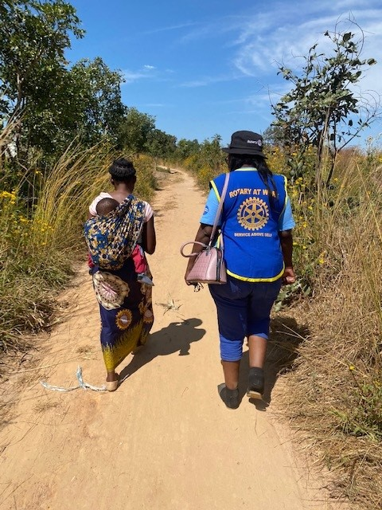



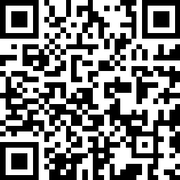
Contact Me Directly
Jenny Andrews
425-890-0204
Jenny.Andrews@MalariaPartners.org
        @malariapartnersinternational
Join the Fight.
        www.malariapartnersinternational.org

