Slide 1
Investing in Clean Technologies
PROFIT WITH A PURPOSE
Lee Otis
E8angels.com

Slide 2
Lee Otis, Background
13 years as Director of Business development for
Analytical software platforms around science and information technology.
12 years at the US EPA as an environmental scientist managing the international program and technical clean up of Hazardous Waste sites.
6 years at E8,
Current Board Chair
Support early-stage clean technology companies.
Manage staff, board & budget.
M.S. Environmental Management,
University of San Francisco, CA
B,A. Geology/Anthropology
University of Arizona. AZ

Slide 3
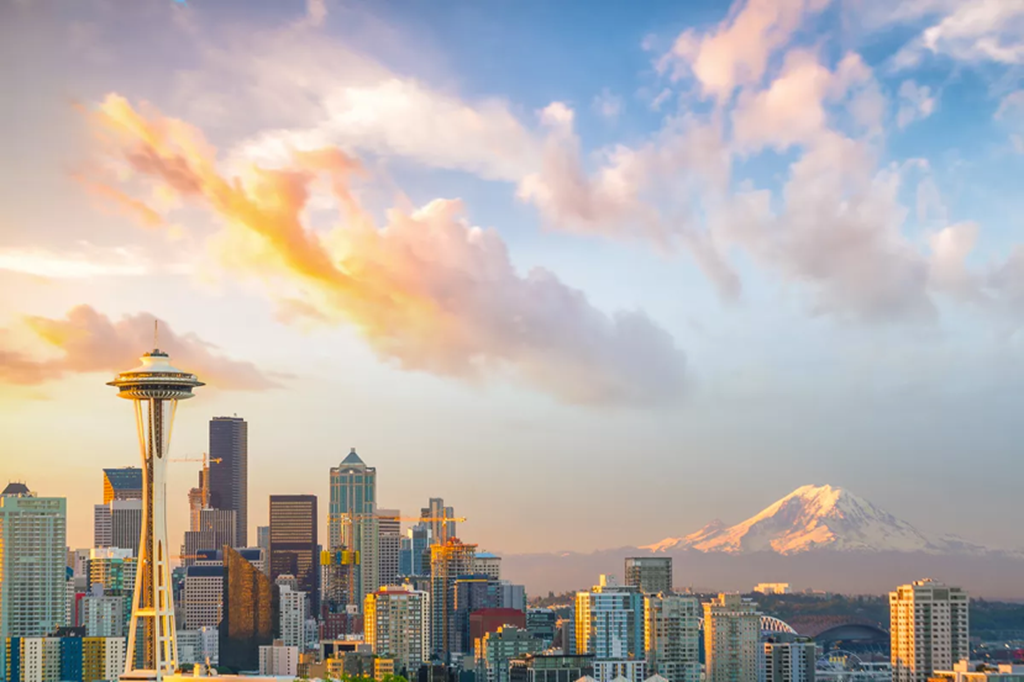
About
At E8, we empower investors to make a difference in fighting climate change by investing in clean technologies. Our members are from around the world, but we started here in Seattle, 15 years ago. We are Angel Investors, and we need more members to join us in making an impact.
E8 is a unique and collegial group of private investors who share a common mission …..

Slide 4
What is Clean Technology?
Alternative energy
Reduce amount or environmental burden to manufacture or transport goods
Reduce use of energy
Energy Storage
Increase efficiency of existing buildings
Detect & reduce toxicity
Non-toxic substitutes
Reduce / convert waste streams
Sustainable agriculture
Software to manage energy usage
Electric vehicles
Desalination
LED lighting
Socially-conscious Incubator
Battery Storage
Wind Energy
Solar energy
Decarbonization
Energy Efficiency

Slide 5
Why Join an Angel group
Collegial and FUN!
Educational
Impactful
The smart way to do angel investing

Slide 6
Our Community
$45 M in collective investments
Over 150 accredited investor families
14 Board Directors
Numerous E8 Fellows representing local Universities
Sponsors and partners
Networking
Monthly meetings provide members opportunities to meet clean technology startups.
We also provide training in Angel investing.
Sponsored sessions to understand clean technology trends.

Slide 7
The WHY
Who are our members?
Why do we come together?
Why do companies seek us out?
Why do we call ourselves a catalyst?

Slide 9
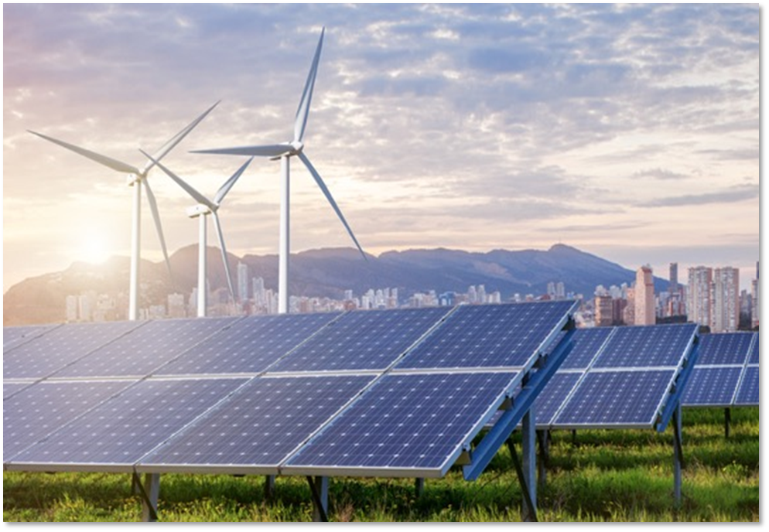
E8 Investment Options
Angels typically:
Participate in early rounds
(Seed, Series A)
write smaller checks ($15-30K average)
Traditional Individual Angel Investing
E8 Syndicate
Pooled Donor Advised Fund
E8 Fund II
Philanthropic Gifts or Grants
Personal or Corporate Donor Advised Funds
Learn
Invest
Connect

Slide 10
What We Have Done
$45 M
since
(2006)

Slide 11
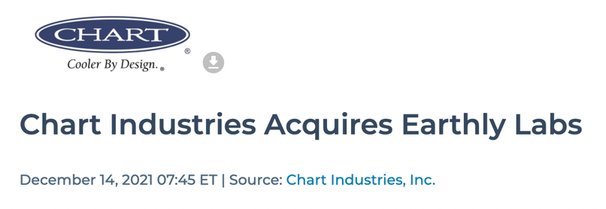
E8 Member Investments
Metering and electrifying the hardest-to-reach last mile.
Low-cost, long-duration flow batteries for commercial and utility-scale storage. Went public in 2022
Female startup, CEO. Animal feed from insect protein: nutrition with less impact, and frass to boot

Slide 12
QUESTIONS

