Slide 1
University Sunrise Rotary Club New Member Guide

Slide 2
Welcome!
We are glad you joined us! Rotary is an amazing organization and University Sunrise Rotary, which is part of District 5030, is a fantastic place to be a Rotarian!
In the following pages, you will find information that will help you to learn more about Rotary.
Read at your leisure, or turn to this deck if you have a question, many answers are provided.
Thank you,
The members of University Sunrise Rotary Club

Slide 3
Vision Statement

Slide 4
Section One: Rotary 101

Slide 5
Early Rotary History
Founded February 23, 1905 by Paul Harris in Chicago, Illinois
Created by men focused on good business ethics (uncommon in Chicago at the time)
It was a business networking group that emphasized fellowship
Everyone was called by their first name
It was a men’s club until 1987 when women were finally allowed to join Rotary.

Slide 6
The Four Way Test
The Four Way Test was created in 1932 by Rotarian Herbert J. Taylor (who later served as Rotary International President) when he was asked to take charge of a company that was facing bankruptcy.
Of the things we think, say and do.
Is it the truth?
Is it fair to all concerned?
Will it build goodwill and better friendships?
Will it be beneficial to all concerned?
It was adopted by Rotary in 1943 and is one of the most widely used quotes on business ethics.

Slide 7
The Rotary Pin
The Rotary pin tells the world that you are a Rotarian; wear it with pride! It symbolizes good business ethics and a commitment to service. You will receive a Rotary pin and a University Sunrise Rotary hat when you join our club.
Anywhere you travel, if you see a Rotary pin you have a friend. It unlocks many doors.
The Rotary pin is a cogged wheel with a keyhole, symbolizing motion or action; and Rotarians are people of action!

Slide 8
Rotary’s Motto
“Service Above Self”
This motto was introduced to Rotarians in a speech at the 1911 Rotary Convention. In 1989 it was adopted as the official motto of Rotary International.

Slide 9
The First Service Project
Rotary’s first service project in 1907 was not entirely altruistic.
Women in Chicago would come downtown to shop, but they didn’t stay long because they had to go home to use the bathroom.
The Rotary Club of Chicago installed public toilets in downtown so the women could shop longer!

Slide 10
The Rotary Foundation
The Rotary Foundation (TRF) was created in 1917 by Rotary International's sixth president, Arch C. Klumph, as an endowment fund for Rotary "to do good in the world." It has grown from an initial contribution of USD$26.50 to more than USD$1billion
Charity Navigator gives TRF a perfect score and ranks it one of the top three charities in the world.

Slide 11
The Mission of The Rotary Foundation
The Rotary Foundation's mission is to advance world understanding, goodwill, and peace.
Rotary Foundation grants promote peace, fight disease, provide clean water and sanitation, sustain mothers and children, improve education, and strengthen local economies.
University Sunrise Rotary has applied for several TRF grants. We just finished a grant for TINFA, a non-profit organization which provides technology and training to schools in Guatemala.

Slide 13
Section Two: Rotary International

Slide 14
The Rotary Org Chart
Rotary
International
This is the governing body of Rotary, all clubs are part of Rotary International or RI. Check out https://www.rotary.org/en it’s a great resource to learn more about Rotary.
Zone
27
Because RI is so large, it is broken into Zones for purposes like training. We are in Zone 27. Together, Zones 26/27 make up most of the western United States. Our Zone website is a great resource too, https://zone2627.org/
District
5030
Each District has about 3000 Rotarians in it. We are District 5030 and are geographically a small footprint due to our densely populated geographic area. We have 46 Rotary clubs and 7 Rotaract clubs (age 20-35). Check out the District website to learn what’s happening in our district, https://www.rotarydistrict5030.org/
Rotary
Club
Clubs are where all the real work of Rotary gets done. Clubs vary in size from 10-700 members. There are over 36,000 Rotary clubs in 190 countries around the world.

Slide 15
Rotary International’s Seven Areas of Focus
Peace through conflict prevention and resolution
Disease prevention and treatment
Water and sanitation
Maternal and child health
Basic education and literacy
Economic and community development
Environmental protection

Slide 16
More Rotary Foundation
The Rotary Foundation is supported by Rotarians around the world.
Simply stated, we put money in, it sits for three years, then it gets sent back to the clubs for projects through a grant process.
You will hear the term EREY (ee-ray), it stands for Every Rotarian, Every Year… giving to the Rotary Foundation. An annual donation is important regardless of the amount.

Slide 17
Paul Harris Fellow
When you give $1000 (cumulative) to The Rotary Foundation (TRF), you become a Paul Harris Fellow
If you are a Rotarian, you give something to TRF every year
It may take you many years to receive your Paul Harris Fellow, and that’s okay
You will see people receiving sapphire or ruby pins, that means their giving level is several thousand over their Rotary lifetime

Slide 19
Section Three: Your Rotary Experience

Slide 20
Get Involved
Jump in! The sooner you get involved, the more you will love Rotary.
One way to get involved is to sign up for a committee with your Rotary club. The work of the clubs and the district is all done by volunteers and committees. University Sunrise’s committees are listed on the next slide.
Whatever your passion, there is sure to be a committee for you. Some examples are:

Slide 21
University Sunrise Committees and Sub-Committees
Club Service
Sub-committee: Family
Sub-committee: President’s Dinner
Sub-committee: Program
Sub-committee: Membership
Community Service
Sub-committee: Fundraising/Big Taste
Social Events
New Generations
International Service
Vocational Service
Sub-committee: Public Relations

Slide 22
University Sunrise Officers
President
President Elect
Vice President (to become President Elect)
Club Secretary
Club Treasurer
Rotary Foundation Chair

Slide 23
University Sunrise Foundation
University Sunrise has its own foundation separate from The Rotary Foundation which has been discussed on prior slides. This is money that we have raised and is distributed by our foundation board. Any member can request such a distribution.
The club foundation has its own treasurer and has a board made up of the past three presidents.

Slide 24
Attendance and Dues
Rotary International does not require attendance. University Sunrise Rotary keeps attendance just to help keep track of members. Hopefully you will want to attend meetings and participate in both service projects and social events.
If you are traveling, attending at another club can be a lot of fun, especially internationally. There is an app called Club Locator that can help you find clubs around the world or around the corner.
Dues are $200 a year and are due at the beginning of the Rotary year in July.

Slide 25
University Sunrise Projects
There are many opportunities for hands-on projects through University Sunrise Rotary. For example:
Tiny Homes – help build tiny houses for the homeless
Teen Feed – prepare and provide food for homeless youth
QFC food collection – collect food at the QFC for the University Food Bank
And many more ….

Slide 26
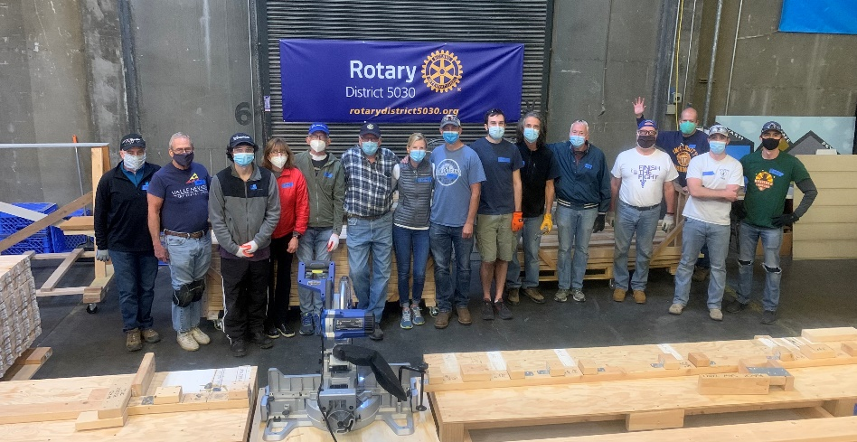
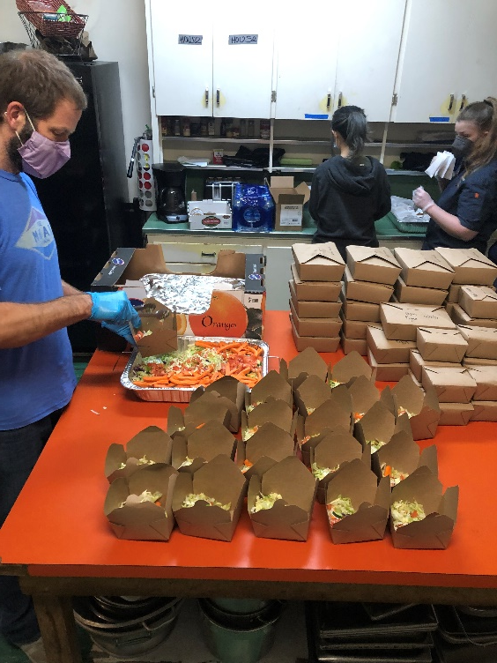
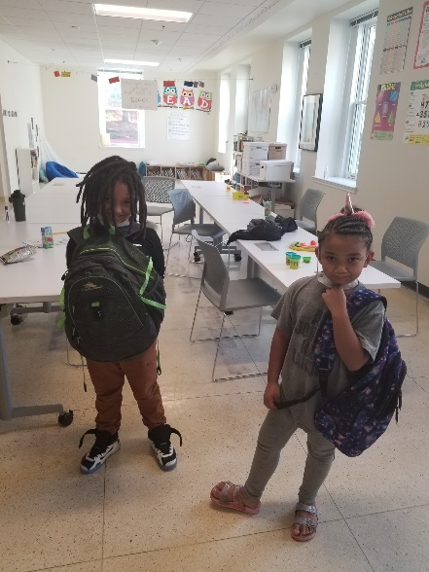
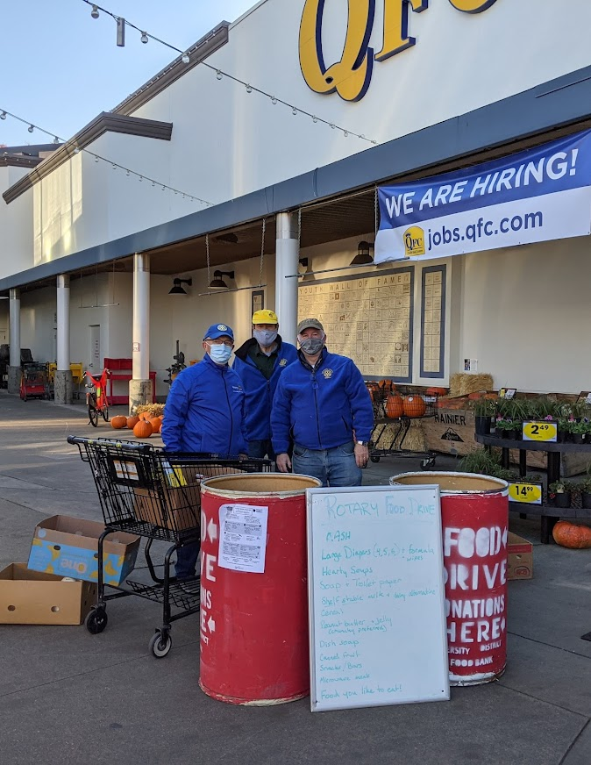
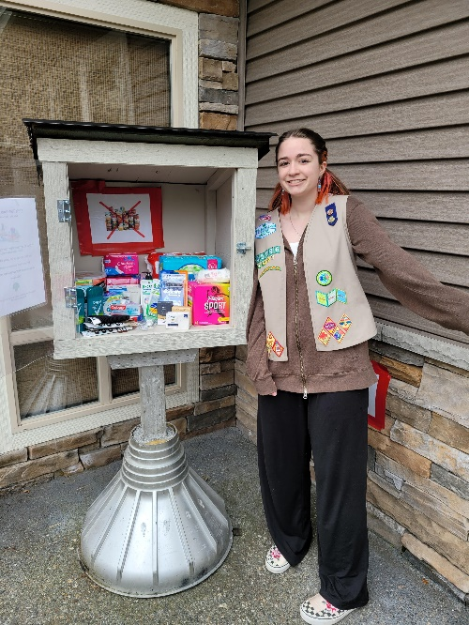
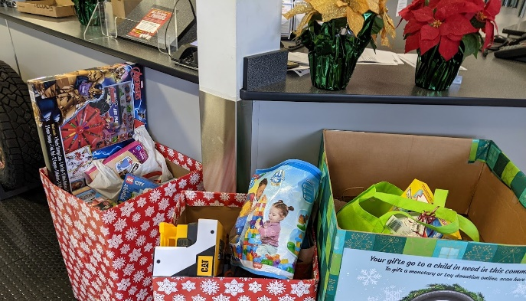

Slide 27
University Sunrise Projects
Magnuson Park Block Party: The club prepares and serves a barbeque dinner to all residents of Mercy Housing and Solid Ground in Magnuson Park. We also have games and prizes for the children and music for all. This is usually in September.
Big Taste: The club’s major fundraiser is this event where we provide food and tastes of wine, liquor and spirits to all who purchase tickets. All money goes to a charity chosen by the club and to our club foundation. This is usually in March. It is highly recommended that all Rotary members purchase and/or sell 10 tickets.

Slide 28
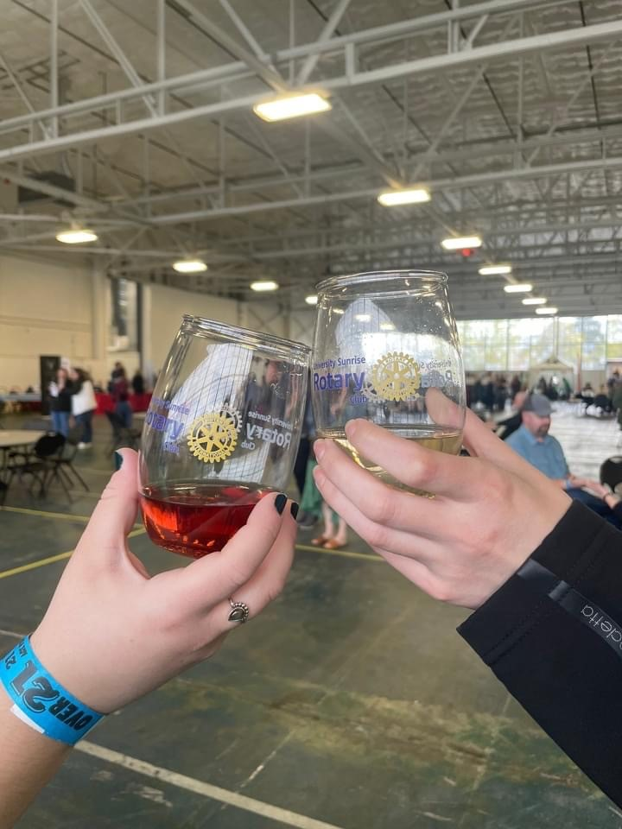
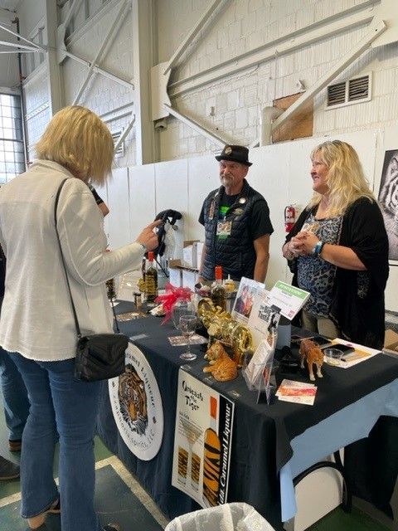
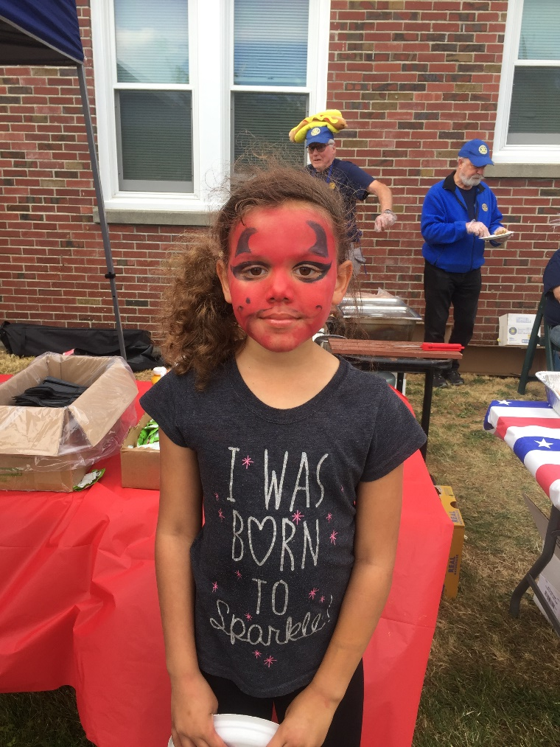
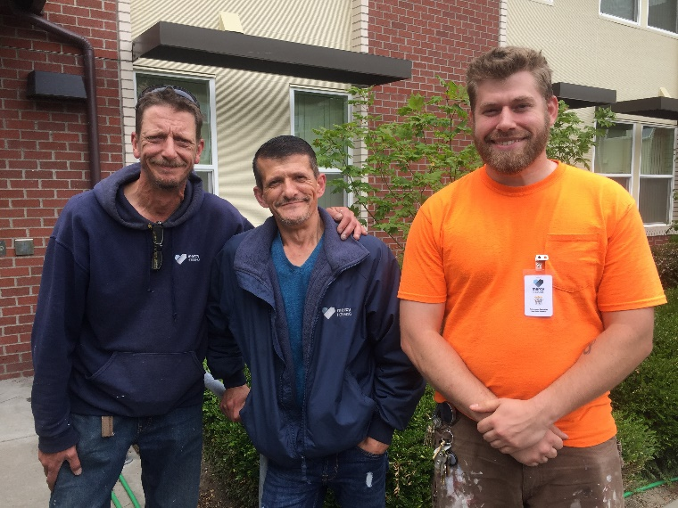
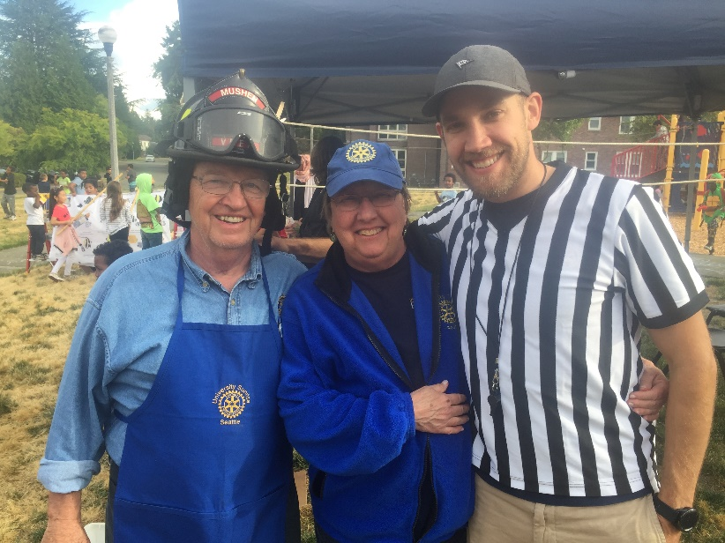
Big Taste
Magnuson Block Party

Slide 29
Getting Social
University Sunrise Rotarians love to get together socially and have fun!
Examples:
Club dinners after we prepare food for Teen Feed
An annual Holiday Party
Potlucks associated with football games
Opportunities to connect with each other
at various restaurants and breweries.

Slide 30
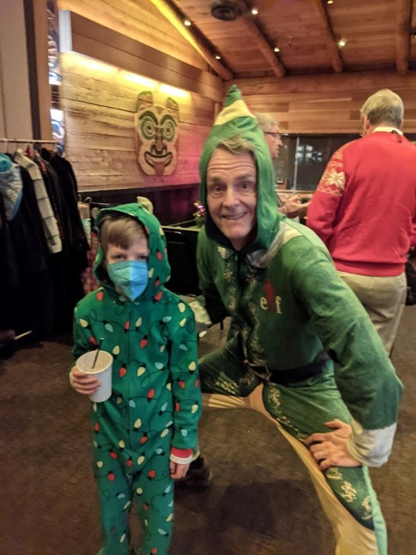
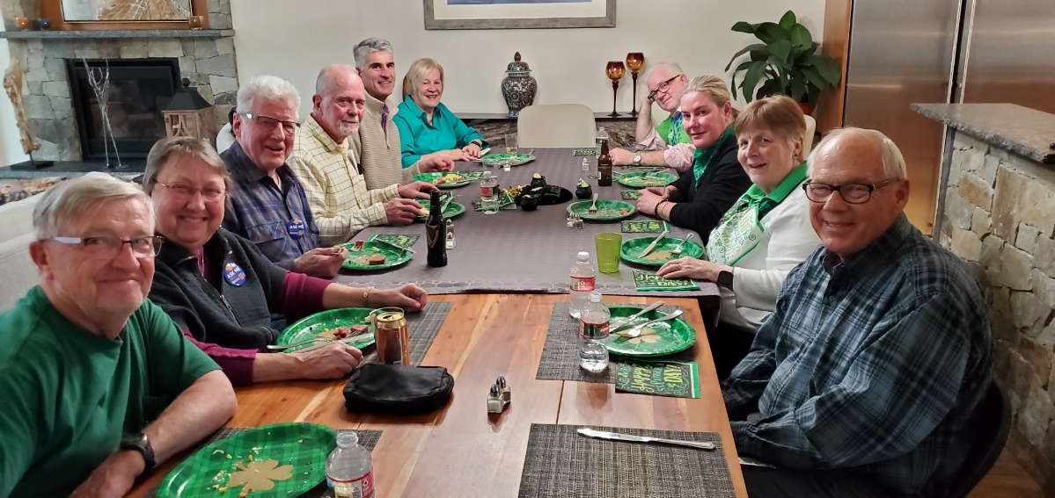
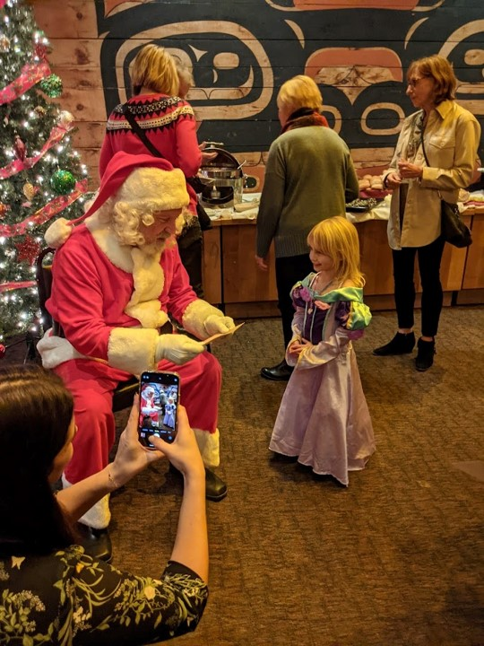
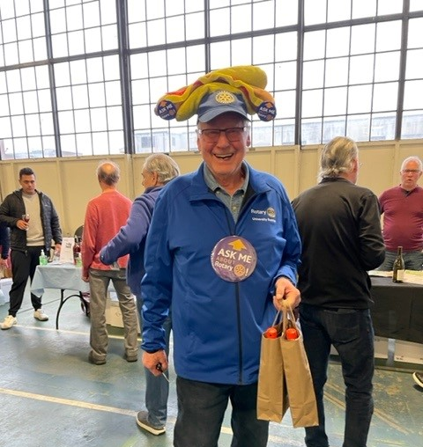

Slide 31
Keeping connected
Our website is usrotary.org. It has all the information about what is going on at the club.
Emails are sent out on a regular basis about zoom meetings, special events and opportunities for service
Our weekly zoom meetings start officially at 7:30 a.m. on Thursdays. However, the socializing starts at 7:15 a.m.

Slide 32
District 5030 Projects
One district project is called Harvest Against Hunger. HAH gets huge bins of fresh produce, like apples, and Rotary volunteers pack them in smaller boxes for distribution to food banks. It is the second Saturday of each month (on hold due to Covid19).
https://www.harvestagainsthunger.org/

Slide 33
Involving Your Family
Your family members and friends are always welcome to join you in Rotary.
Some meetings and activities are adults only (wine tastings), others are great for kids too, (Rotary First Harvest, hands-on projects…) Check on age requirements before bringing little ones.

Slide 34
Rotary Means Business
District 5030 has its own business networking website. You can list your business at no charge.
It is also a great resource when you are looking for a printer, painter, eye doctor, accountant…
Check out the Puget Sound Rotary Network
http://www.pugetsoundrotarynetwork.org/

Slide 35
District 5030 Social Media
We also have a members only Facebook page
Search: Rotarians of District 5030 on Facebook
Click to join, and very shortly someone will approve you for the private group
You will be able to find out what’s happening in the district and meet lots of new people as the group grows

Slide 36
Our District Newsletter
It is truly one of the very best!
Information about what is happening in clubs and in our community – there are often articles about what University Sunrise Rotary is doing
Learn about socials and fundraisers across the District
Meet District leaders
Emailed monthly and available on the District website.
Click here for an example

Slide 37
Additional Resources
www.Rotary.org is all things Rotary!
https://my.rotary.org/en/learning-reference
www.zone2627.com is our Zone (the West Coast) and there is a wealth of information on Membership, our Brand, and the Foundation
www.rotarydistrict5030.org is our own district website. Here you find more specific information relevant to our district, including a calendar of events
The District YouTube channel has trainings, stories and project highlights https://www.youtube.com/channel/UCIyEfD5PzwDK0fEX6U691Ow

Slide 38
The End of The Beginning
You’re finished! This is by no means a complete look at Rotary, our district, or your club, but it’s a start.
Never hesitate to ask questions.
Remember, the more you put in, the more you get out!
Rotary comes down to two things… Relationships and Experiences!
Jump in and have fun!!

