Slide 1

University Sunrise Rotary Service Foundation
Report to Membership, January 4, 2024

Slide 2

This is Our Club’s Foundation
Independent of the Club
Independent of the Rotary International Foundation
Every Club member is also a member of the Service Foundation

Slide 3


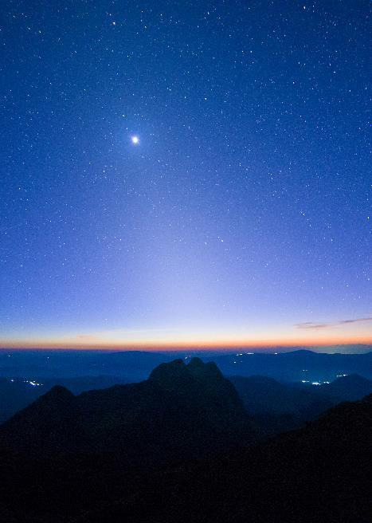

Agenda
Club Approval
Financial Position
Investment Philosophy
Grants
The Future
Discussion

Slide 4
Topic One: Club Approval
Tom Ranken, Chair

Slide 5
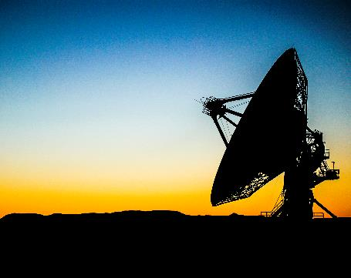
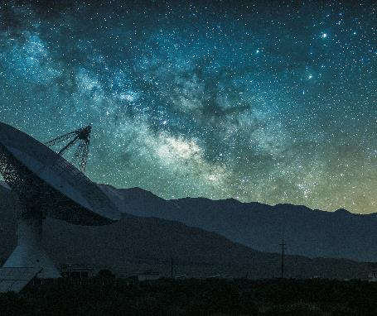
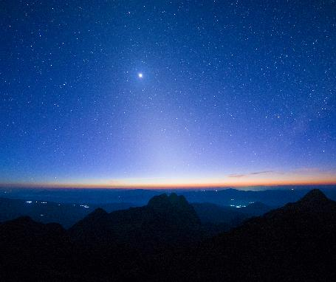
Approval of Board Members (Action Item)
Board Members:
Tom Ranken, Chair (2021)
Lincoln Ferris (2023)
Dave Mushen (2023)
Pam Mushen (2022)
Stuart Webber (2023)

Slide 6
Proposed Bylaw Change (Action Item)
New Article XI: “In the case of the dissolution of the University Sunrise Rotary Club or the University Sunrise Rotary Club Service Foundation, all of the Foundation’s property, real and personal, after paying all just claims upon it, shall be conveyed to and vested in the Rotary International Foundation or its legal successor and the Board of Directors of the Foundation shall perform all actions necessary to effect such conveyance.”

Slide 7
Screening Committee
Members:
Hal Beals
Nancy Bolin
Mike Madden

Slide 8
Topic Two: Financial Position
Stuart Webber, Treasurer

Slide 9
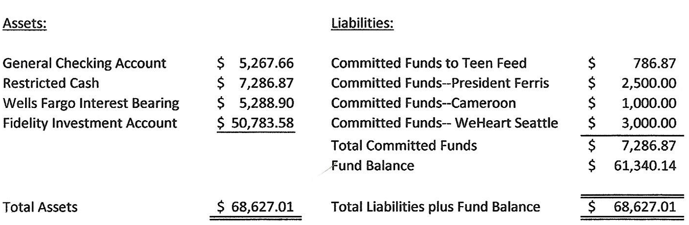
Balance Sheet, Nov. 2023

Slide 10
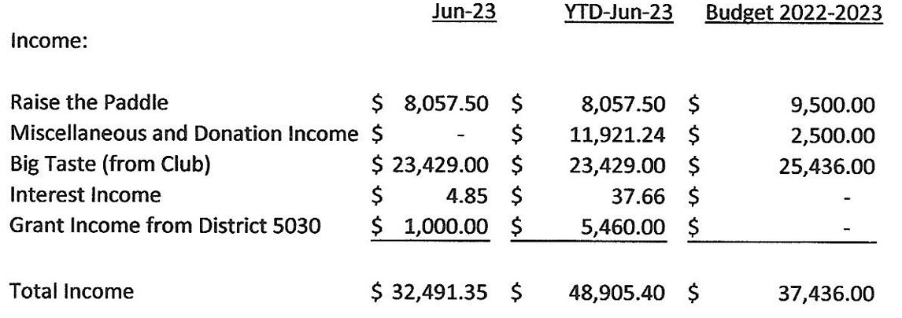
2022-23 Income Statement, p. 1.

Slide 11
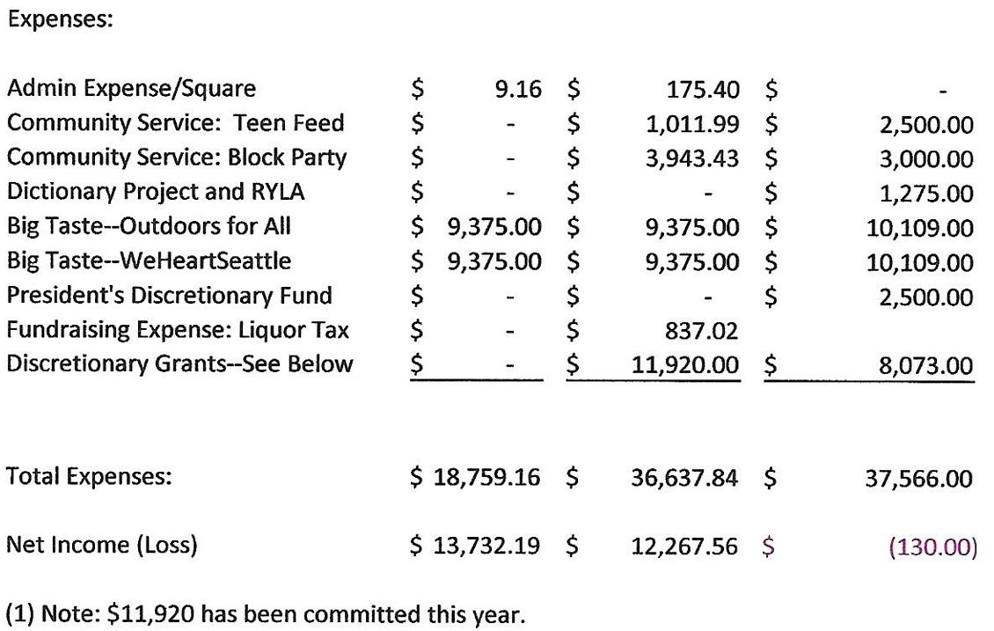
2022-23 Income Statement, p. 2.

Slide 12
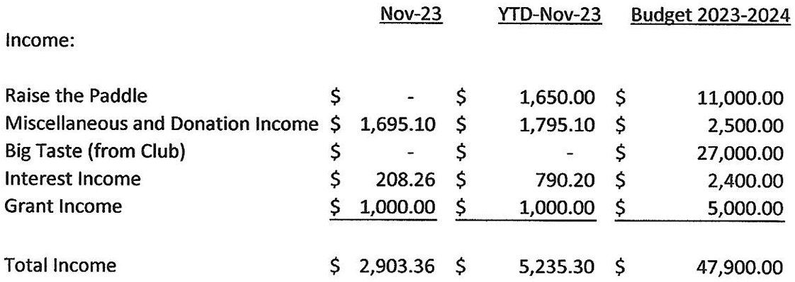
YTD Income Statement, p. 1.

Slide 13
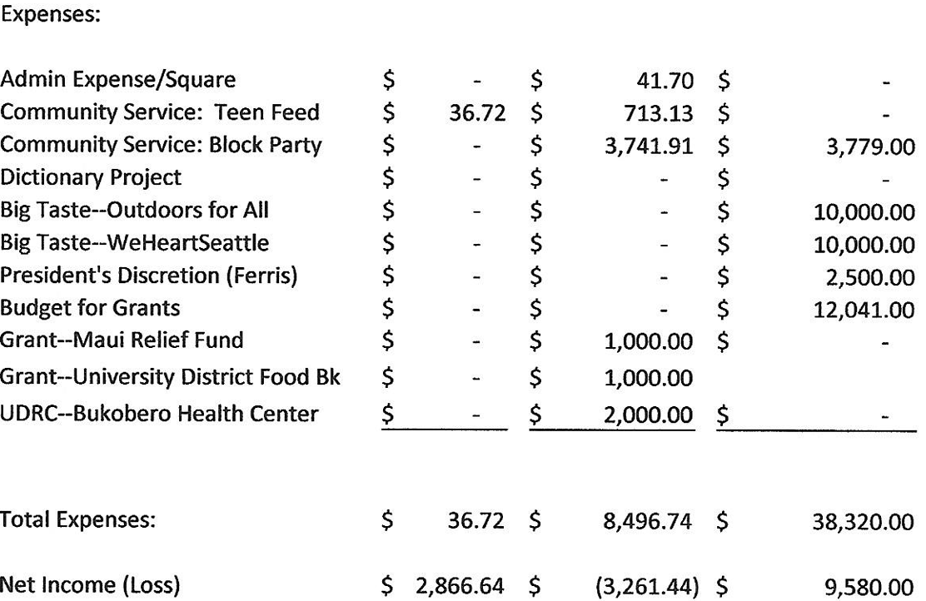
YTD Income Statement, p. 2.

Slide 14
Topic Three: Investment Philosophy
Tom Ranken, Chair

Slide 15
Investment Philosophy
Moderate Risk Investments
Giving Criteria:
  Support efforts of the members of the University Sunrise Rotary Club
  Collaborate with Partner Clubs
  North Seattle Children

Slide 16
Investment Philosophy
Publicity: Priority for grants will be given to partners that are able to acknowledge and/or publicize efforts fo the USRD and USRSF.
Spend or grow?
  Giver’s discretion
  General Policy:
    80% to be spent in the current year
    20% to build the Foundation endowment

Slide 17
Topic Four: Grants
Stuart Webber, Treasurer

Slide 18
Grants
 | Amount | Leader | Leverage
Teen Feed | $350 | Dave Mushen | $1,500
WeHeartSeattle | $3,000 | Andrea Suarez | $9,000
University Food Bank | $1,000 | Nancy Bolin | NA
Maui Relief Fund | $1,000 | Ron Espiritu | Significant
Community Health Centre, Uganda | $2,000 | University District Rotary | Significant
Block Party | $3,742 | USRC | NA
School Renovation, Cameroon | $1,000 | Jim Horrigan | Significant
Total | $12,092 |  | Greater than $21,092

Slide 19
Topic Five: The Future
Tom Ranken, Chair

Slide 20
Board Campaign
Initial Commitments
  David Storm
  New Pledges: $196,000 (Ferris, Madden, Mushens, Ranken, Webber)

Slide 21
Member Campaign
How can University Sunrise Rotary Club members participate?
  President’s Dinner
  Annual or Monthly Gifts
  Wills

Slide 22
Participate!!
Request Support for things you care about!
Board Participation
Screening Committee Participation
Give!!

Slide 23
Discussion
How should givers be recognized?
Are the giving priorities right?
Are the splits between current expenditures and building and endowment right?

Slide 24

Thank You
The University Sunrise Service Foundation:
Hal Beals
Nancy Bolin
Mike Madden
Paul Meehan
Dave Mushen
Jeff Mushen
Pam Mushen
Tom Ranken
Stuart Webber

