Slide 1
Community Support Groups
Small Acts, Big Impact

Slide 2
01
Background and Context
02
Community Support Groups
AGENDA
Introduction to Community Support Groups
03
Get Involved
04
Q&A

Slide 3
Introduction to International Rescue Committee
Founded in 1933
We help people whose lives and livelihoods are shattered by conflict and disaster, including the climate crisis to survive, recover and regain control of their future.
IRC Seattle opened in 1976
Since then, we have welcomed over 25,000 refugees to Washington from 35+ countries
In FY 2023
The US resettled 60,014 refugees out of the 125,000 goal, or 48%.
IRC WA resettled 810 individuals

Slide 4
Pathways to IRC Seattle for Refugees
Allocation
Referral for Resettlement
Arrive to SEA
Refugee cases are allocated at a weekly Allocations Meeting of all resettlement agencies’ headquarter offices, depending on where refugees have acquaintances or are otherwise best-suited to specific agencies.
IRC HQ informs us anywhere between 2 months and 24 hours of when a case will arrive to SEA. A caseworker picks them up at the airport.
Especially vulnerable refugees are referred to nations that resettle refugees.
01
03
05
Registration
Overseas Processing
Assurance
An individual crosses an international border and is registered with UNHCR and deemed to meet the 1951 UN Convention Relating to the Status of Refugees.
02
04
06
Refugees go through medical checks, security checks, interview with USCIS, more security check, voluntary cultural orientation.
IRC HQ informs our agency of the case we will receive, basic biographical information including health conditions, family composition, language abilities, past employment, etc.

Slide 5
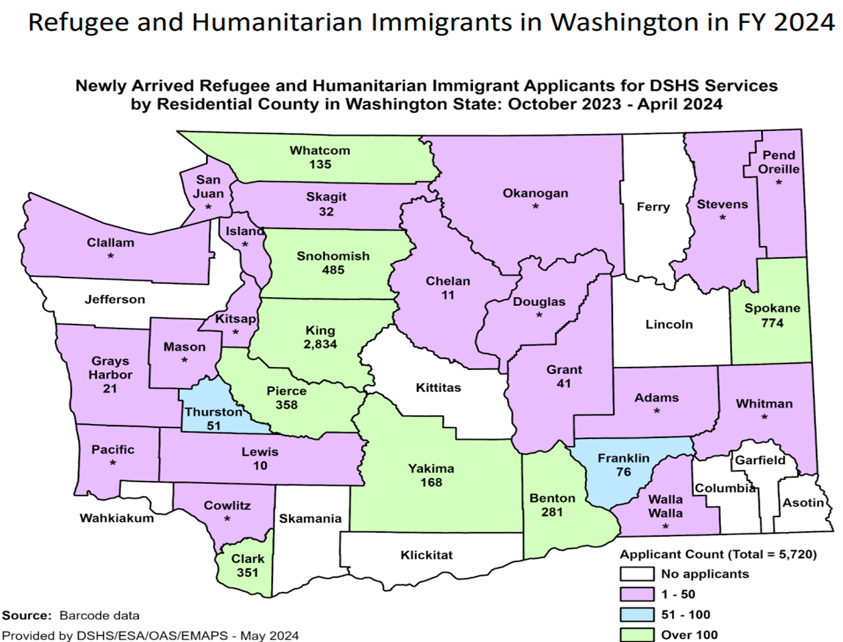

Slide 6
IRC Seattle Fy 2024 Refugee arrivals
Total Arrival for FY 24: 887
Notes:
In order to be on track to meet the FY24 goal of 125,000 refugees resettled the US needs to resettle an average of 10,416 refugees per month, or just over twice as many as the monthly average for FY23.
Sept 2023—the highest monthly total of 8762

Slide 7
Resettlement
Immigration Assistance
Economic Empowerment
Early Employment
WHAT WE DO
Health and Wellness
Children Legal Services
Mentoring, Education, &
Enrichment (youth + adult)
Survivor Services
SERVICES

Slide 8
Who We Serve
Refugee
Someone who has fled their home country and fears return to their home country due to well-founded fear of persecution. Arrives through USRAP.
Eligible for many public benefits!
SIV
Special Immigration Visa Holder. Special status for individuals who have helped US military, humanitarian organizations, and diplomatic programs.
Eligible for resettlement services like refugees
Humanitarian Parolee
Afghans after Taliban took over. Ukrainians fleeing the Russian invasion. Have not yet been found to have a well-founded fear of persecution.
Some profiles qualify for resettlement services and public benefits eligibility vary
Asylee
Almost identical definition of refugee their status has been granted after their arrival to the US.
Not eligible for resettlement services but eligible for same public benefits as refugees
Asylum Seeker
Someone seeking asylum or other immigration protections in the U. S. due to a well-founded fear for persecution or other harm. May include Survivors or Torture, Human Trafficking, or other crimes.
Others
Survivors of Human Trafficking, Survivors of Torture, Survivors of Crime, Unaccompanied Immigrant Children, Other Immigrants regardless of status.

Slide 9
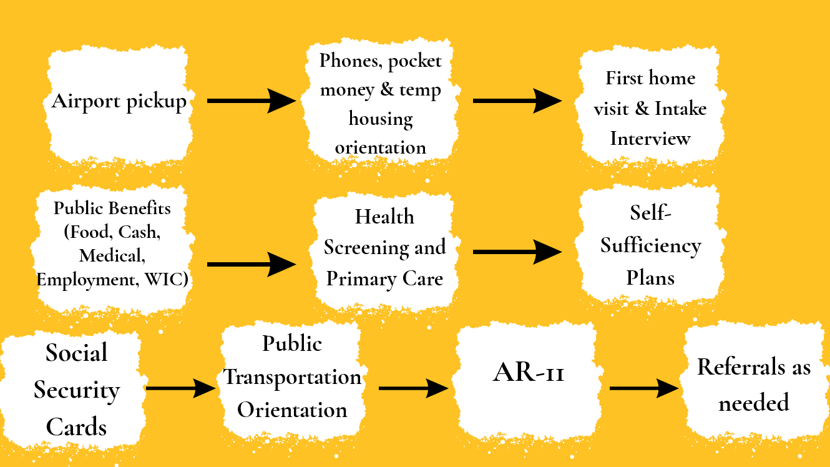
The first 30 days of resettlement

Slide 10
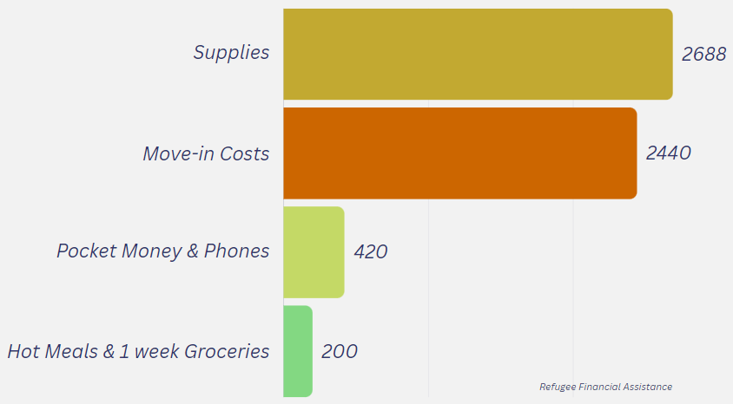
Challenges:
Limited Capacity
High Service Volume: Competing priorities, with limited time to provide quality support
Staff Overload: FY24: Average of 20 cases per caseworker, up to 35 during surges (~100 clients).
Resource Constraints
Initial Funds per Family Member: $1,125.
Move-in expenses—application fees, security deposits, and pro-rated rent use up most of the initial funds.
Insufficient funds for furniture and household items
Amount per Family Member:
FY 2024 - $1125
FY 2025 - $1300
Total family assistance for a family of five is
FY 2024 - $5,625
FY 2025 - $6500
Total Costs (Move-in Costs + Supplies + Pocket Money & Phones + Hot Meals & Groceries): $5,748

Slide 11
BE THE CHANGE
Community Support Groups program is a resettlement model where refugee families are matched with community groups interested in welcoming newcomers to the US.
These groups provide volunteer services and financial or in-kind contributions to help integrate the beneficiaries into the local community.

Slide 12
Community Sponsorship in FY24
Team Engage to Change
Amazon and the Congolese Integration Network (CIN) co-sponsored two families—a family of five and a single mom with five kids.
Team Elyas
A group of Ethiopian and Eritrean community members, in collaboration with the IRC, have supported a medical transfer case from the ATL office.

Slide 13
Community Support Group Types
Direct Support
Responsibilities:
Volunteer Services
Mentorship
In-Kind Donations
Expectations
Commitment: Minimum of three volunteers. Four months commitment.
Training: Complete required training sessions to understand family needs and best practices for support.
Documentation: Maintain accurate records of assistance provided and volunteer hours
OR
Donation Support
Responsibilities:
Donation Campaigns
Donor Relations
Financial Support
Expectations
Commitment: Contribute 2-4 hours per week to fundraising activities
Communication: Keep open and transparent communication with program staff regarding fundraising needs and progress.
Engagement: Ensure all fundraising activities adhere to legal and ethical standards.

Slide 14
Who Can Participate?
Faith-based institutions
Local clubs
Groups of friends or neighbors
University communities
Book clubs
Cultural groups
Corporate teams
Sport teams
Many more

Slide 15
Case Eligibility Criteria
Who is eligible to enroll in Community Support Groups Program:
Single Parent Cases
Expectant mother cases
Family size: 4 to 7

Slide 16
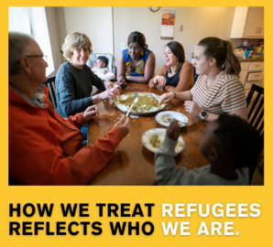
Thank you!
GET INVOLVED
Q&A
Thank You!
Contact:
Lidet Gezahegne
Community Support Groups Coordinator
Lidet.Gezahegne@rescue.org
Visit: https://www.rescue.org/united-states/seattle-wa

