Slide 1

University Sunrise Rotary Service Foundation
Report to Membership, July 23, 2026

Slide 2

This is Our Club’s Foundation
Independent of the Club 501(C)(3)
Independent of the Rotary International Foundation
BUT every Club member is also a member of the Service Foundation

Slide 3
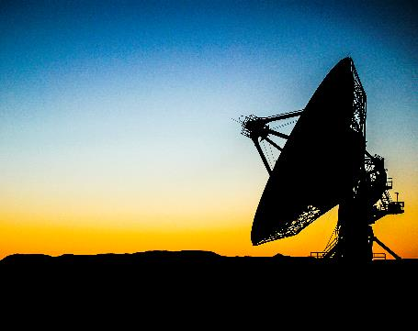
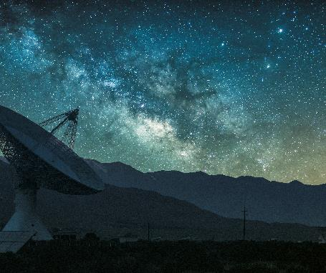
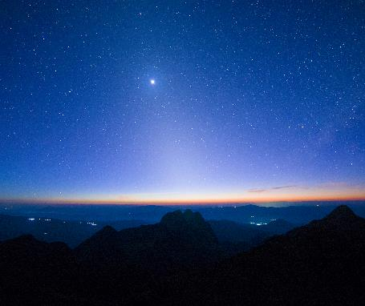
Mission Statement
The University Sunrise Rotary Service Foundation is the charitable Foundation of our Club.
The Foundation is chartered in the State of Washington and organized and operated as a 501(c)(3) tax exempt organization.
The Foundation is managed by its Board of Trustees, according to its bylaws.
The mission of the Foundation is to enable members to advance world understanding, goodwill and peace through the improvement of health, the support of education and the alleviation of poverty. The Foundation may fund activities or make direct grants to individuals or organizations and may combine its financial resources with other Rotary clubs and Districts, for the greater good.

Slide 4
Investment Philosophy
Moderate Risk Investments
Giving Criteria:
  Support efforts of the members of the University Sunrise Rotary Club
  Collaborate with Partner Clubs
  North Seattle Children

Slide 5
Foundation Policies
Publicity: Priority for grants will be given to partners that are able to acknowledge and/or publicize efforts of the USRC and USRSF.
Allocation Policy:
  Giver’s discretion
  General Policy:
    80% to be spent in the current year
    20% to build the Foundation endowment

Slide 6
Foundation Policies
Endowment: When total endowment funds are more than $100,000, the Board will allocate 5% of the total to current year grants. If three-quarters or more of Board members agree, the allocation may exceed five percent.
Funding Cycles: There are two grant review periods: Summer (application received by July 31) and Winter (application received by January 31).

Slide 7
Board Members
Board Members:
Tom Ranken, Chair
Lincoln Ferris
Dave Mushen
Pam Mushen
Stuart Webber

Slide 8
Screening Committee
Members:
Hal Beals
Nancy Bolin
Mike Madden

Slide 9
Topic Two: Financial Position
Stuart Webber, Treasurer

Slide 10
Income Statement
 | 2025-2026 actual
Raise the Paddle | $14,150
The Big Taste (total) | $23,250
Misc Donations | $4,400
TINFA Grant Income (other Rotary Clubs) | $20,600
Total Revenue | $62,400
Grants (includes Big Taste) | $34,300
Surplus | $28,100*
*Note: $26,300 collected for TINFA Global Grant in 2025-2026 will be released in 2026-2027

Slide 11



Budget 2026-2027
Revenue | 2026-2027 Preliminary Estimate
Raise the Paddle | 12,000
Miscellaneous Donations | 5,000
Big Taste | 5,000
Endowment (5% of Balance) | 5,600
Total Revenue | 27,600
Expenses:
Teen Feed | 4,200
President’s Discretion | 3,000
RYLA/Admin | 1,000
Discretionary Grants | 19,250
Total Expenses | 27,450

Slide 12
Balance Sheet, June 30, 2026
 | June 2026
Cash (Current) | $25,848
Cash Restricted (TINFA) | $26,296
Endowment Fund (mkt value) | $113,943
Total Assets | $166,087

Slide 13
2025-2026 Grants
 | Amount | Club Contact
Teen Feed | $3,870 | Dave Mushen
We Heart Seattle | $9,300 | Andrea Suarez
Outdoors for All | $9,300 | Ed Bronsdon
Block Party | $3,422 | Hal Beals
The Rally Club | $2,000 | Nancy Bolin
The Healing Center | $1,000 | Victoria Wenick
Bukobero Sanitation Project | $1,500 | Mike Madden
Tweagshe Water Harvesting | $1,000 | Mike Madden
Hunger Intervention Program | $1,000 | Mike Madden
Art for All | $750 | Nancy Bittner
Misc/Other | $1,100 | --
Total | $34,222

Slide 14
Member Campaign
How do University Sunrise Rotary Club members participate?
  President’s Dinner (Raise the Paddle)
  Annual or Monthly Gifts
  Wills

Slide 15

Thank You!
Questions?

