Slide 1

University Sunrise Rotary Service Foundation
Report to Membership, January 8, 2026

Slide 2

Our Club’s Foundation: University Sunrise Rotary Service Foundation
Independent of the Club
501(C)(3)
Independent of the Rotary International Foundation
BUT every Club member is also a member of the Service Foundation
The Foundation Board of Directors is elected by Club members

Slide 3


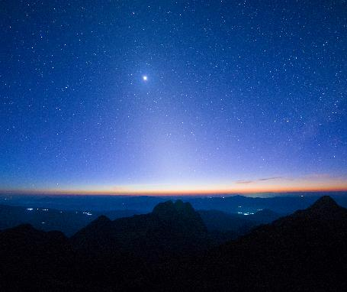
Investment Philosophy
Two funds within the University Sunrise Rotary Service Foundation:
  Current Year Giving
  Endowment
Spending policy:
  Giver’s discretion
  General Policy:
    80% to be spent in the current year
    20% to build the Foundation endowment

Slide 4
Board Members: Club Action Item
Board Members:
Tom Ranken, Chair (2024-27)
Lincoln Ferris (2023-26)
Dave Mushen (2023-26)
Pam Mushen (2025-28)
Stuart Webber (2023-26)

Slide 5
Screening Committee
Members:
Hal Beals, Chair
Nancy Bolin
Mike Madden

Slide 6
Topic Two: Financial Position and Grants
Stuart Webber, Treasurer

Slide 7
Income Statement
 | 2025-2026 Budget
Misc. Donations | $5,500
The Big Taste | $22.500
Raise the Paddle | $13,500
Total Revenues | $41,500
Grants | ($41,500)
Net Income | $0

Slide 8
Balance Sheet, January, 2026
 | January, 2026
Cash (Current) | $21,554
Endowment Fund | $99,936
Total Assets | $121,490

Slide 9
2025-26 Budgeted Grants
 | Amount | Club Contact
TINFA | $5,000 | Mike Madden
The Healing Center | $500 | Victoria Wenick
Art for All | $750 | Nancy Bittner
The Rally Club | $2,000 | Nancy Bolin
Hunger Intervention Program | $1,000 | Mike Madden
Bukobero Community Health Center | $1,000 | Mike Madden
Twegashe School Water Project | $1,000 | Mike Madden
Nepal Tailoring and Training Center | $500 | Mike Madden
Regional Hospital, Jundiai, Brazil | $500 | Mike Madden
Total | $12,250

Slide 10
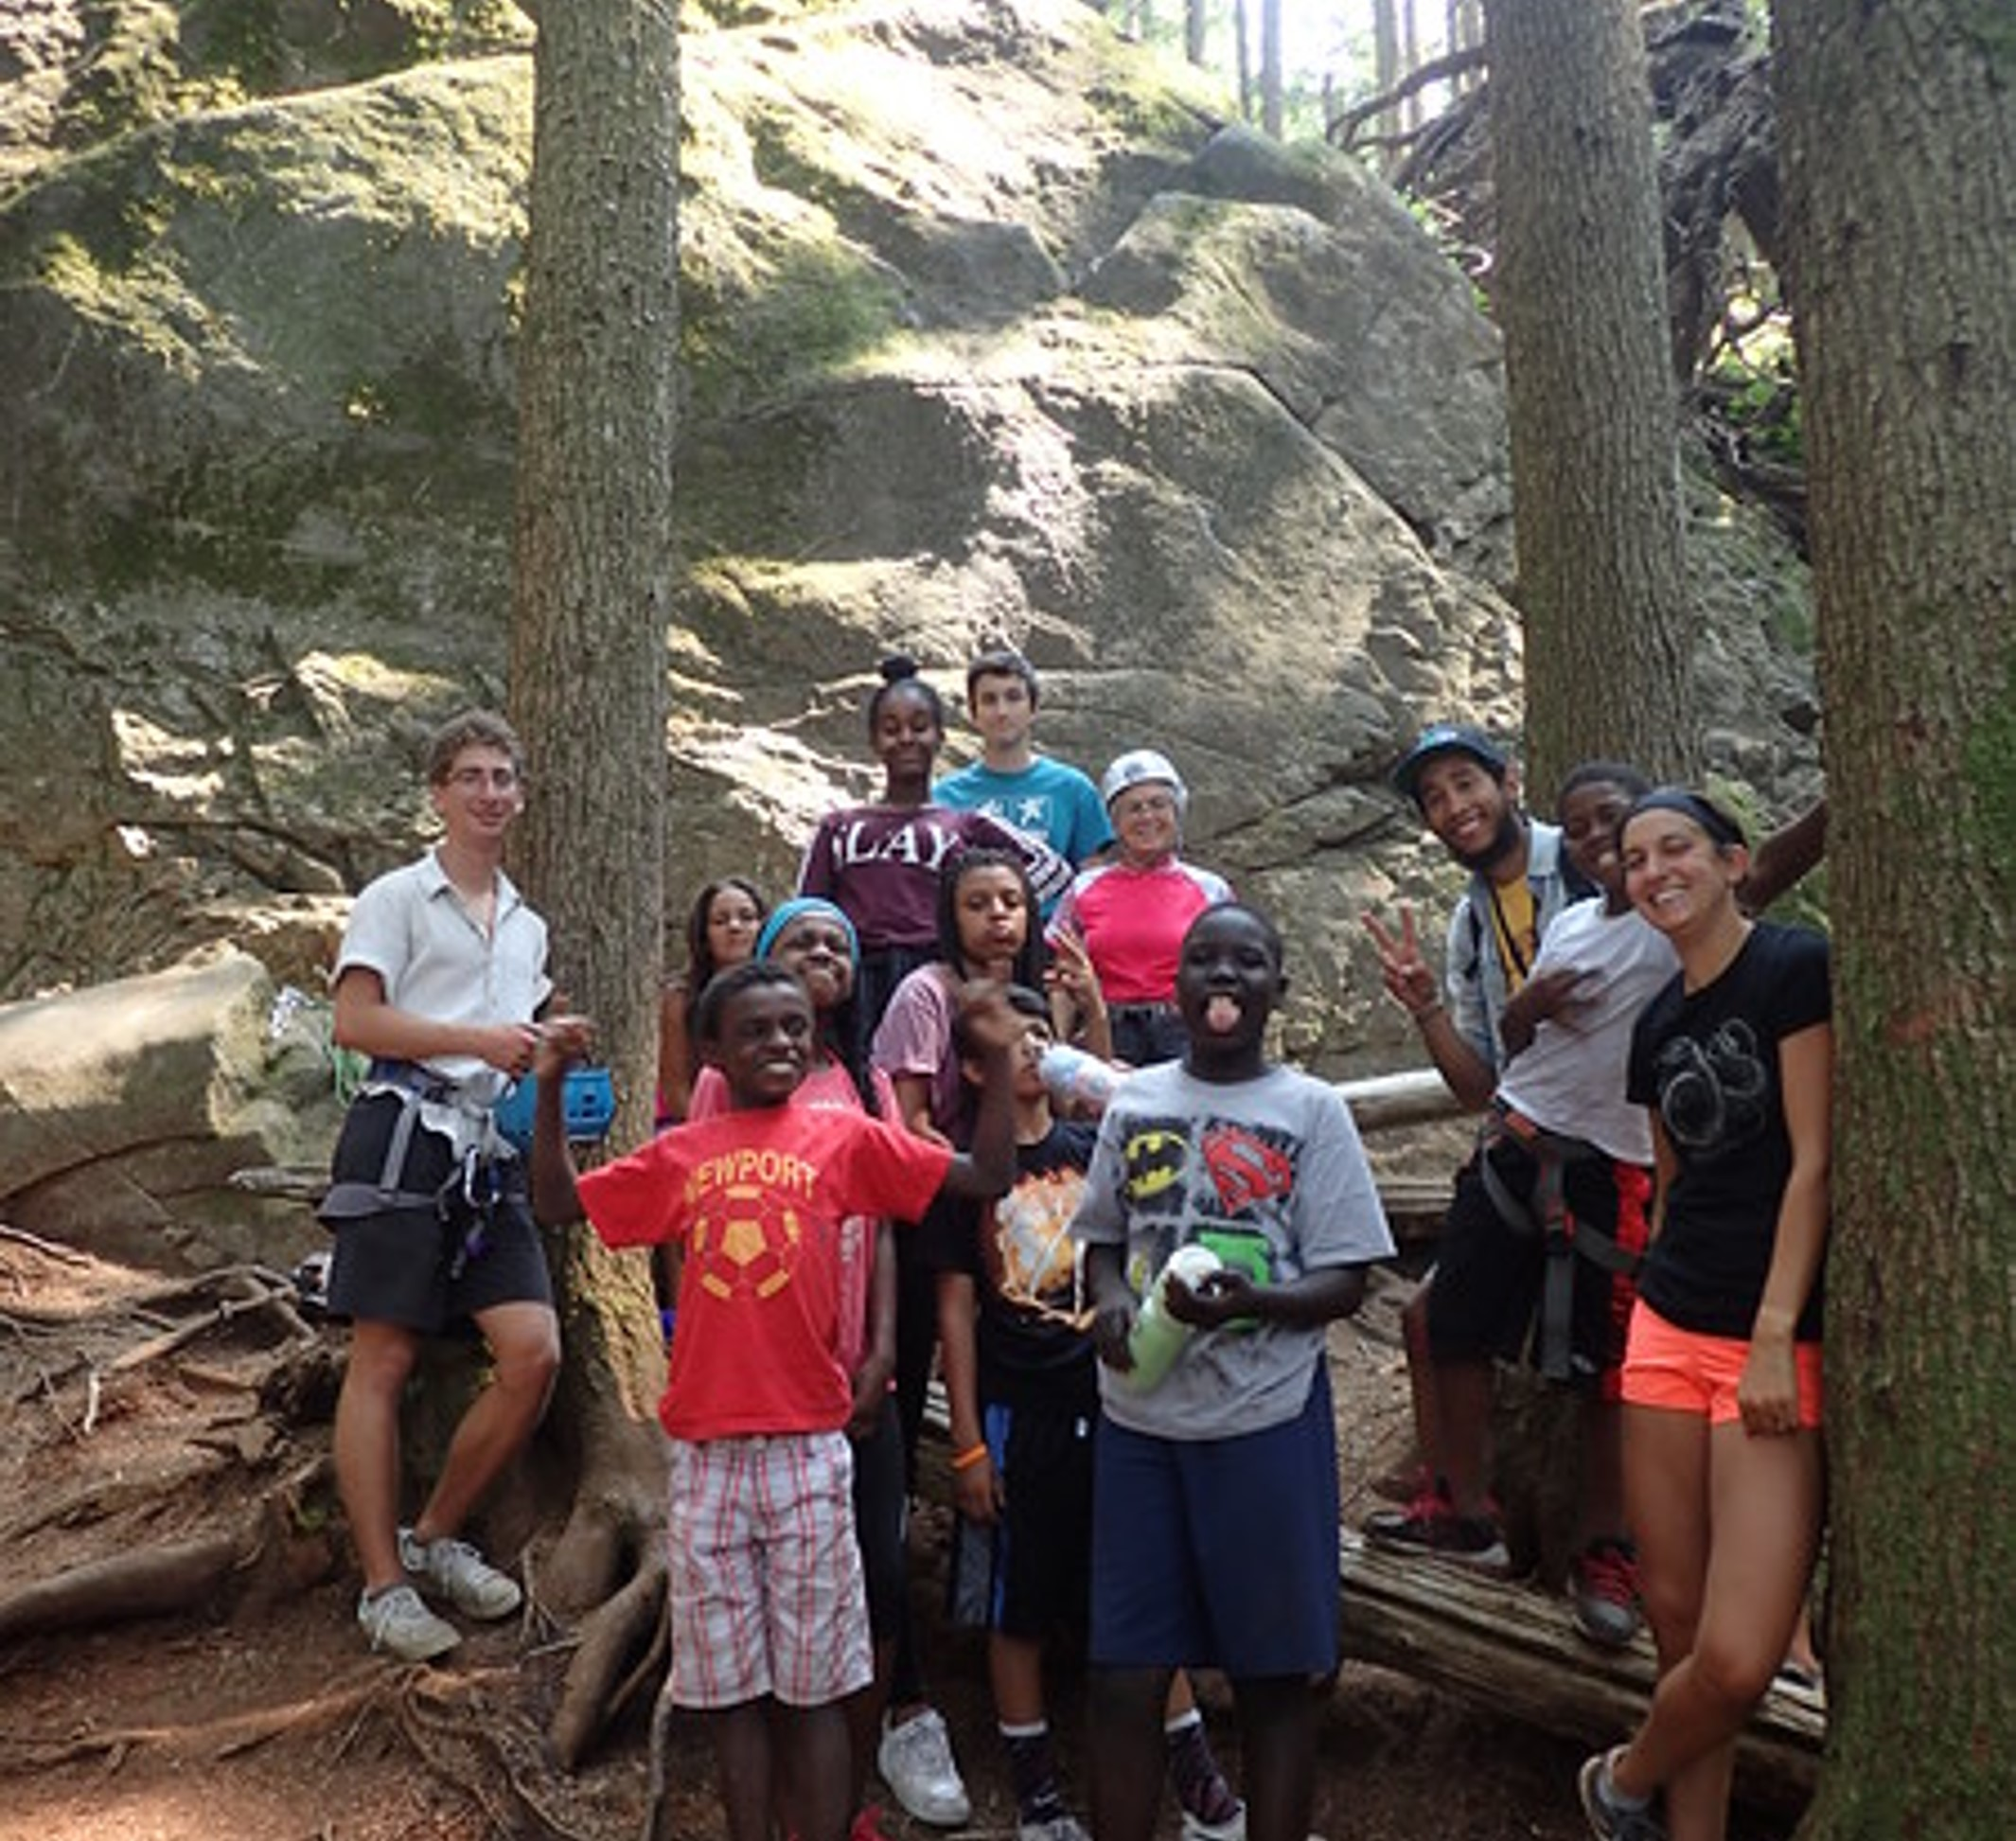
Associated Resource Council - $1,000
A grant to be used for snacks, program supplies, and field trip admissions for Rock the Park, a free, drop-in summer camp experience for teens living in Sand Point housing.

Slide 11
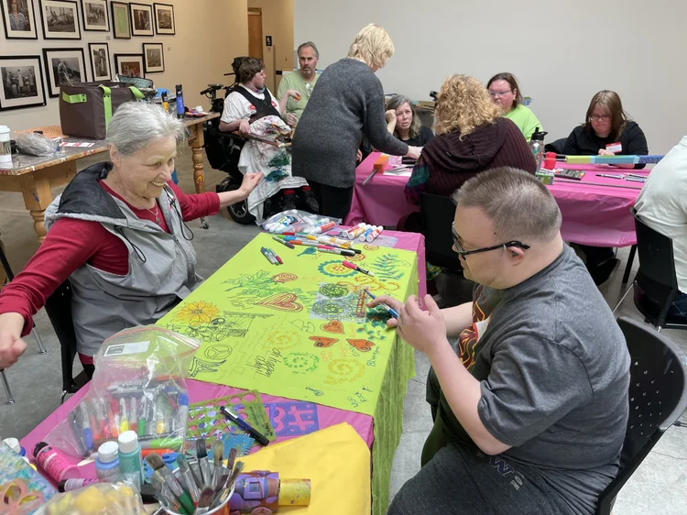
✓ Art for All - $750
We gave money to purchase supplies for this Edmonds community program providing disabled persons to make and sell their art creations.

Slide 12
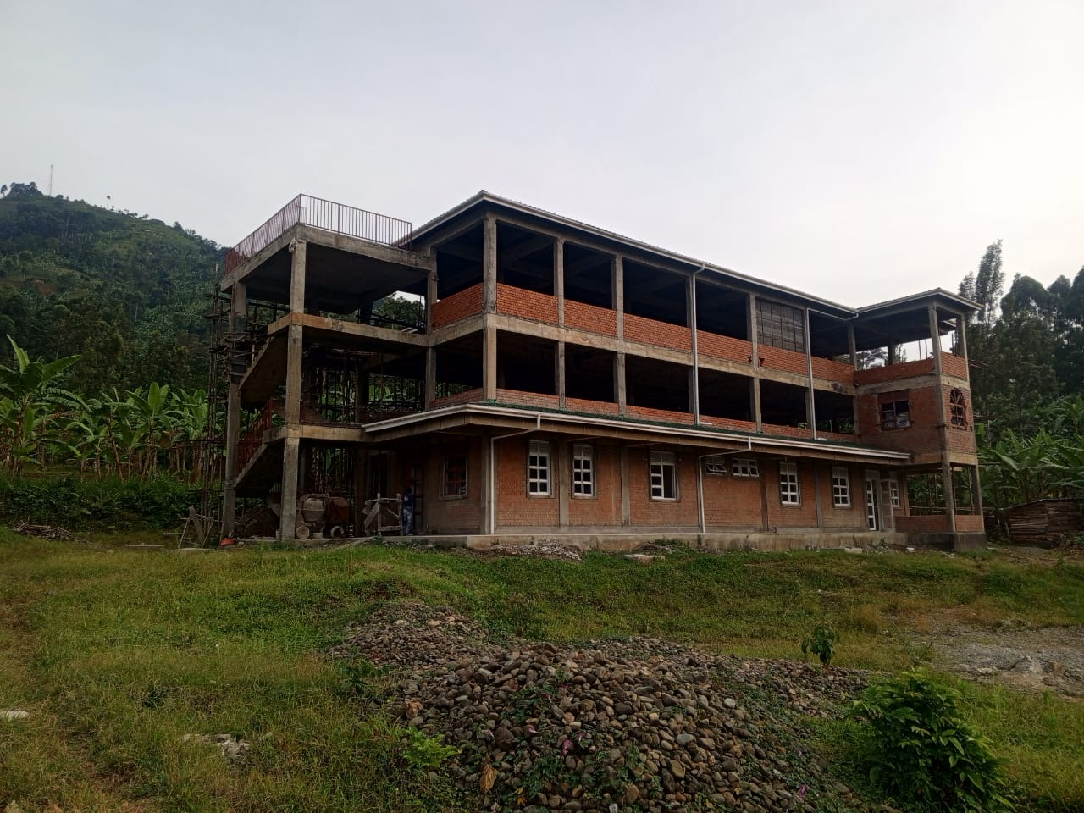
Bukobero Community Health Center - $1,000
We authorized our third grant for a project led by Sheila Hosner, of University District Rotary to build a community health clinic and health education facility in a remote area of Uganda. Sheila will be presenting the project at an upcoming club meeting.

Slide 13
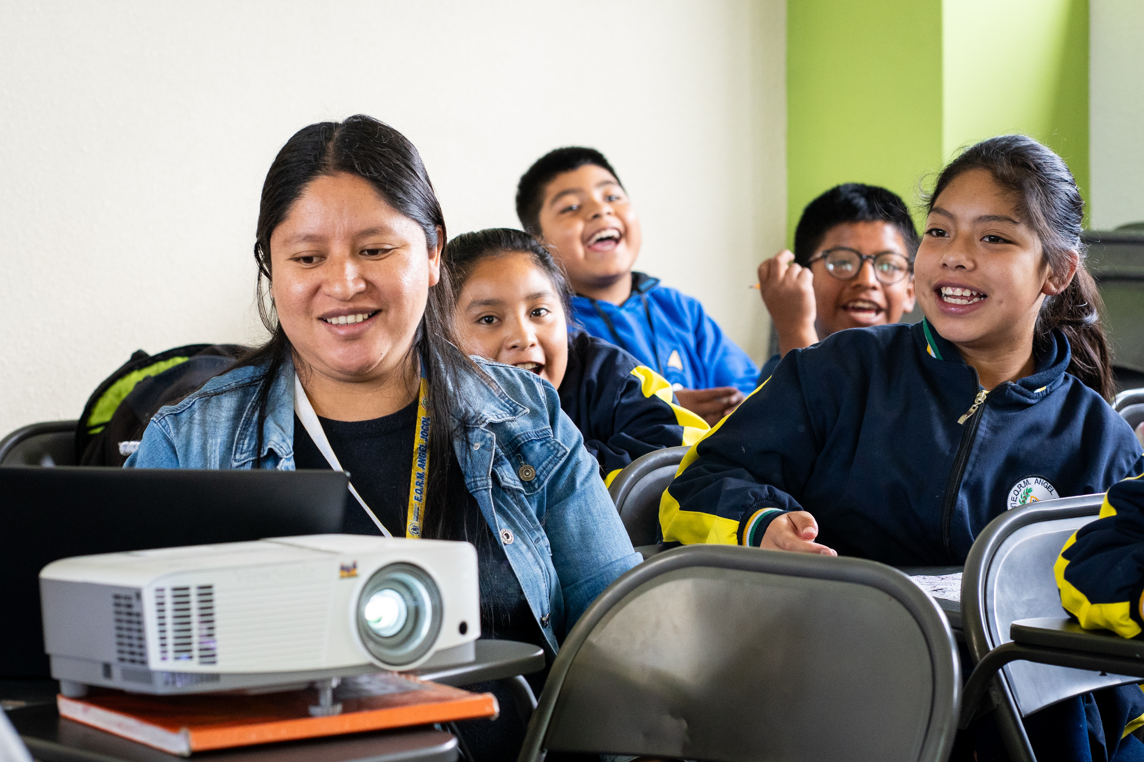
Global Grant, Technology for Teachers - $5,000 foundation money, plus $2,000 from individual club members, and $18,000 from partner clubs
We are sponsoring our third Global Grant in partnership with TINFA to bring technology and training to teachers at three under-resourced schools in Guatemala. To be matched by district and Rotary Foundation funds.

Slide 14
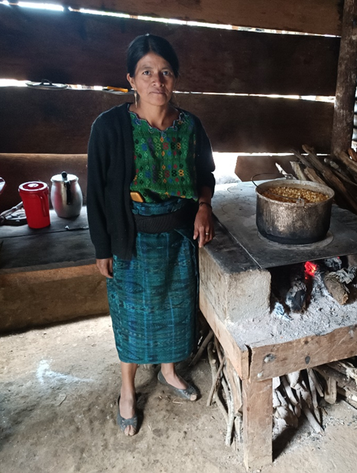
Guatemala Stove Project - $1,500
We partnered with West Seattle Rotary on their project to install vented efficient stoves to replace open fire indoor cooking and sanitary water access in a remote village, Blanca Flor, in rural Guatemala

Slide 15

The Healing Center - $500 club foundation + $500 from District 5030 matching funds
We will sponsor a child to recover from the trauma of loss through the counselling offered by The Healing Center.

Slide 16
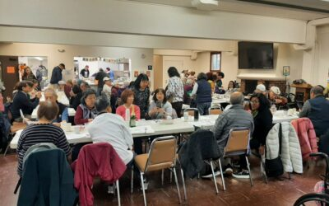
Hunger Intervention Program - $1,000
We support the grant led by Lake Forest Park Rotary to provide healthy food to distressed families in our community through the Hunger Intervention Program.

Slide 17
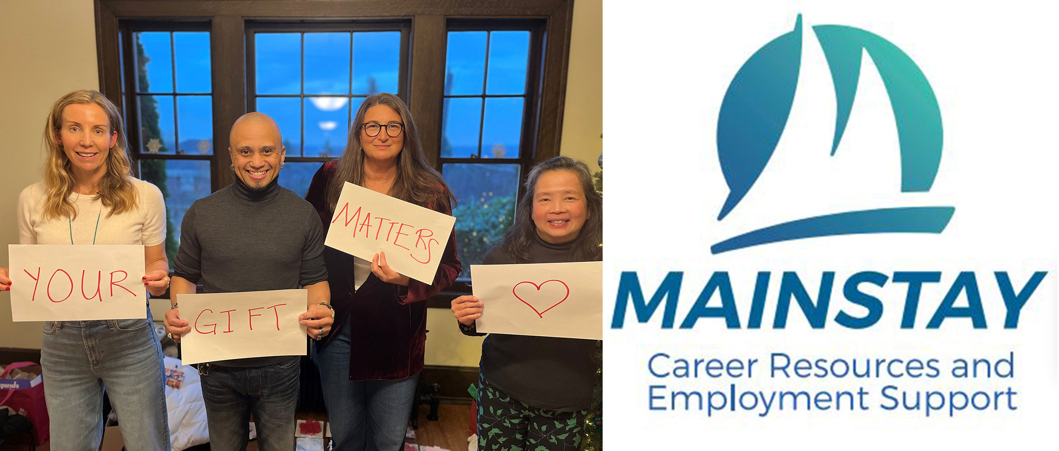
Mainstay - $4,000 of club funds plus $4,000 from partner clubs, $250 from Rotaract, district matching money of $8,000 and $668 from club members
We provided money to buy eleven MS Surface touchscreen computers for Mainstay staff to use to facilitate job applications for learning disabled clients.

Slide 18
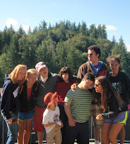
Outdoors for All - $8,160
We shared the proceeds of The Big Taste to support OFA’s program of providing adaptive equipment use and outdoor recreational experiences to people who otherwise would not have access.

Slide 19
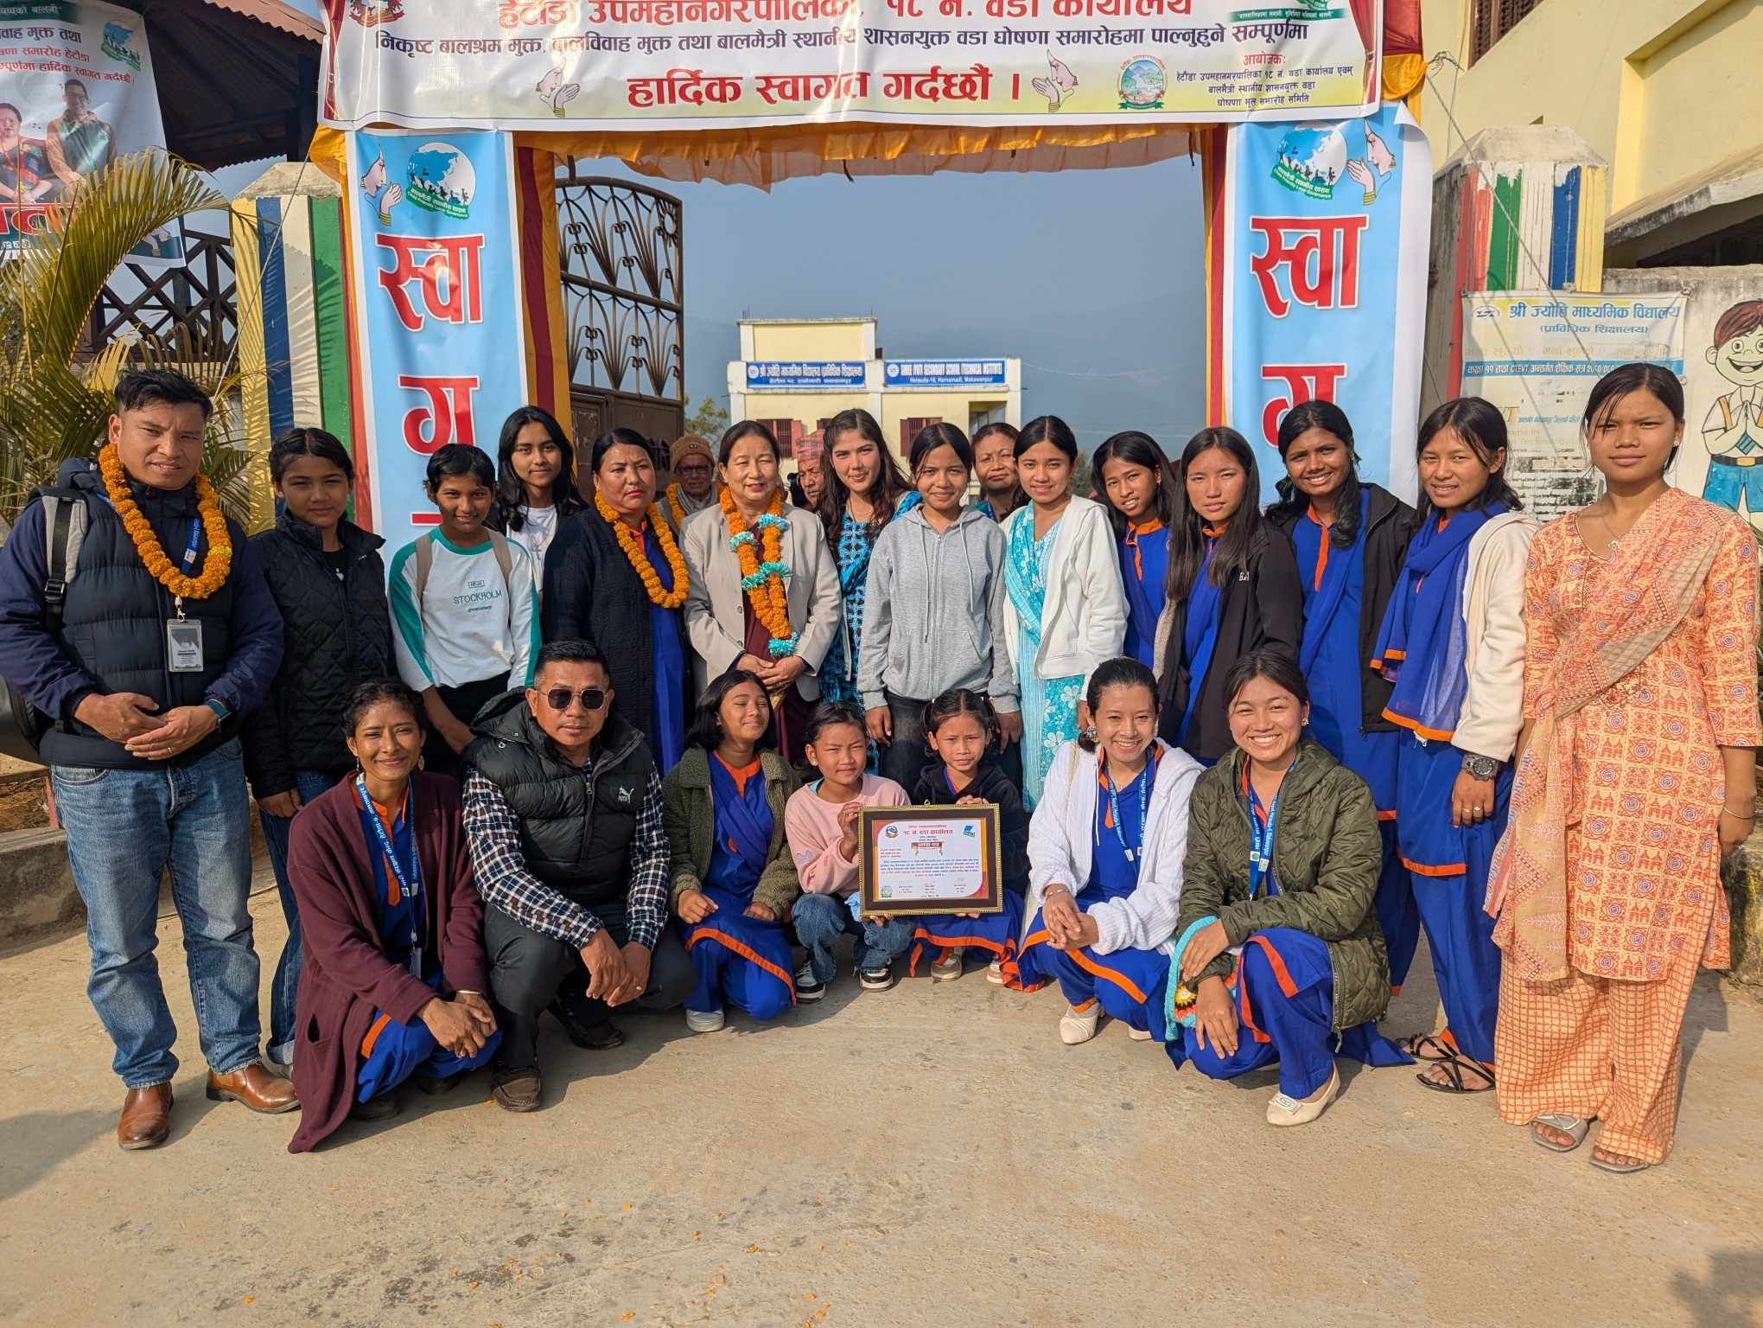
Nepal Tailoring and Training Center - $500
We support Edmonds Rotary Club’s project for a center to give tailor training and business support to vulnerable women and adolescent girls in an underserved rural area in Nepal.

Slide 20
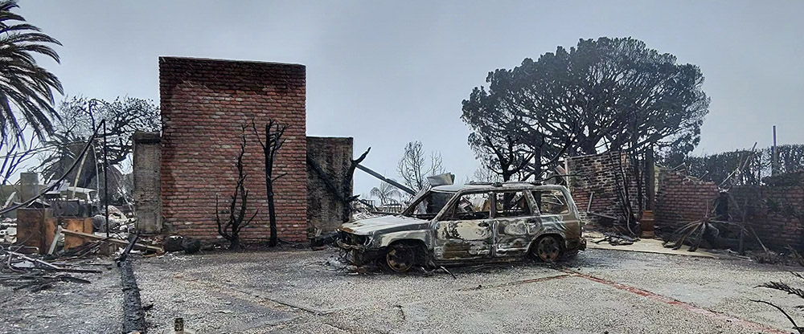
Palisades Fire - $500 from foundation plus $550 from individual club members
We sent funds to a Rotary Club in So. California leading Rotary support for recovery from the Palisades fire.

Slide 21
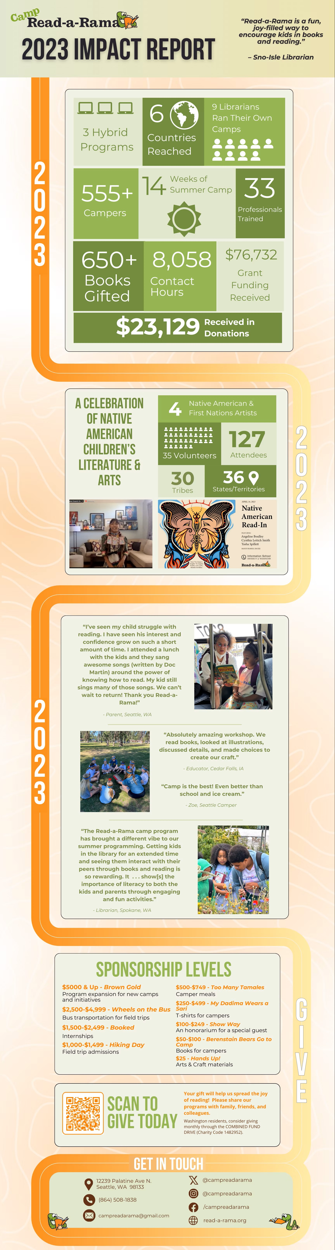

President’s Grants - $2,500
$1,000 for Seattle Public Library
$1,500 for Read-A-Rama

Slide 22
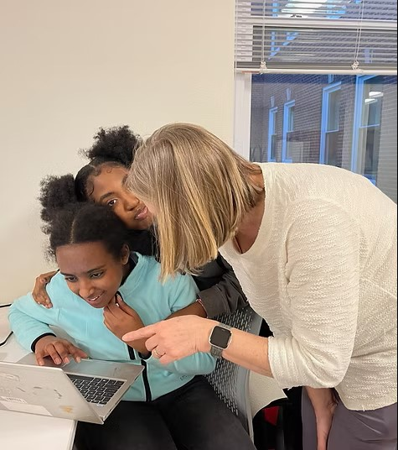
Rally Club - $2,000
Rally Club Seattle is a 501c3 nonprofit group mentorship program for underserved teens and tweens in Northeast Seattle.
We are supporting funding to serve of a warm meal each week for the club at Eckstein Middle school.

Slide 23
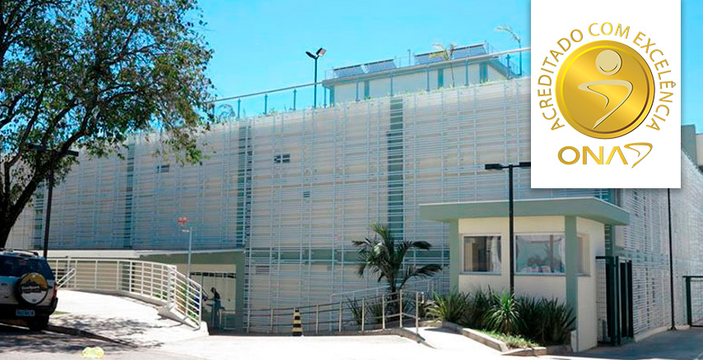
Regional Hospital Jundiai, Brazil - $500
This hospital’s diagnostic imaging equipment is about to fail. The Rotary Club of Jundiaí Serra do Japy is writing a Global Grant to replace it with new equipment.

Slide 24
Regional Hospital Jundiai, Brazil - $500
This hospital’s diagnostic imaging equipment is about to fail. The Rotary Club of Jundiaí Serra do Japy is writing a Global Grant to replace it with new equipment.

Slide 25
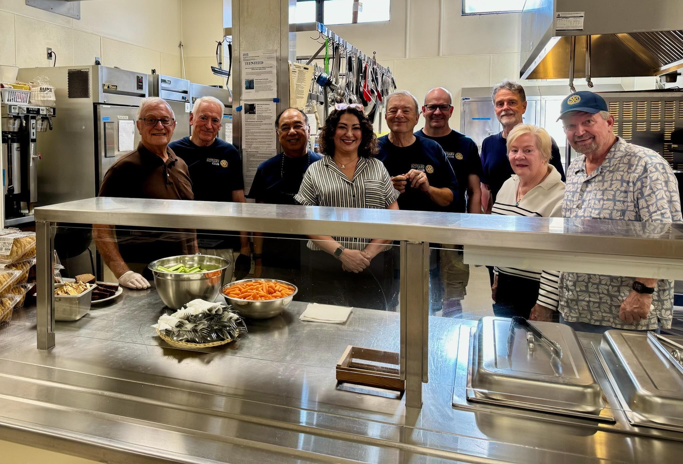
Teen Feed - $4,891
We bought ingredients and cooked to provide approximately 840 dinners and donated $1,000 for winter clothing to homeless youth in North Seattle.

Slide 26
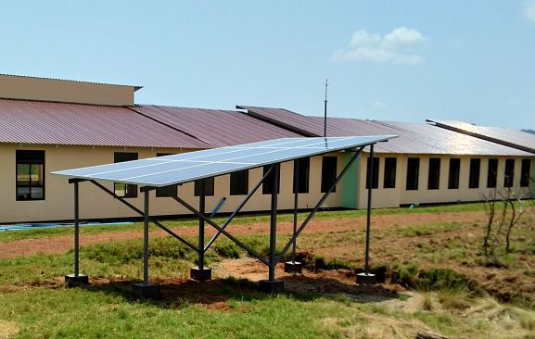
Twegashe School Water Project - $1,000
We support the grant led by Seattle International District Rotary to create a water catchment system, making this school in Tanzania viable for students and teachers.

Slide 27
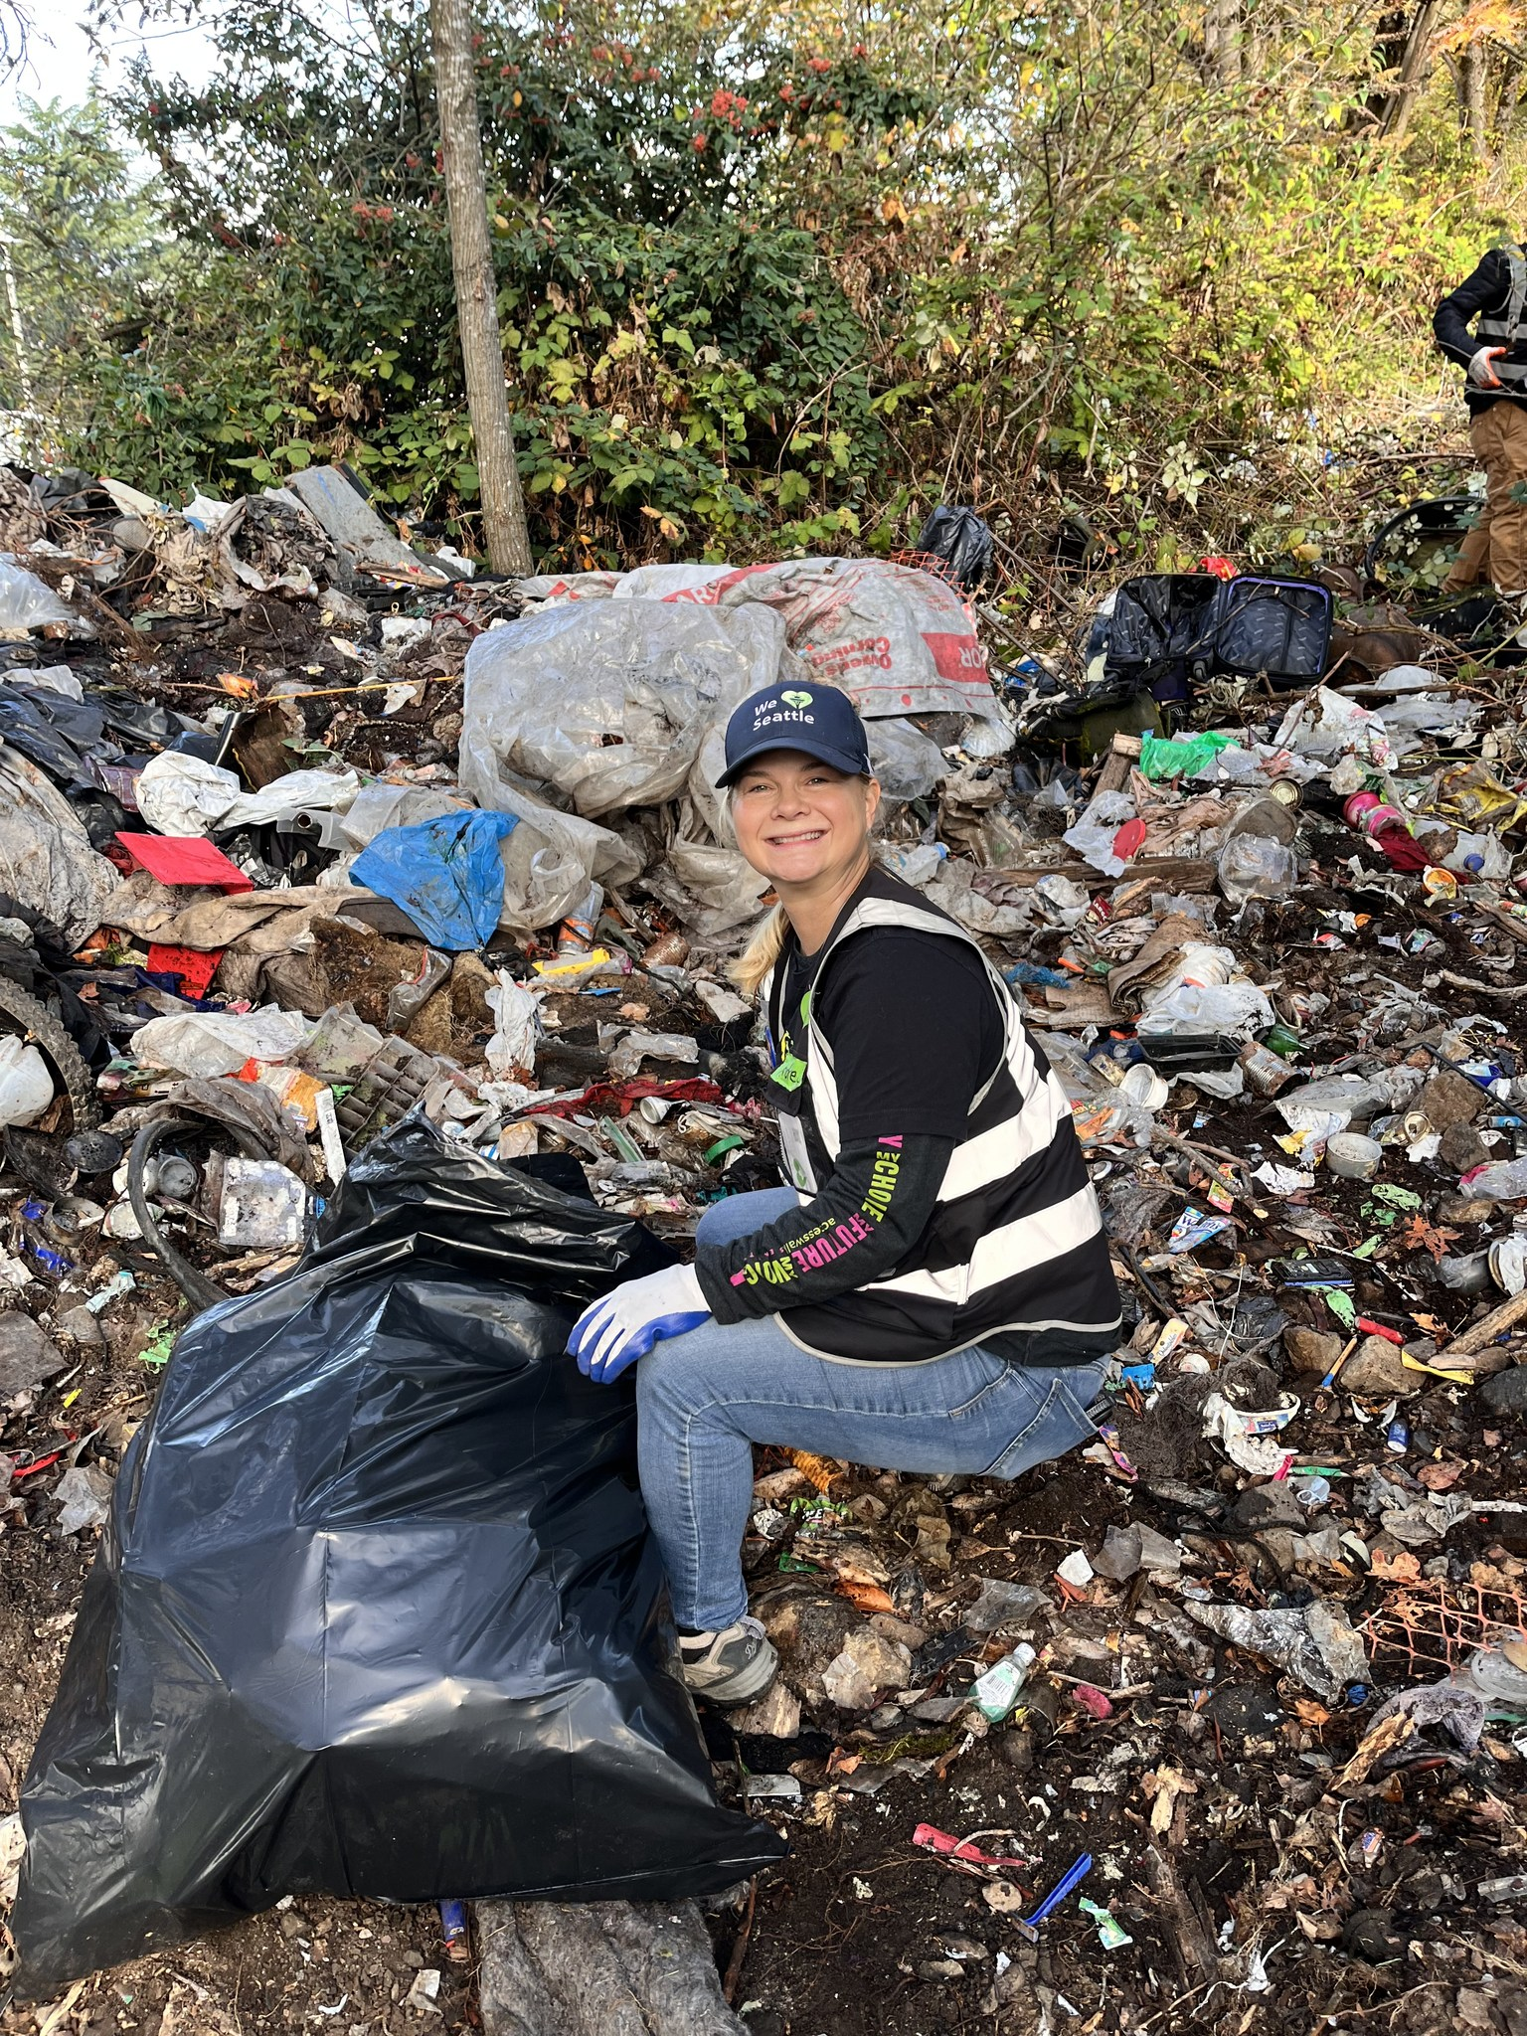
We Heart Seattle - $8,160
We shared the proceeds of The Big Taste to support the WHS program to clean up Seattle Greenspaces and to help get people off the streets and into treatment and housing.

Slide 28
Discussion Items
Ratification of Board of Trustees: Tom Ranken:
  Lincoln Ferris
  Dave Mushen
  Pam Mushen
  Tom Ranken
  Stuart Webber
Endowment Policy: Tom Ranken
Screening Committee: Mike Madden

Slide 29
Endowment Policy Possibilities
The Board meets in early March to consider approval of endowment policy:
Threshold: Once the endowment fund reaches $100,000, we will begin to make draws to fund current year grants.
Annual draw: Assuming a future long-term return of 7%; an annual withdrawal of 5% would be prudent.
Apply a hybrid rule: Spend the lesser of 5% of the average balance or last year’s spend plus inflation.
Set guardrails: Keep spending between 4–6% and reduce to the floor if the fund drops below original gifts.
Maintain a cash buffer for 6–12 months of grants.

Slide 30
Proposed Grant Review Cycles
The volume of grant requests has increased recently and may continue to increase. We may well use all available funds and may still receive more applications.
The Screening Committee is proposing to the board that we change from submitting applications for approval one at a time, in the order received, to applying two deadlines for applications, July 31st and January 31st.
Applications would be considered in two batches, at the foundation board meetings following each deadline, to assure that we recommend the best proposals for the funds available.
Up to two thirds of the discretionary grant funds would be available for to applications received by the July 31st deadline, and the remaining funds would be reserved for applications received by January 31st.

Slide 31
Screening Criteria for Grant Applications
Current
Proposed Criteria
Is the proposal genuinely beneficial to someone in need or to an important cause?
Will the funds be administered responsibly and effectively?
Do we have sufficient funds for this request and our other priorities?
Does the proposal support our mission of helping children live, learn, and laugh?
Is the proposal sponsored or recommended by a USRC member?
Will the recognition generated help University Sunrise attract new members, encourage donations and add participants?
Is the request from a Rotary club we have partnered with in the past?
Is the request from a Rotary club that will be a good future partner?
Is the proposal genuinely beneficial to a community in need? Does this project align with our Mission Statement: “Our Club creates positive, lasting change locally and globally. We accomplish this through service, investments in the community, and building close relationships.”
Does it appear that the requestor will administer the funds responsibly and effectively? What is the basis of such trust? Is the applicant a 501c3 organization? Does the applicant have a website with sufficient information on their financial status? Is the latest annual report or tax return available for review?
Do we have sufficient funds for this request? Will we fund the full “ask” or a portion of it? Where does this request rank among the other requests under consideration during this evaluation period?
Does the proposal support our preference for helping the community in Northeast or North Seattle?
Is the request from a Rotary club we have partnered with in the past? How did past partnerships work out? Were we given periodic updates and follow-up reports?
Has the applicant answered all questions on the Application Instruction Page or addressed the questions in accompanying materials? If not, the applicant must provide such information prior to having their appeal considered.
Is the request from a Rotary club that will be a potential future partner?

Slide 32

Thank You!
Questions?

