Slide 1




THE STATE OF
HOMELESSNESS IN AMERICA

Slide 2



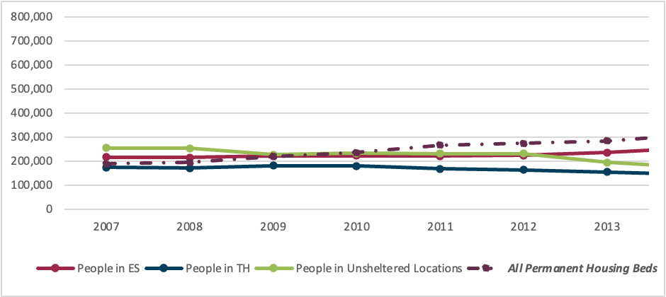
PEOPLE EXPERIENCING HOMELESSNESS 2007-2013

Slide 3


CHANGES MADE IN 2013 CONTINUUM OF CARE PROGRAM COMPETITION NOFA
  Formally Introduces “Housing First”
  Formally Introduces “Rapid Re-Housing”
  Discontinues “Service Participation Requirements”
  Cuts CoC NOFA Funding for Emergency Shelters
  Dramatically Reduces Funding for Treatment Services
  Starts Phasing Out of Funding for Transitional Housing
  Unbalances the Continuum of Care

Slide 4

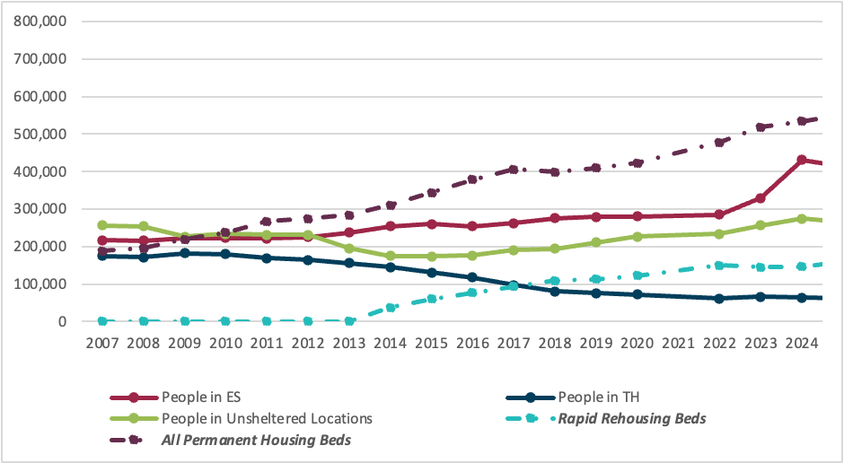
PEOPLE EXPERIENCING HOMELESSNESS
2007-2024

Slide 5

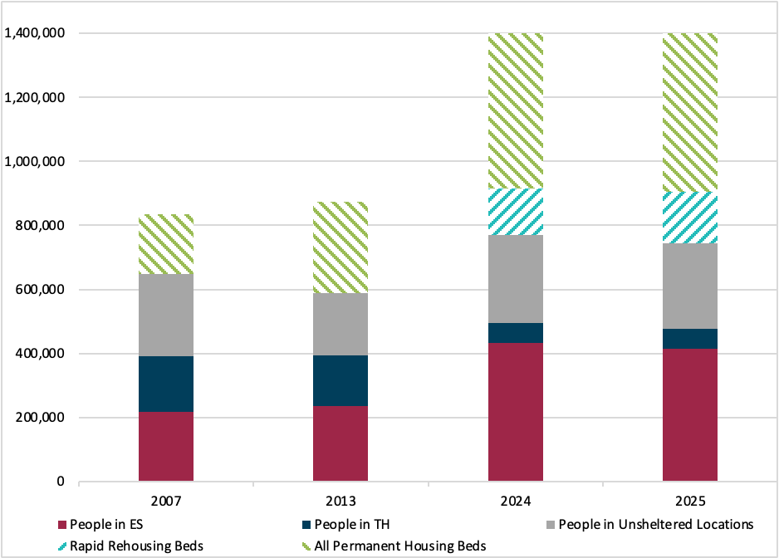
PEOPLE EXPERIENCING HOMELESSNESS
2007, 2013 AND 2024
  All Permanent Housing Beds
  Rapid Rehousing Beds
  People in Unsheltered Locations
  People in Transitional Housing
  People in Emergency Shelters

Slide 6

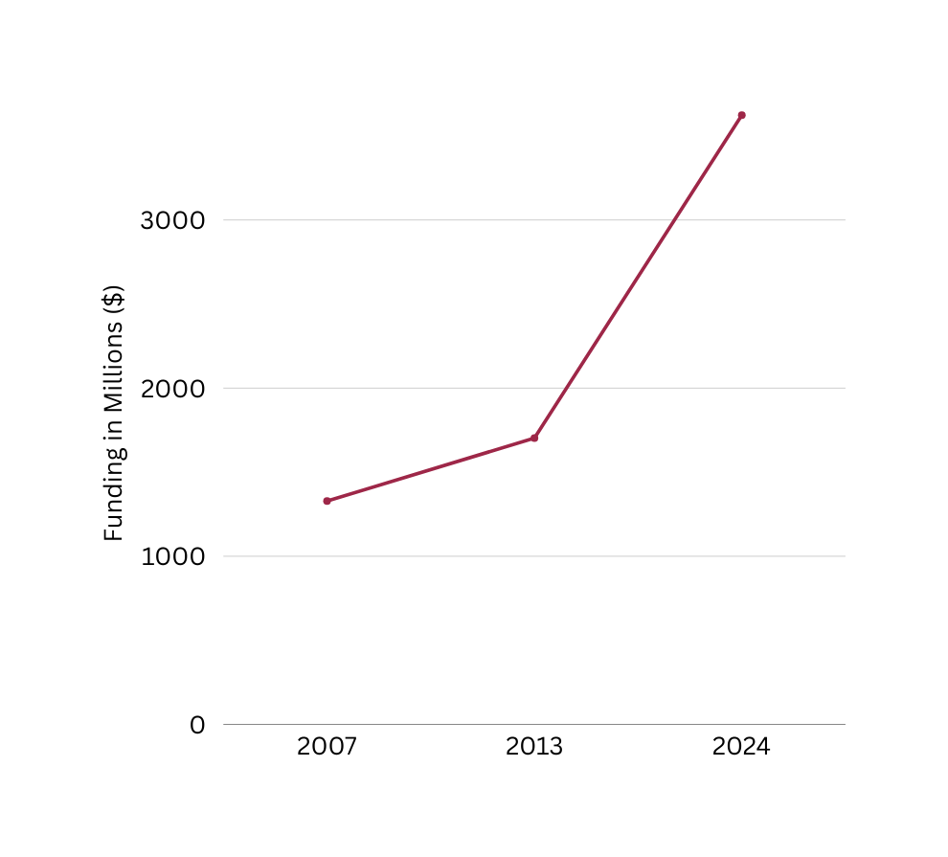
PEOPLE EXPERIENCING HOMELESSNESS
2007, 2013 AND 2024
WITH TOTAL CoC PROGRAM FUNDING AWARDS
$3,623,037,241
$1,702,784,492
$1,327,573,959

Slide 7
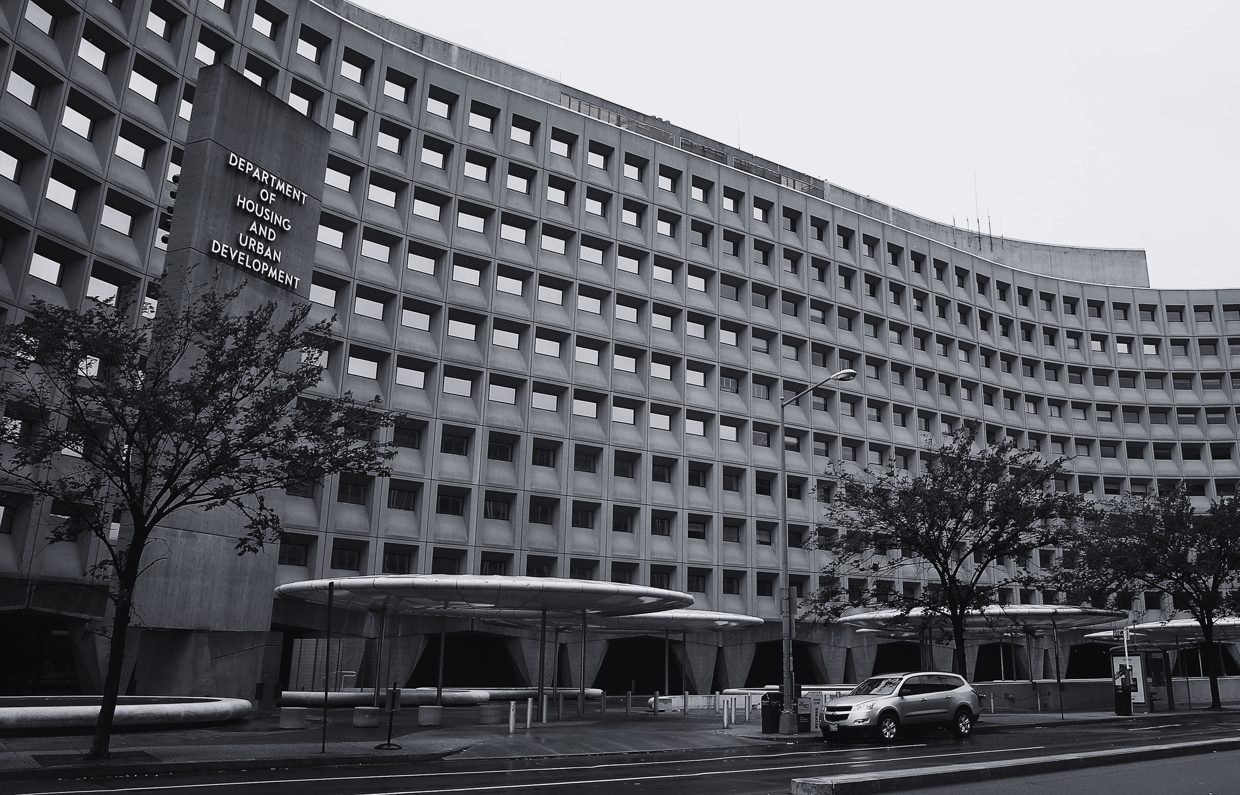

SOURCES:
  The 2024 Annual Homelessness Assessment Report (AHAR) to Congress
    Slides 2, 4, 5 and 6
  Notice of Funding Availability (NOFA) for Fiscal Years 2013 and 2014) Continuum of Care Program Competition.
    Slide 3
  HUD Exchange – CoC Award Summary Reports by Component and Project Type
    Slide 6

Slide 8

Q & A

