Slide 1
Reaffirming Commitments to Equity, Justice, and Inclusion in the Current Climate
Maya Angela Smith
Associate Dean for Equity, Justice, and Inclusion
College of Arts and Sciences
University of Washington

Slide 2
Agenda
How my research and teaching informs my administrative work
Doing Equity, Justice, and Inclusion (EJI) in the current climate
Overview of EJI in CAS

Slide 3


My Scholastic and Pedagogical Journey: Researcher

Slide 4
My Scholastic and Pedagogical Journey: Teacher
Courses
  200-level outreach courses taught in English
  300-level courses for the major taught in English
  300-level advanced intermediate courses taught in French
  400-level upper division courses for the major taught in French or French/English
Approach
  Inclusive Pedagogies
  Active and Engaged Teaching
  Growth Oriented

Slide 5
My Scholastic and Pedagogical Journey: Teacher
Courses
  French 225: Dealing with Death in Francophone Lit and Media
  French 229: Comparative Immigrant Cultural Production
  French 301: Language and Music in the Francophone World
  French 304: Issues and Perspectives in French and Francophone Studies
  French 320: French Language and Cultural Identity
  French 378: The Making of Contemporary France
  French 448: Cultures of Franco-America (mixed grad/undergrad)
  French 578: Qualitative Research Methods (grad)

Slide 6
My Scholastic and Pedagogical Journey: Administrator
Inaugural Associate Dean for Equity, Justice, and Inclusion in the College of Arts and Sciences
  Spearheaded two college-wide climate surveys
  Created a mechanism for co-sponsoring EJI-related events
  Started a mentorship program
  Built a multi-pronged initiative around inclusive pedagogies
  Created a website with resources including a searchable repository

Slide 7
Anti-DEI Backlash
Tracking Higher Ed’s Dismantling of DEI
DEI Legislation Tracker
  Since 2023, 152 bills have been introduced in 30 states and US Congress
  32 have become law, 110 have been tabled, failed to pass, or been vetoed
https://www.chronicle.com/article/tracking-higher-eds-dismantling-of-dei
https://www.chronicle.com/article/here-are-the-states-where-lawmakers-are-seeking-to-ban-colleges-dei-efforts

Slide 8
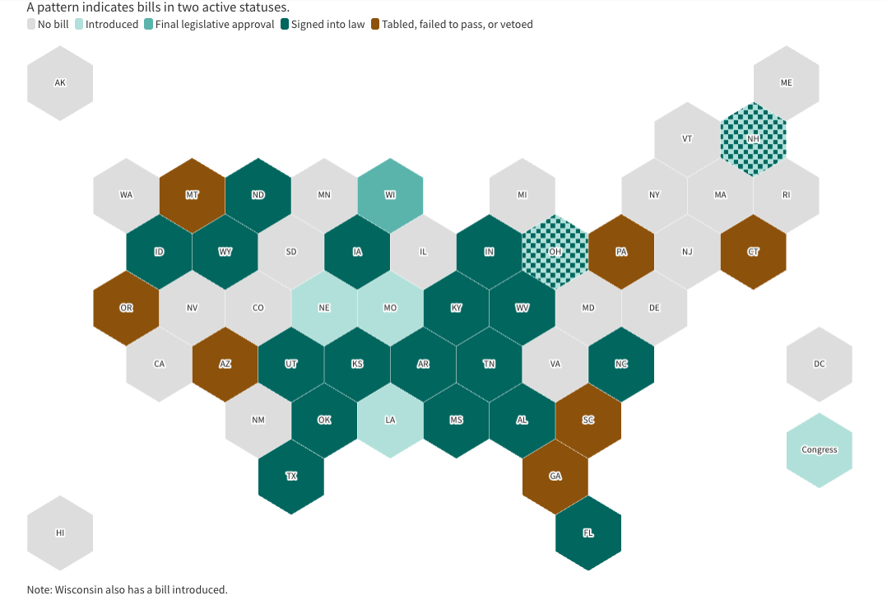
Anti-DEI Backlash

Slide 9
Reactions
Threats to academic freedom
  Self-censorship, preemptive compliance, and a tendency to let compliance concerns take up too much space
  Worrying about objections
  Retreat from one’s mission
Changing terminology
  Can’t be the primary strategy
  Provides false sense of safety while underlying retreat continues
  Need to be able to describe our work in plain language

Slide 10
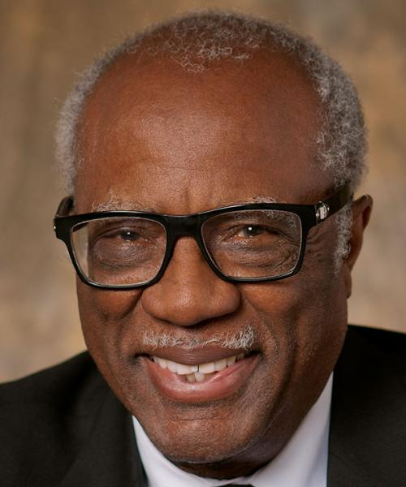
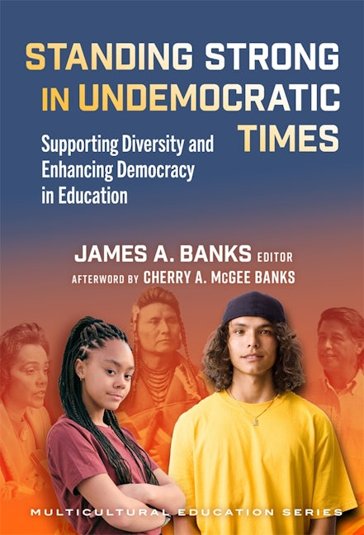
James Banks
Democracy is fragile
Teaching about diversity, equity, justice, and democratic participation is not peripheral, but essential, to education
Faculty need to continue to teach, research, write, and engage with the world
Our core mission, preparing students to engage a complex and diverse society, has not changed

Slide 11
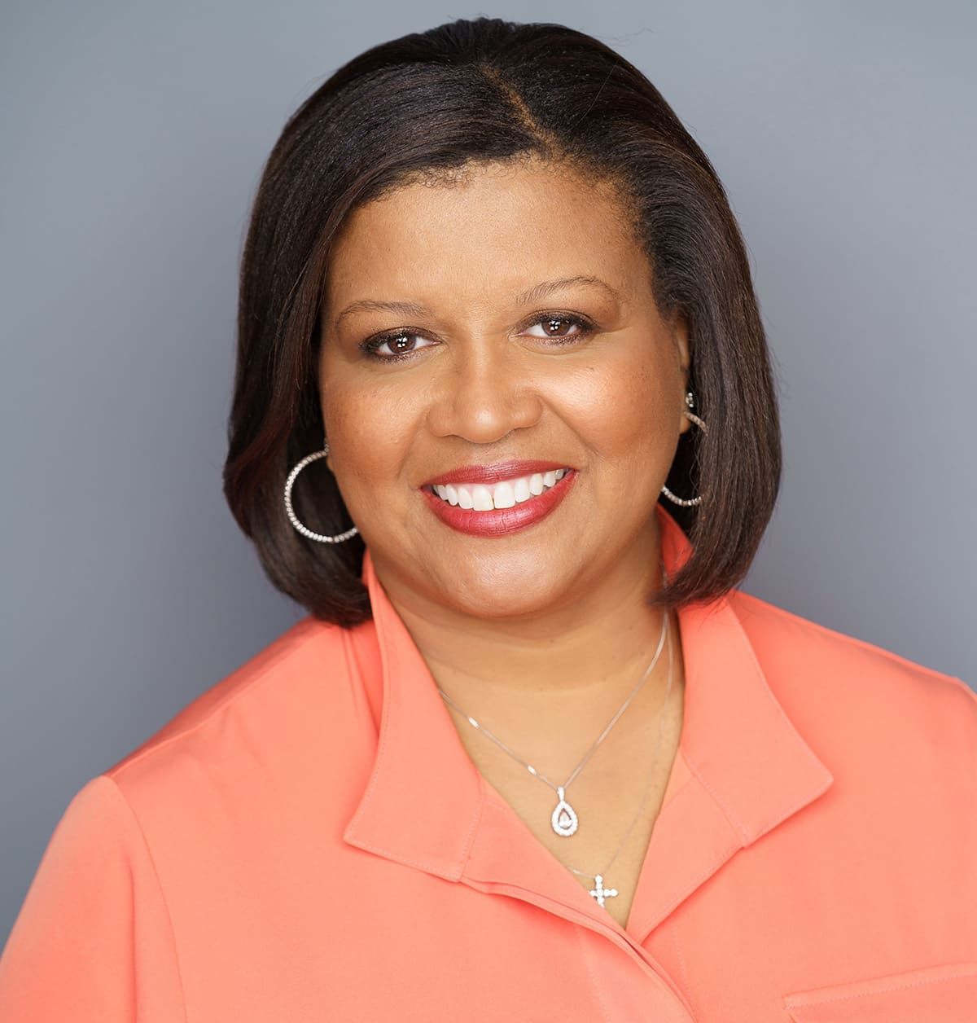
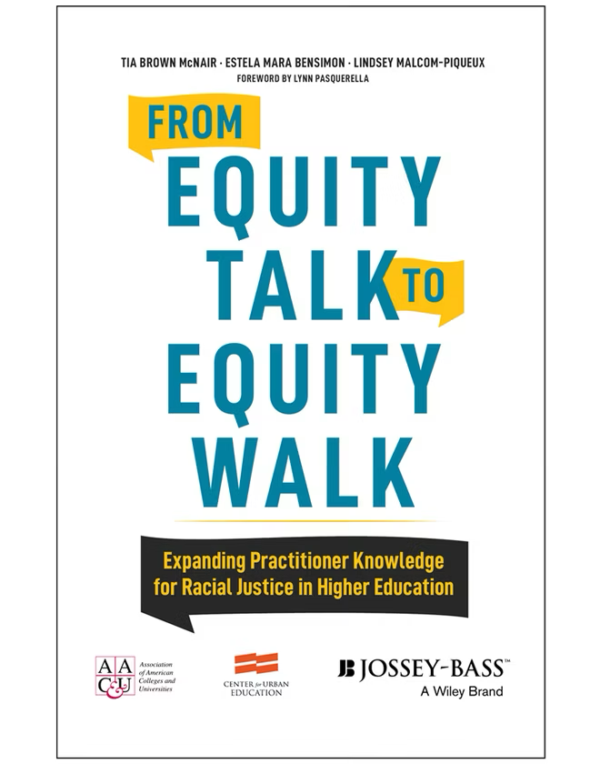

Tia Brown McNair
Question is less about whether students are “ready” for our institutions and more about whether our institutions are ready for the students we serve
Equity - whether our policies, classrooms, advising structures, curricula, and campus cultures are producing equitable outcomes
Targeted universalism - universal goals for all groups using targeted, customized processes to help different populations achieve those goals
Notes:
Tia Brown McNair, Estela Mara Bensimon, and Lindsey Malcom-Piqueux (2020)
Tia Brown McNair, Susan Albertine, Nicole McDonald, Thomas Major, Jr, and Michelle Asha Cooper (2022)

Slide 12
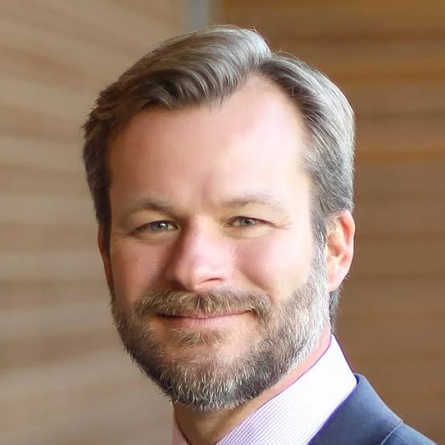
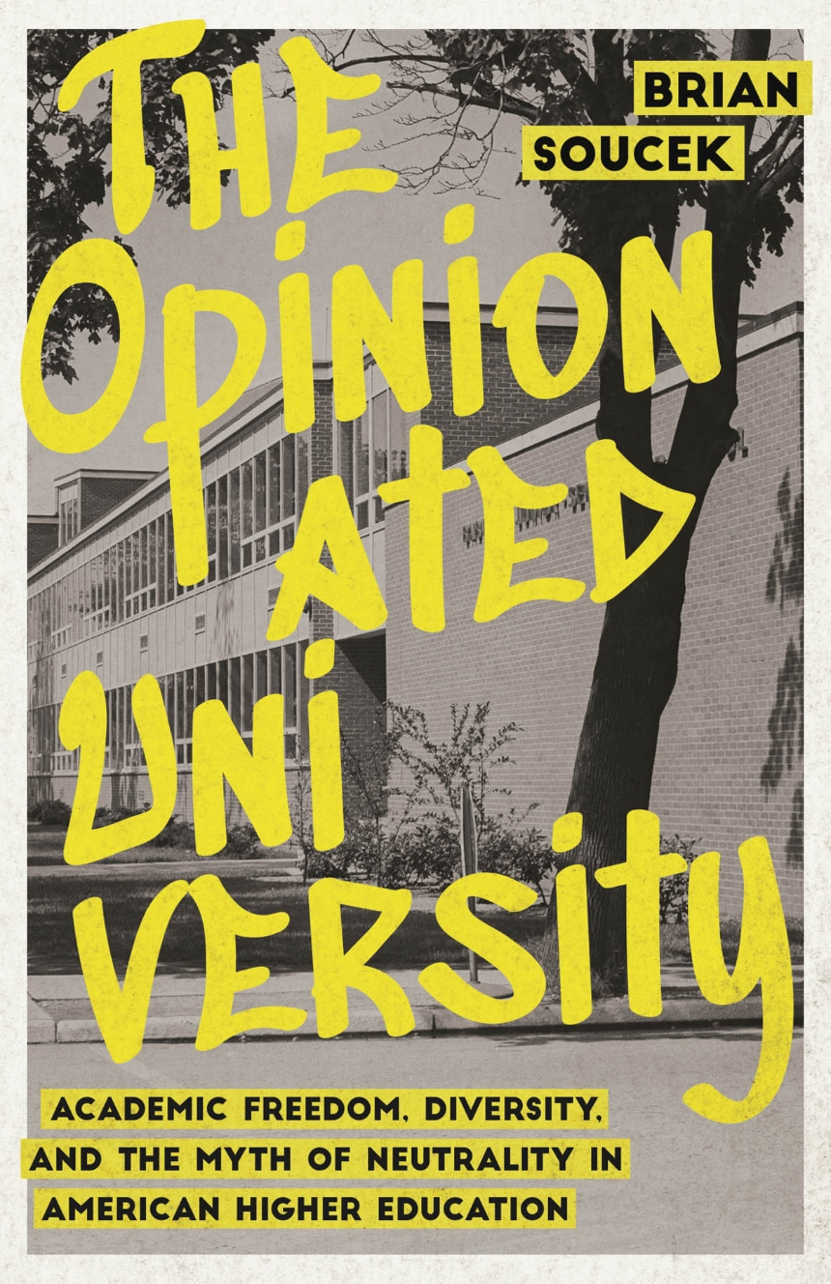
Brian Soucek
Universities are never truly neutral
Budgets, hiring priorities, curriculum, admissions practices, nondiscrimination policies, and research investments all express commitments
If we want to know what a university actually values, we should look there

Slide 13
Regent Policy No. 33
Diversity, broadly understood
  is integral to excellence
  is a key part of the academic mission
  allows us to challenge one another’s assumptions, broaden one another’s range of experience, and teach one another to see the world from varied perspectives
There is a need to recruit, support, and retain people from groups that have been historically underrepresented
  We can do so while adhering to state and federal law
https://policy.uw.edu/directory/brg/regent-policies/statement-on-diversity/

Slide 14
The Framing of “Illegal DEI”
The phrase “illegal DEI”
  executive orders
  agency guidance
  DOJ pressure
  attempts to restrict geographic targeting
  settlement letters that institutions sign under pressure
The goal is to make people believe that the very aim of advancing equity and inclusion is unlawful

Slide 15
Supreme Court Ruling
SFFA v. Harvard/UNC (2023)
  The Supreme Court struck down certain race-conscious admissions practices, particularly systems that treat race as a check-box category in admissions
  Importantly, the Court did not say that the goal of diversity is illegal, describing it as a worthy and commendable goal
  Applicants can discuss how race has shaped their experiences, character, leadership, or achievements

Slide 16
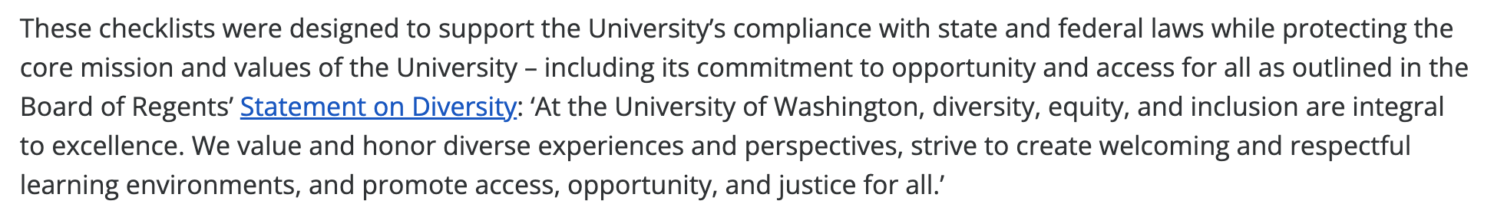
Initiative 200 (1998) and Compliance
RCW 49.60.400 Discrimination, preferential treatment prohibited
  The state shall not discriminate against, or grant preferential treatment to, any individual or group on the basis of race, sex, color, ethnicity, or national origin in the operation of public employment, public education, or public contracting
https://www.washington.edu/civilrights/policies-and-guidance/compliance-checklists/

Slide 17
Broadening Access by Using Diversity as a Goal not a Mechanism
Focus on race-neutral efforts that broaden access, improve student success, address exclusion, and build a more diverse academic community
Valid and legal to value what people have done to advance inclusive teaching, mentoring, research, public engagement, or student flourishing

Slide 18
DEI Work Sustains Excellence
Anti-DEI critics often treat DEI work as something separate from merit
  But teaching and research can not be extracted from the question of who benefits from that teaching and research
The ability to teach diverse students well is part of teaching excellence
The ability to ask research questions that matter to broader publics is part of scholarly excellence
The ability to mentor and build intellectual community is part of academic merit

Slide 19
Move Beyond Generic Vocabulary
What can we do at the local level?
Departments should ask:
  Where are we falling short of our mission?
  Which students are not flourishing?
  Which fields, communities, archives, methods, and forms of knowledge have been marginalized?
  What would excellence look like here, in this department, in this discipline?

Slide 20
Defending Academic Freedom
Academic freedom is built around disciplinary expertise
Faculty have the right and responsibility to set curriculum, define standards, and engage contested questions within their fields
Gender, race, democracy, inequality, language, migration, public health, environmental justice, and social power are not “external politics” when they are part of the scholarly terrain

Slide 21
The Dangers of Neutrality
A right-leaning effort to get universities to adopt policies limiting when universities can speak on social issues unless the issue is mission-based
But the danger is that “neutrality” becomes a tool for silencing some disciplines more than others
Many humanities and social science fields can be branded as non-neutral, while STEM treated as neutral even though every discipline has social commitments and public consequences

Slide 22
The Costs of Retreat
Eroded shared governance
Chilled speech
Narrowed curriculum
Weakened trust
  It teaches students, faculty, and staff that institutions abandon their principles when pressured

Slide 23
What Can Universities Do?
1) Resist anticipatory retreat
  Comply with actual law, not with imagined future attacks
2) Center curriculum and learning
  If a topic belongs in the course because it belongs to the field, we should not remove it because it has become politically contested
3) Speak up
  A university is not its administration
  Faculty, students, staff, and departments are also the university
  It’s powerful when the community come together around a clear account of what the institution is for

Slide 24
What Can Universities Do?
4) Work Across Institutions
  Accrediting bodies, professional associations, departments, and faculty senates all matter
  If individual institutions retreat in isolation, the pressure campaign wins one campus at a time
5) Recommit to our mission
  Use language people can understand
  DEI should not sound like signing up for a secret ideological agenda
  The work of helping a diverse set of students flourish, preparing them for a complex world, and producing knowledge that matters

Slide 25
More Important than Ever
Since the 1990s, public education in the U.S. has grown significantly more segregated by race
  Black and Brown students are more likely to attend schools that are doubly segregated: racially isolated and with fewer resources but higher needs
In the employment sector, Black workers face persistent gaps in promotion, pay, and opportunity
  The Black-white wage gap was larger in 2020 than it was in 1970
  Black, Latina, and Native women make less than 65 cents for every dollar earned by a white man, a differential that adds up to nearly a million dollars lost over the course of a woman’s career
https://www.aclu.org/news/racial-justice/supreme-court-signals-that-institutions-can-keep-designing-programs-to-foster-diversity-after-affirmative-action-ruling

Slide 26
Opportunities
Opportunity to build something better
Need for clarity, solidarity, and creative leadership
As the Provost and President say
  Talent is broadly distributed, but opportunity is not, so we need to bridge the gap
  Excellence emerges from access and opportunity
Our task is to stand strong
  to teach, research, govern, and lead as if democracy, academic freedom, and student flourishing still matter

Slide 27
College of Arts and Sciences
https://artsci.washington.edu/about/diversity-equity-inclusion

Slide 28
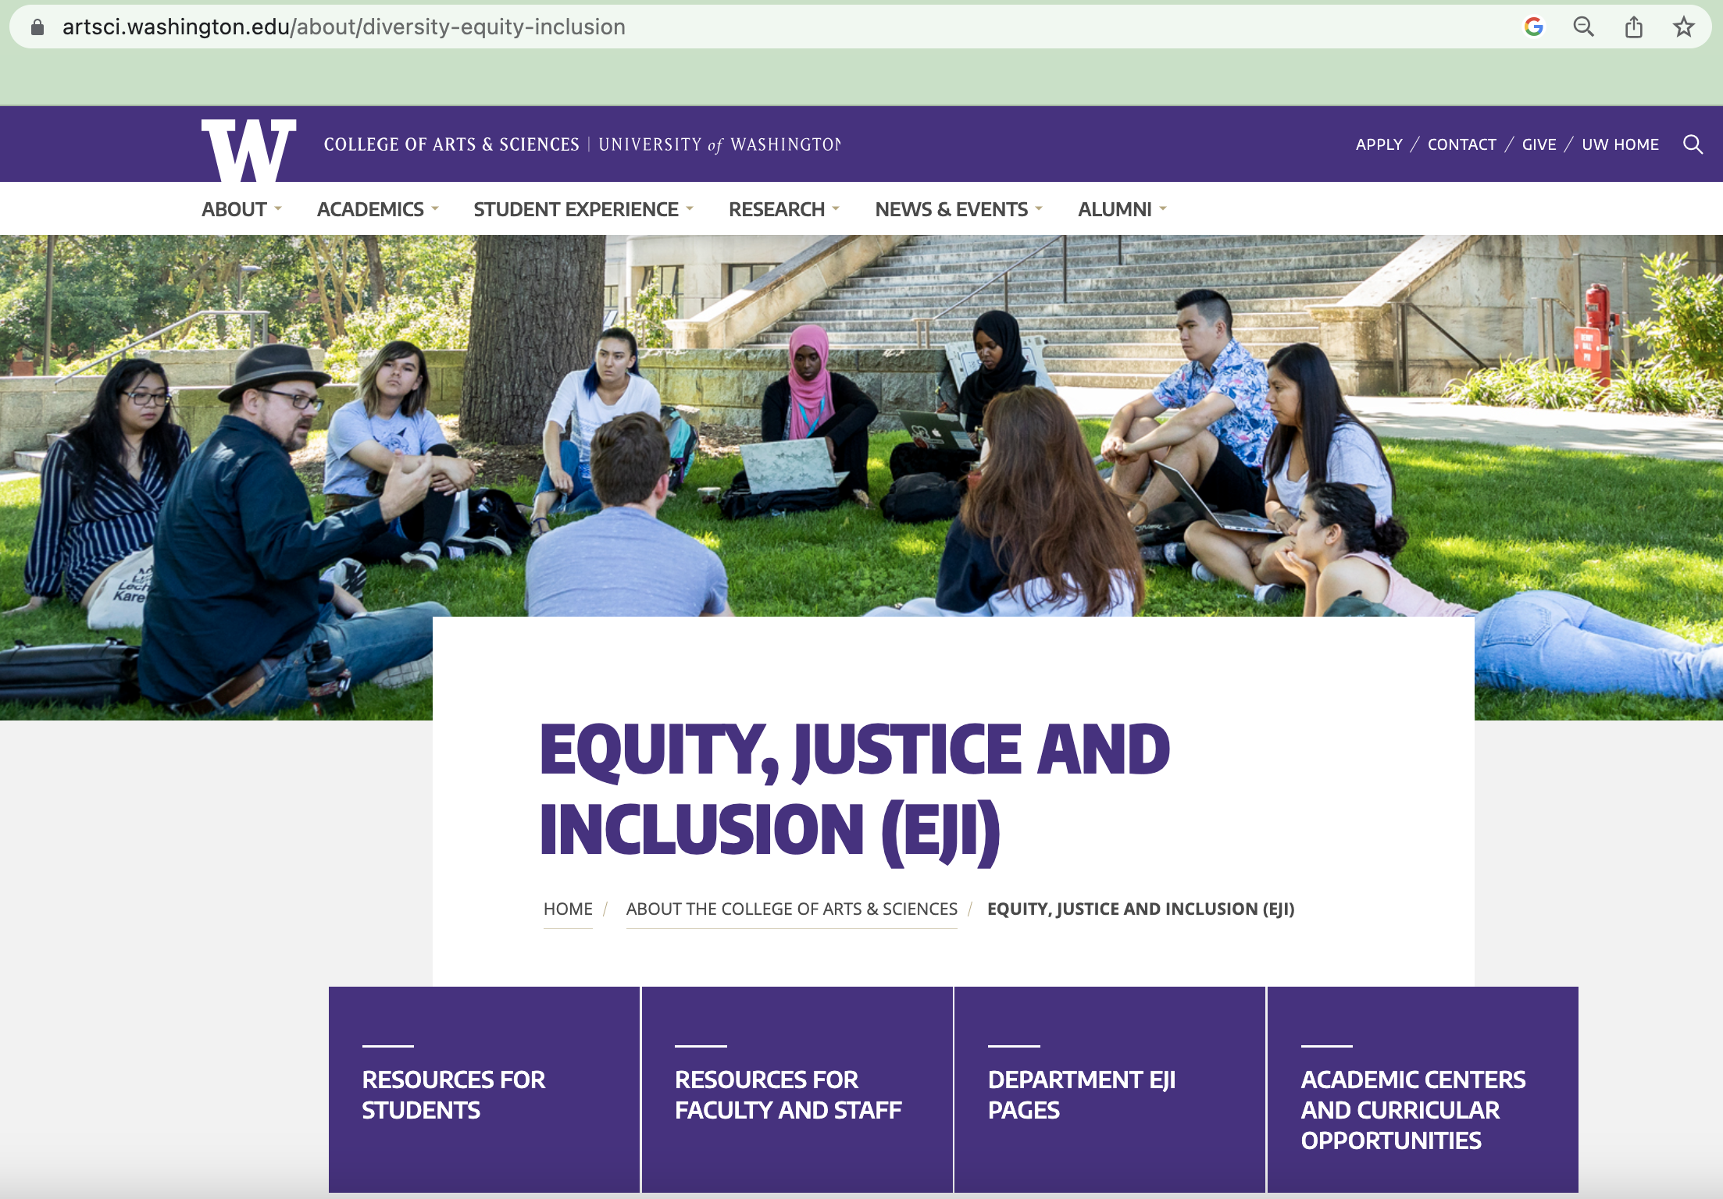
Notes:
How EJI work in the college connects to larger university-wide efforts
Where you can find the college’s vision and action plan
Dept EJI pages
https://artsci.washington.edu/about/diversity-equity-inclusion

Slide 29
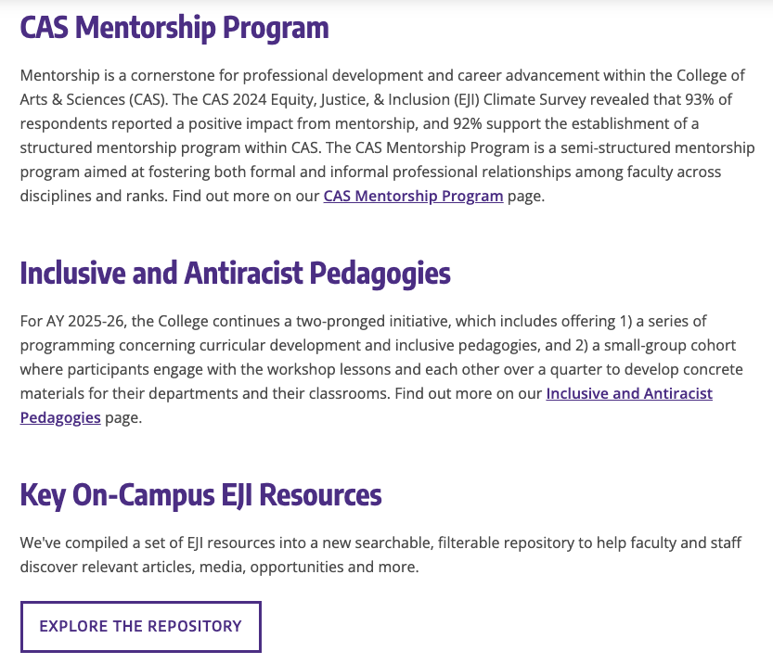

Slide 30
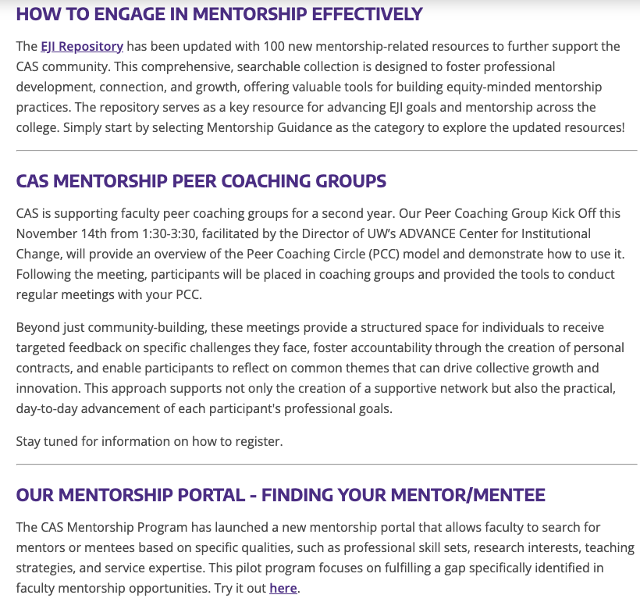
CAS Mentorship Program

Slide 31
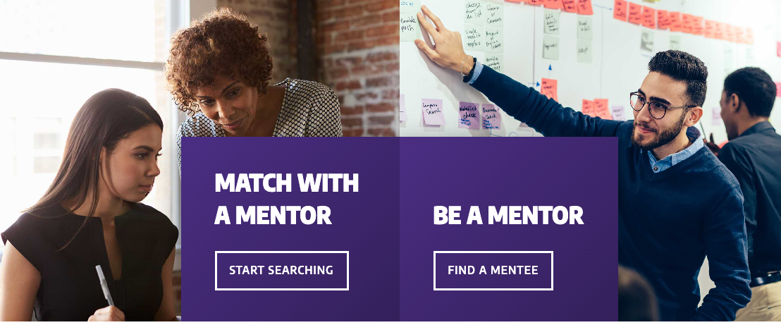
Mentorship Portal
Notes:
Search for mentors or mentees based on specific qualities, such as personal strengths, research interests, teaching strategies, and service expertise.
https://mentorship.artsci.washington.edu/

Slide 32
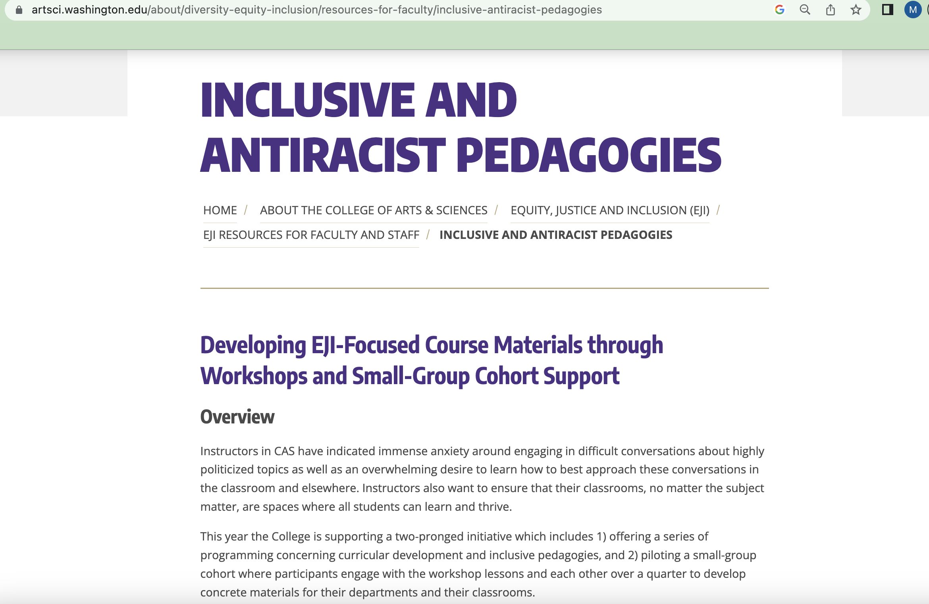

Slide 33
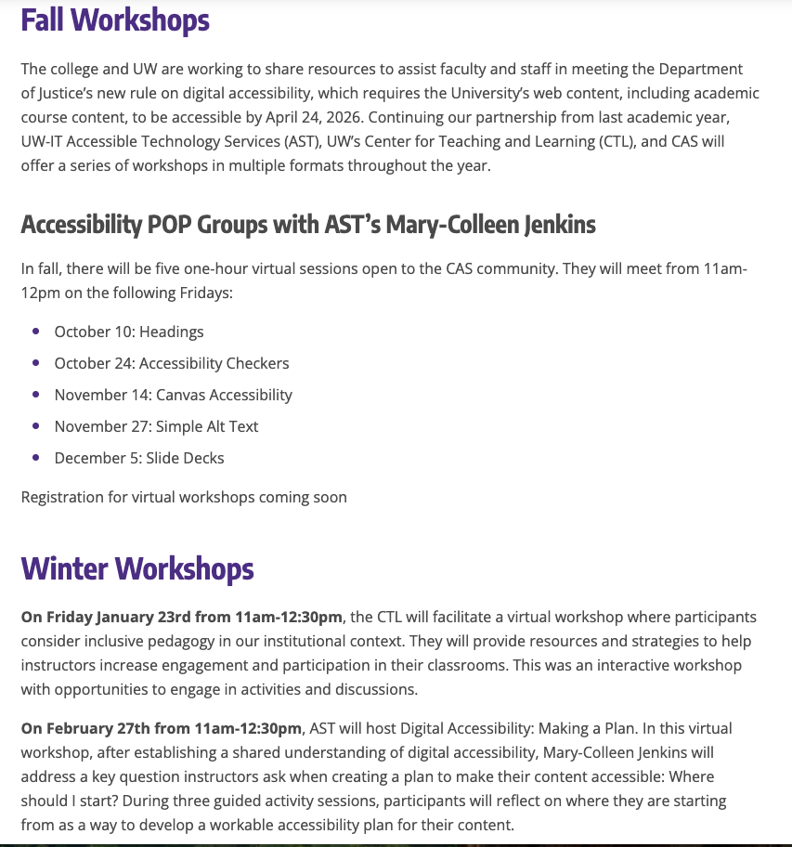

Slide 34
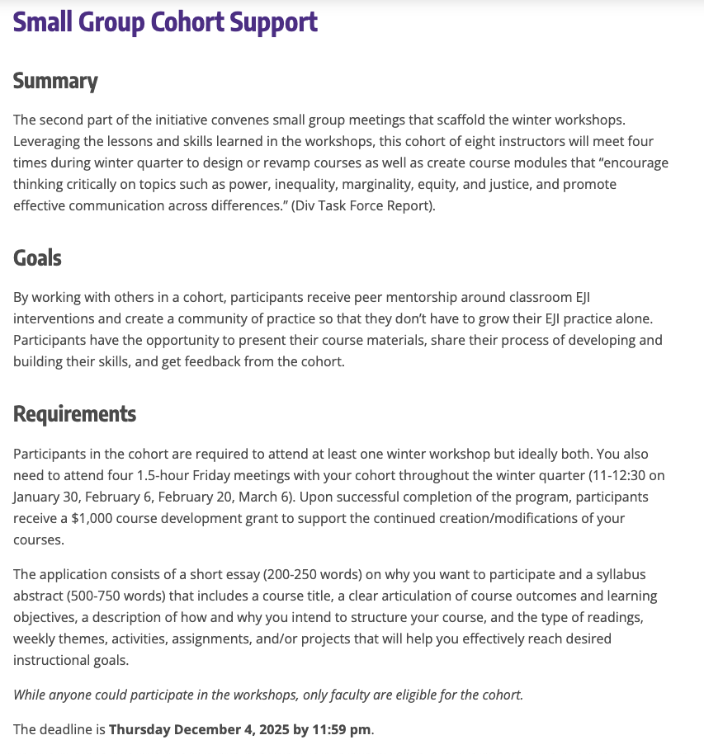

Slide 35
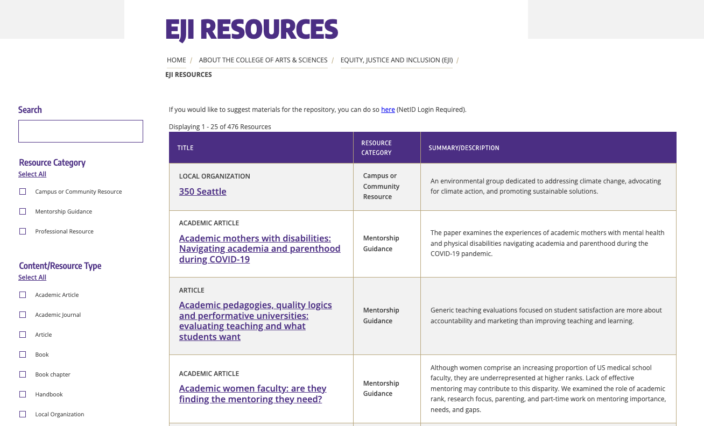

Slide 36
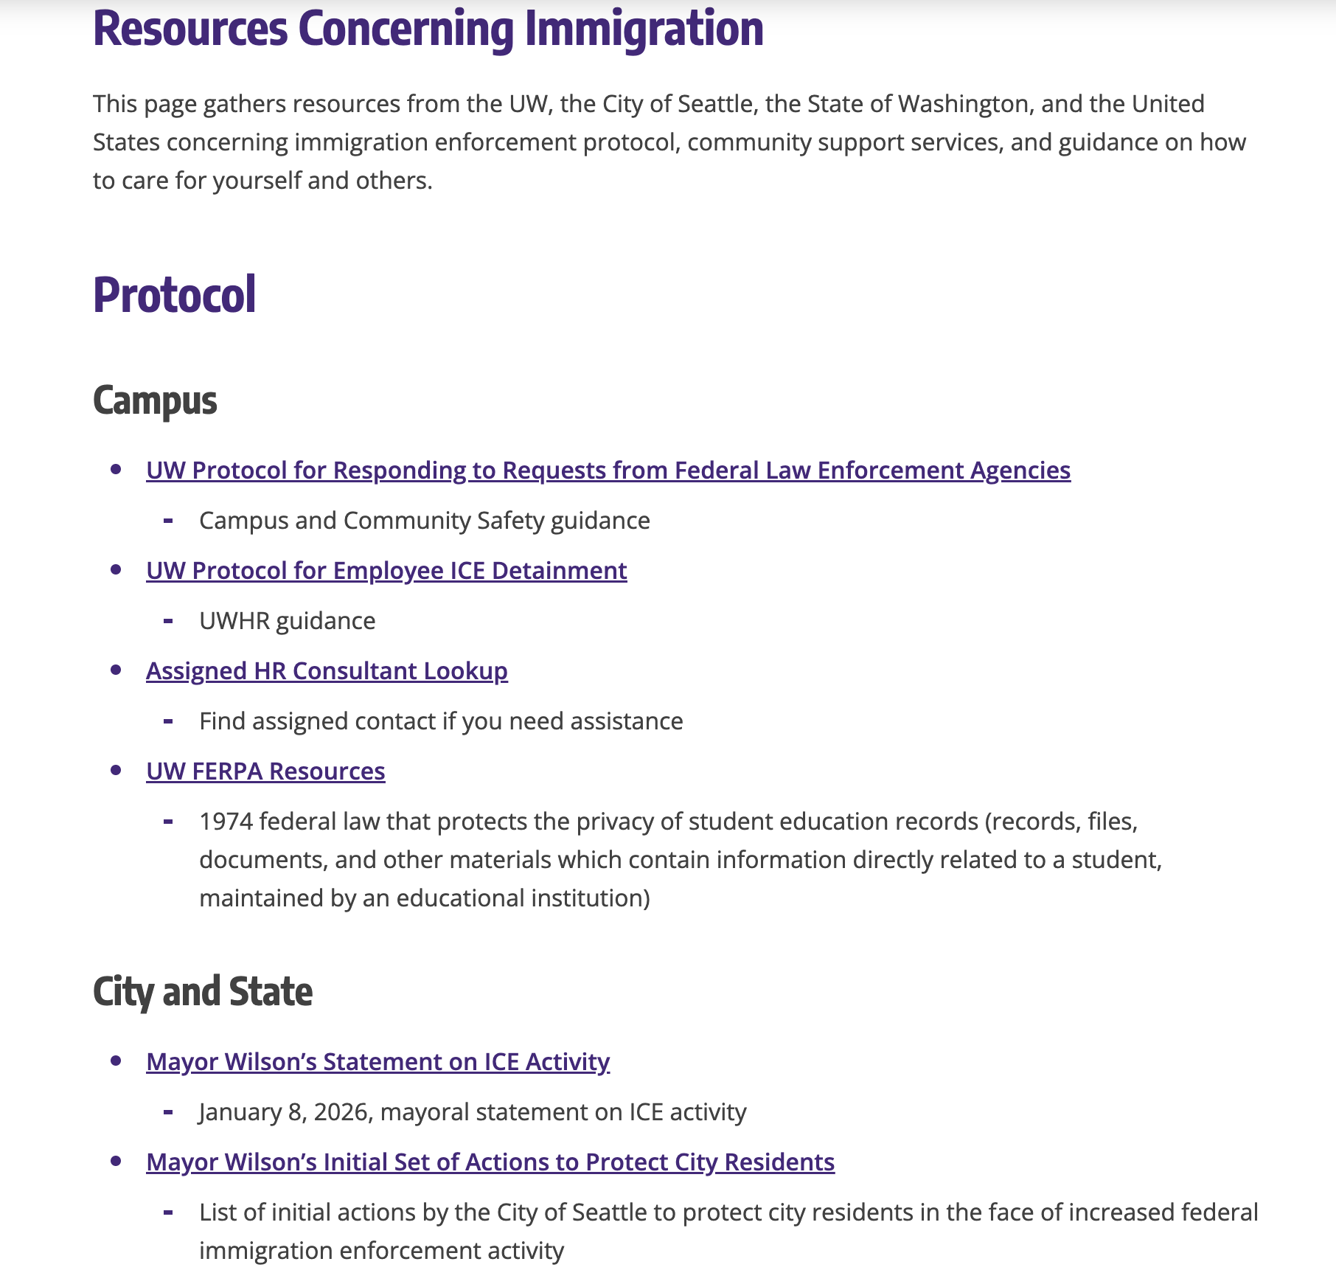

Slide 37
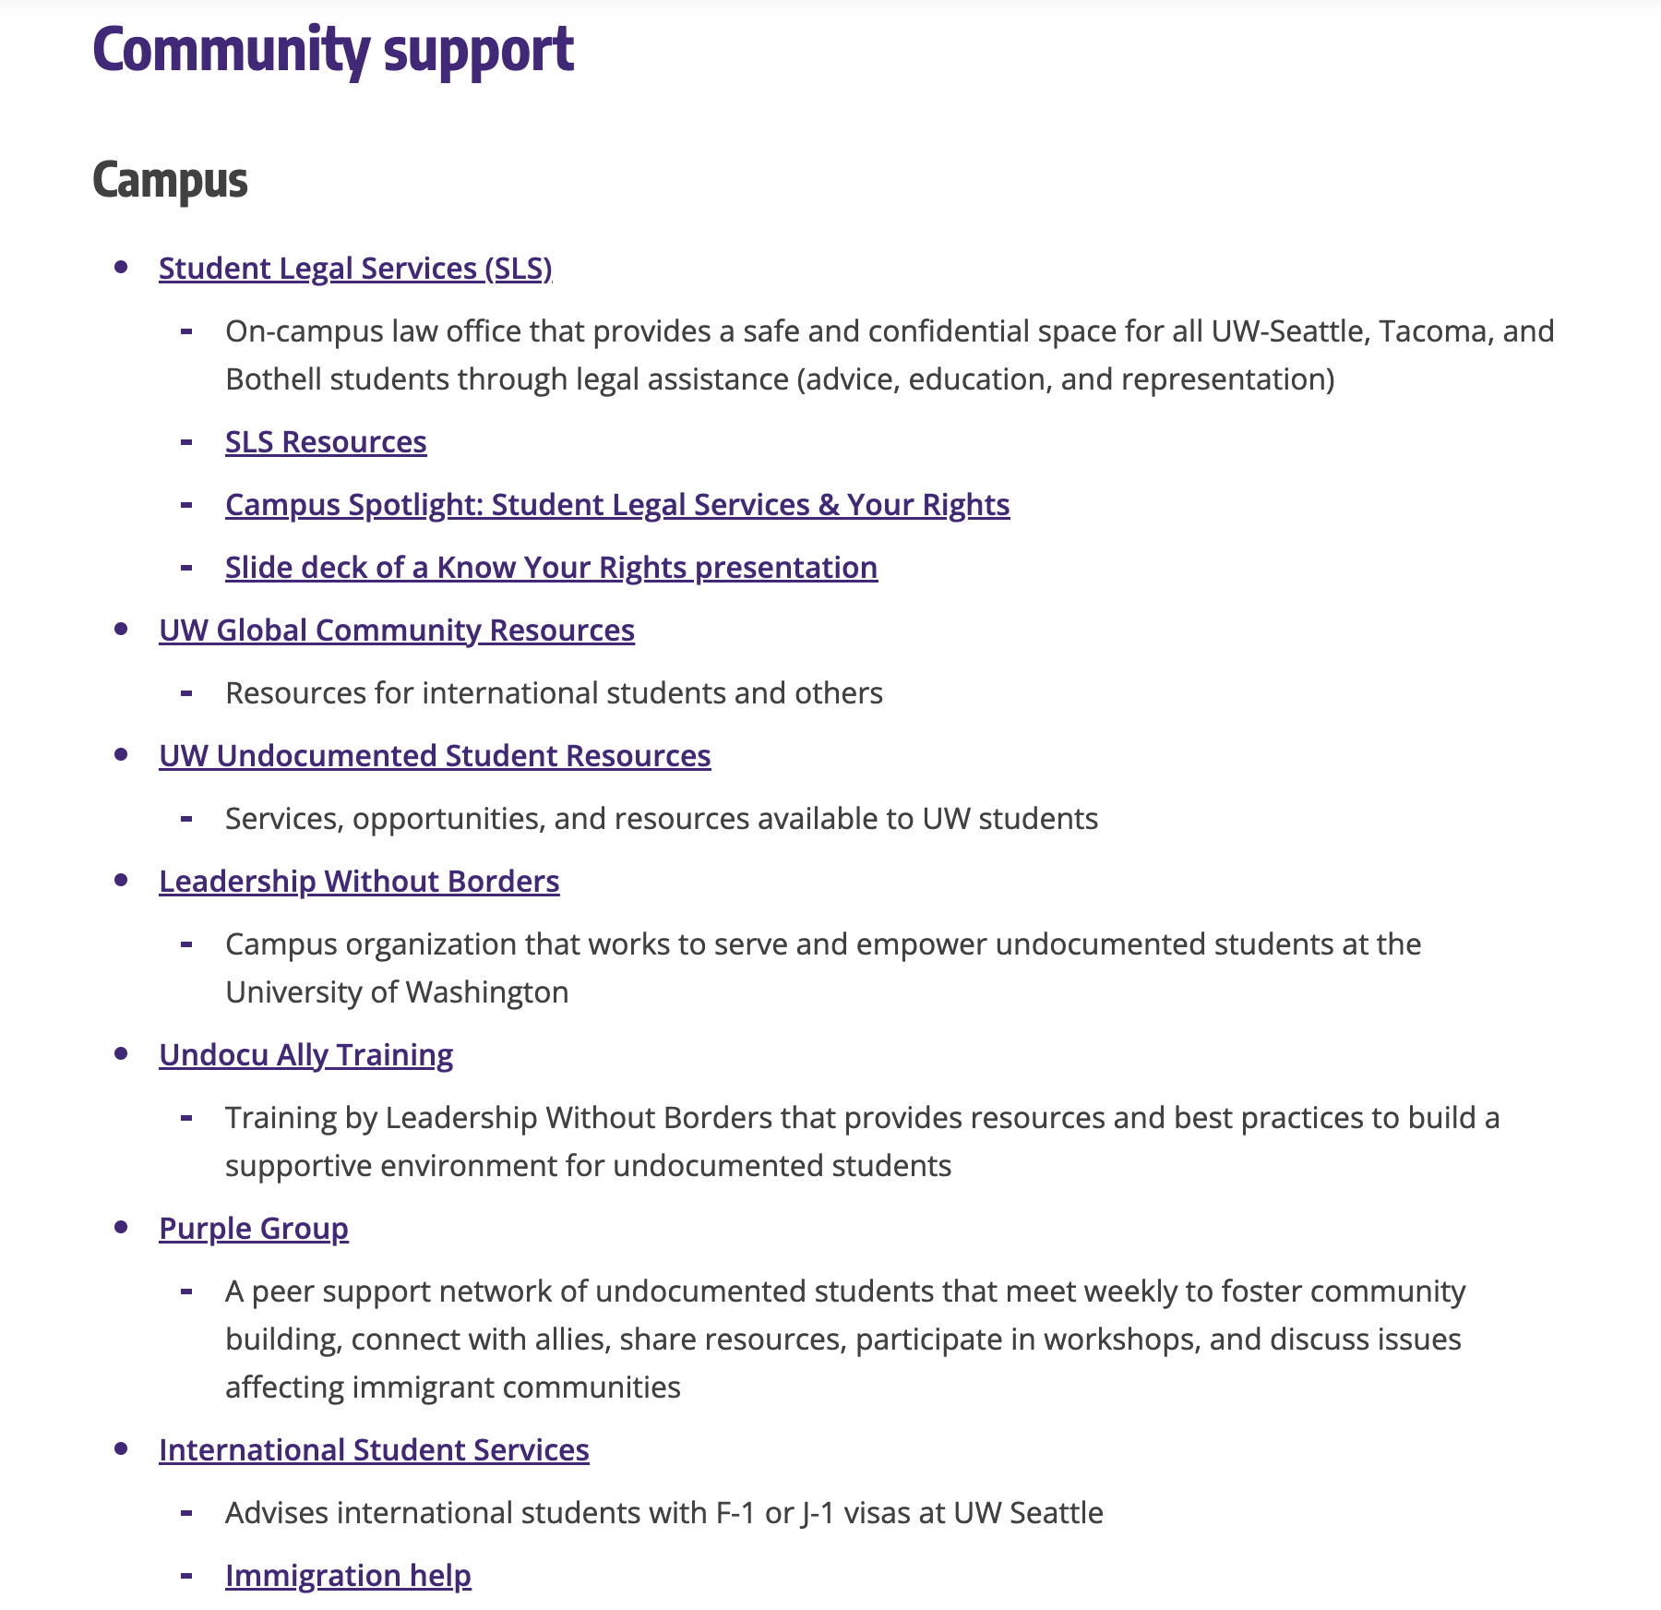

Slide 38
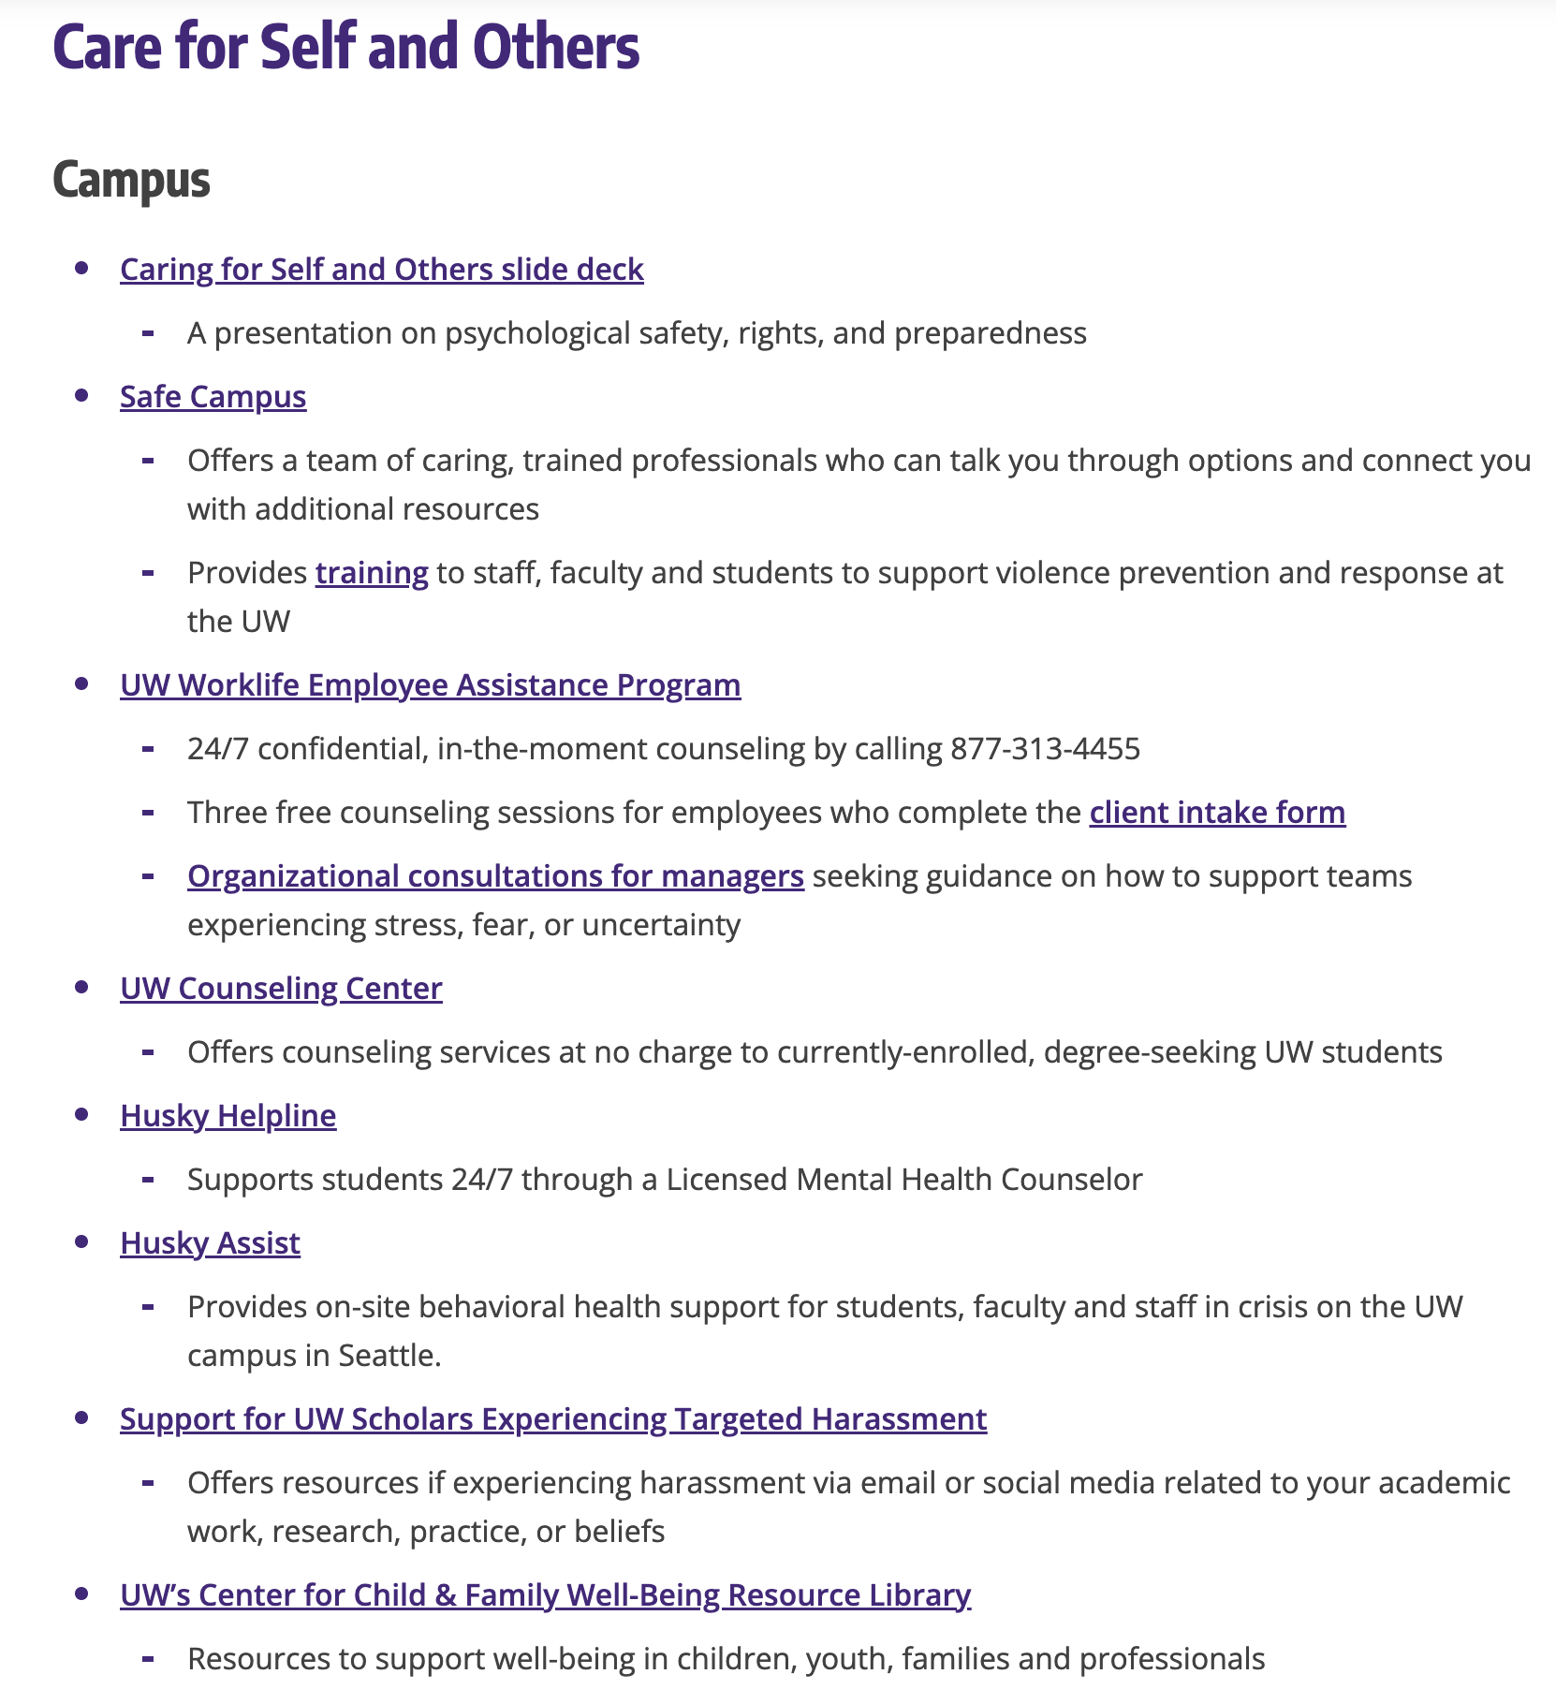

Slide 39
