Slide 1

Nancy
Bittner

Slide 2
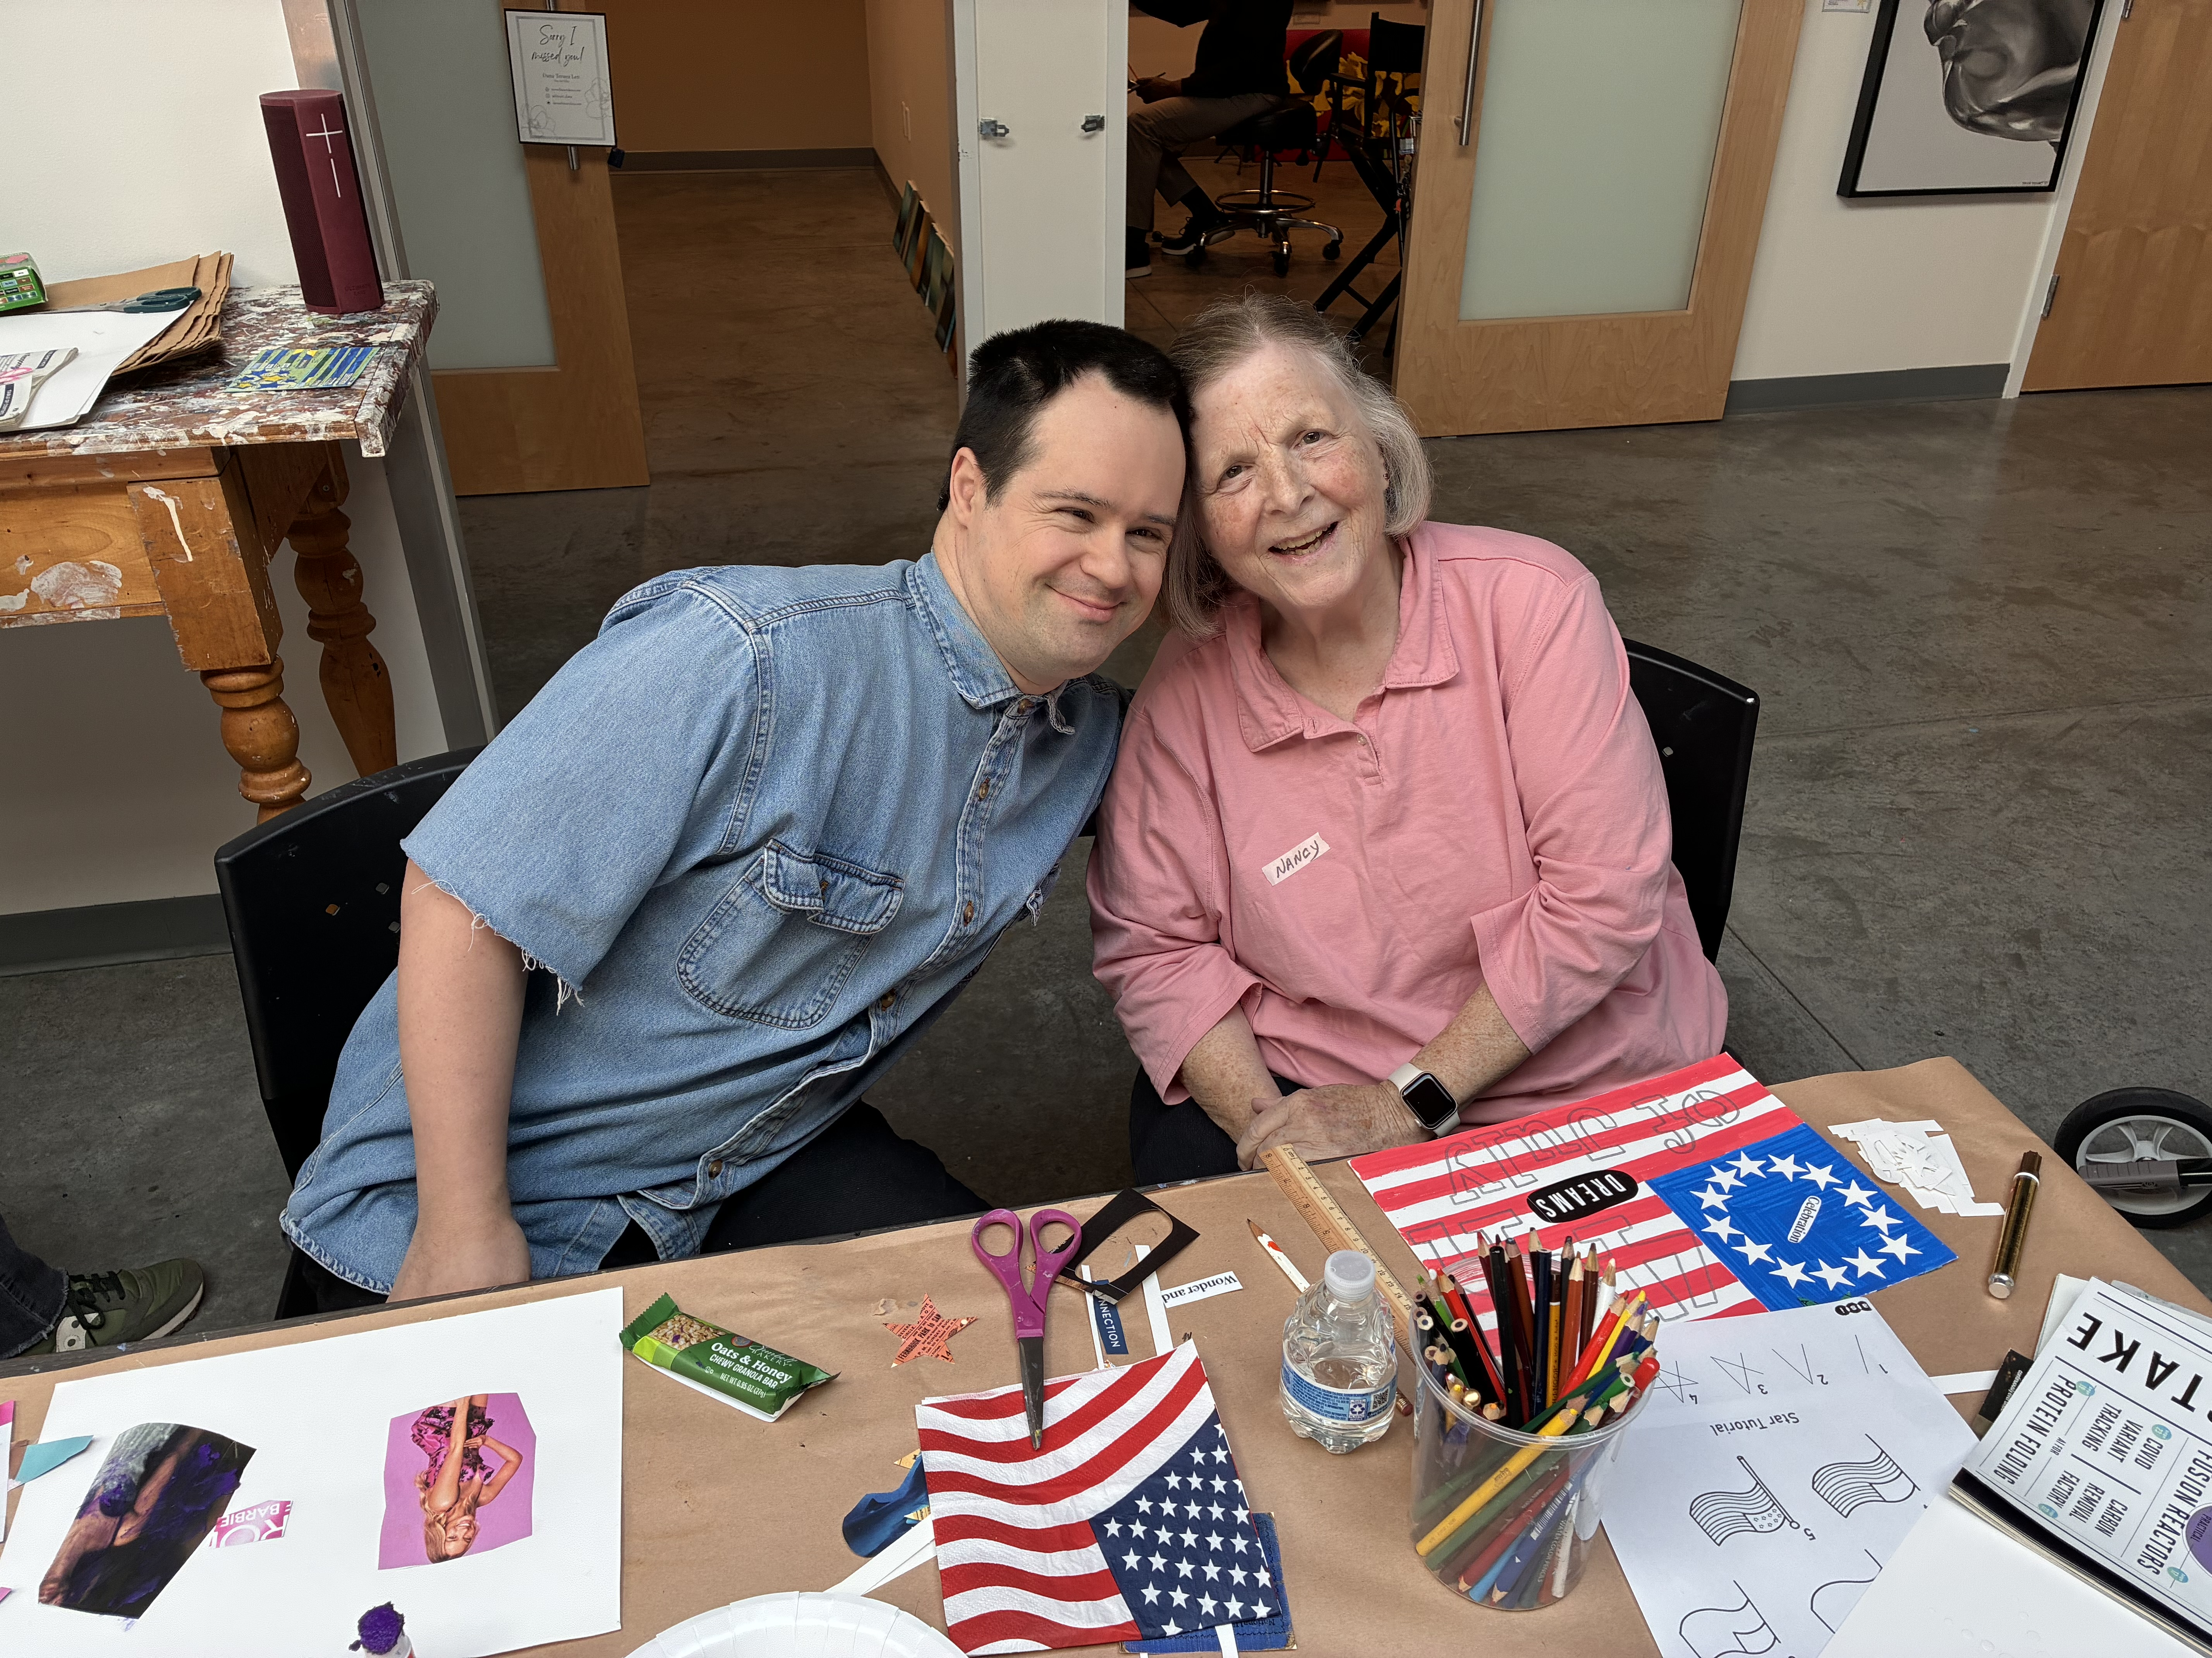
Nancy
Bittner

Slide 3
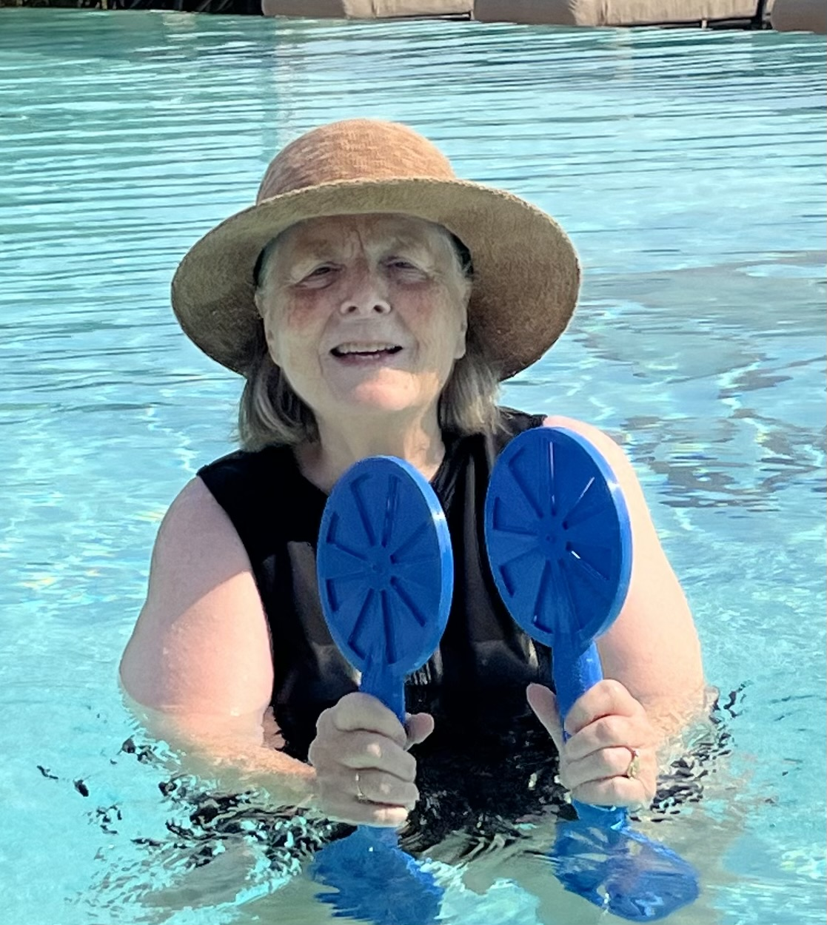
Nancy
Bittner

Slide 4
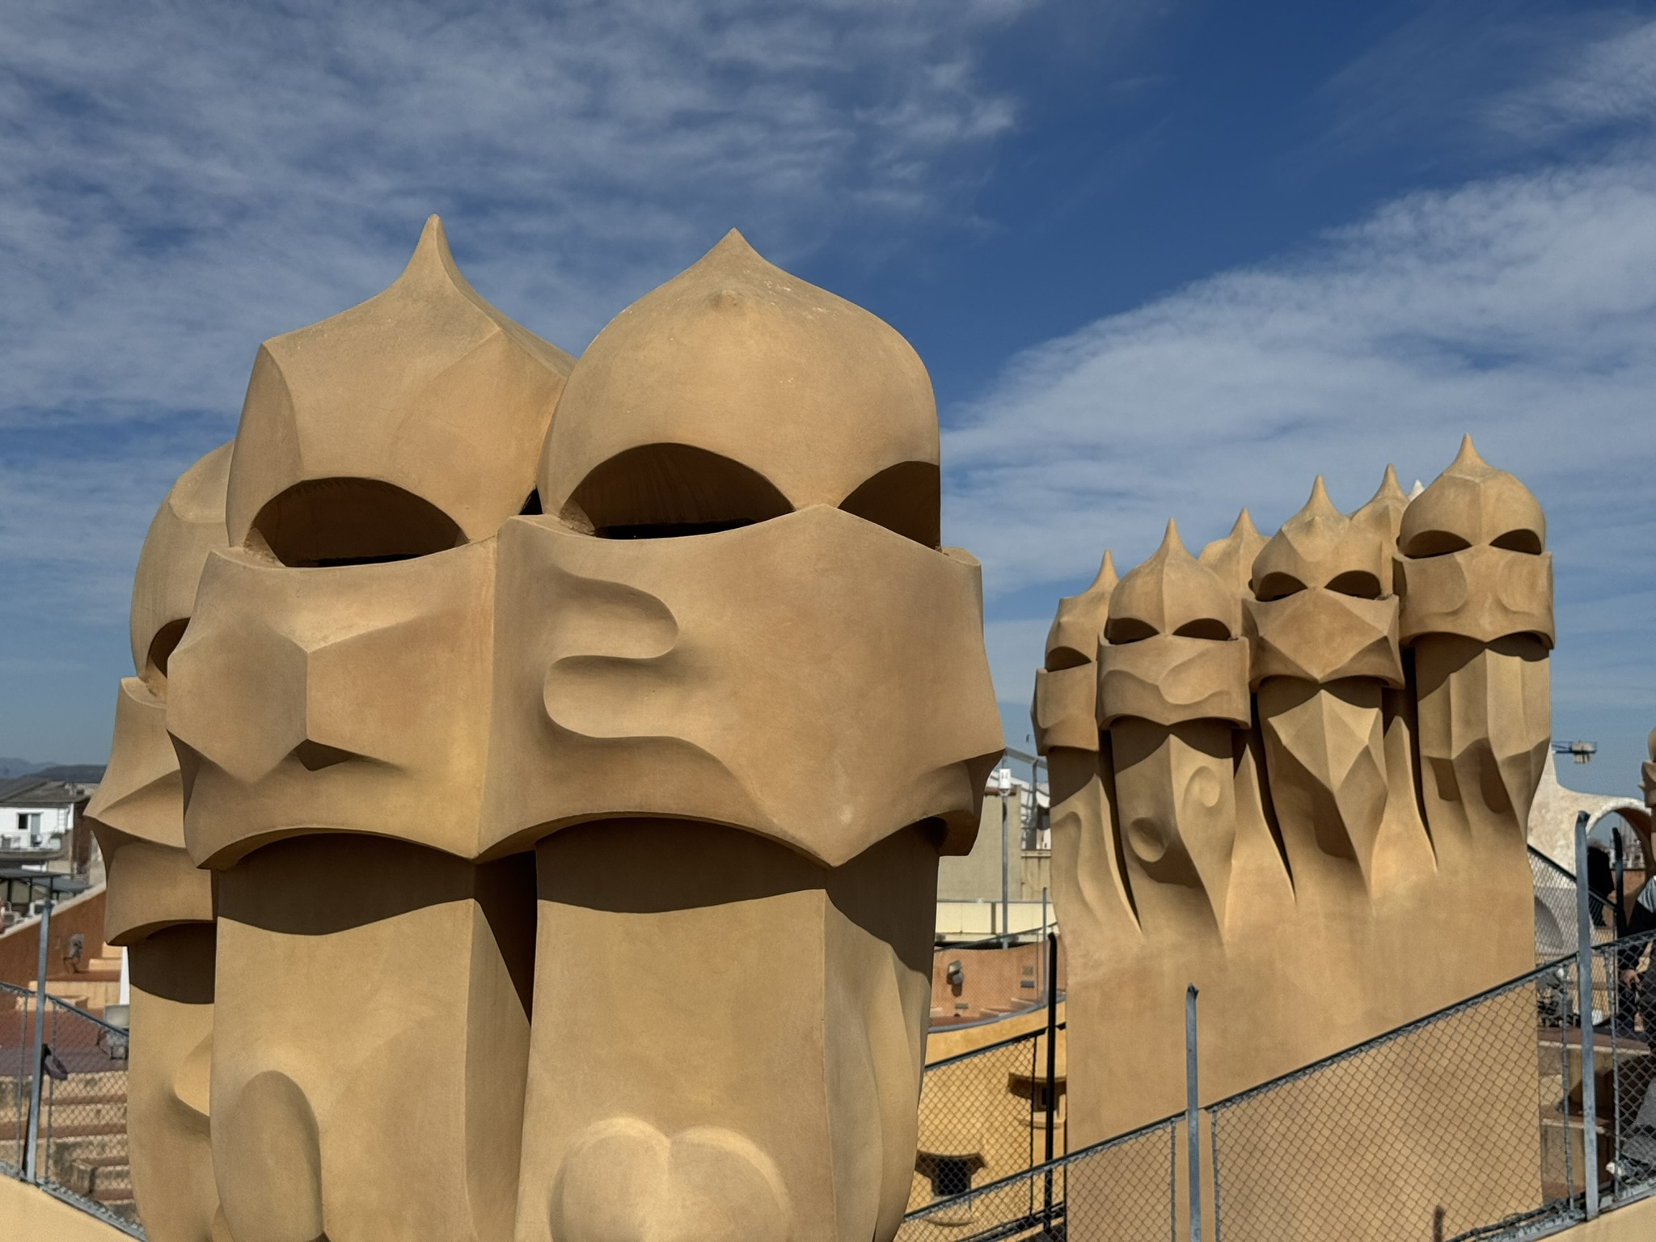
Ed
Bronsdon

Slide 5
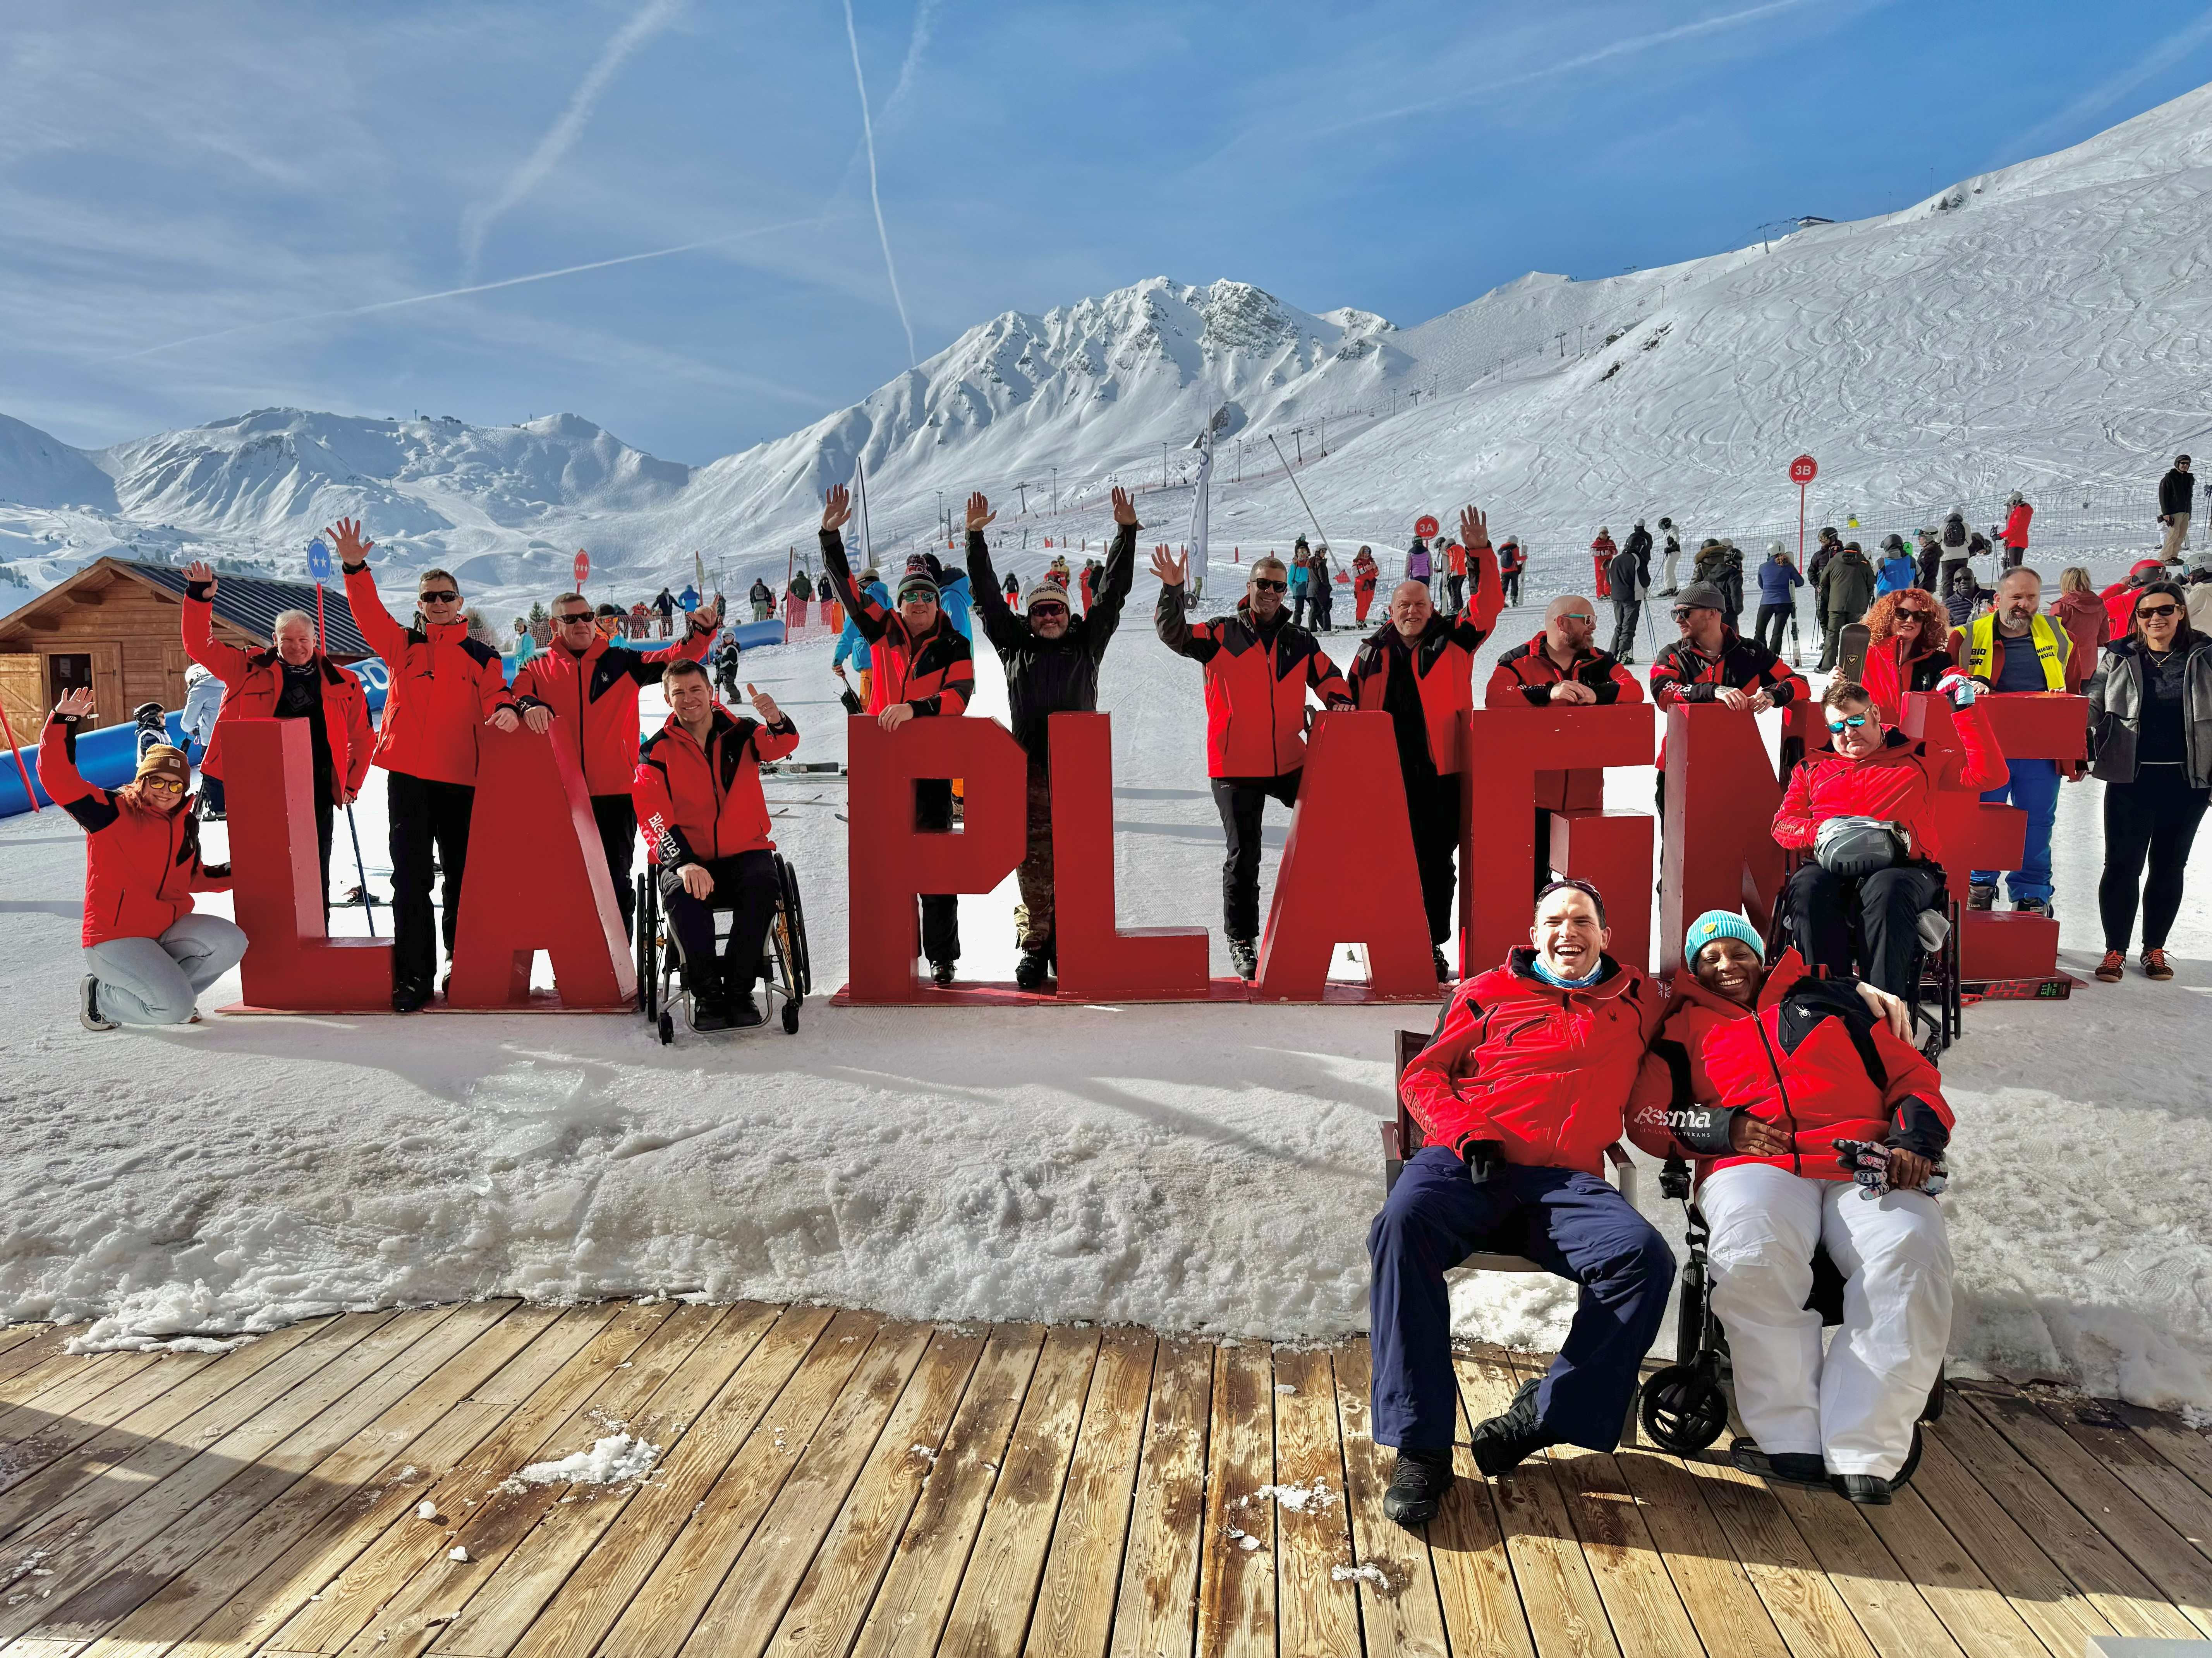
Ed
Bronsdon

Slide 6
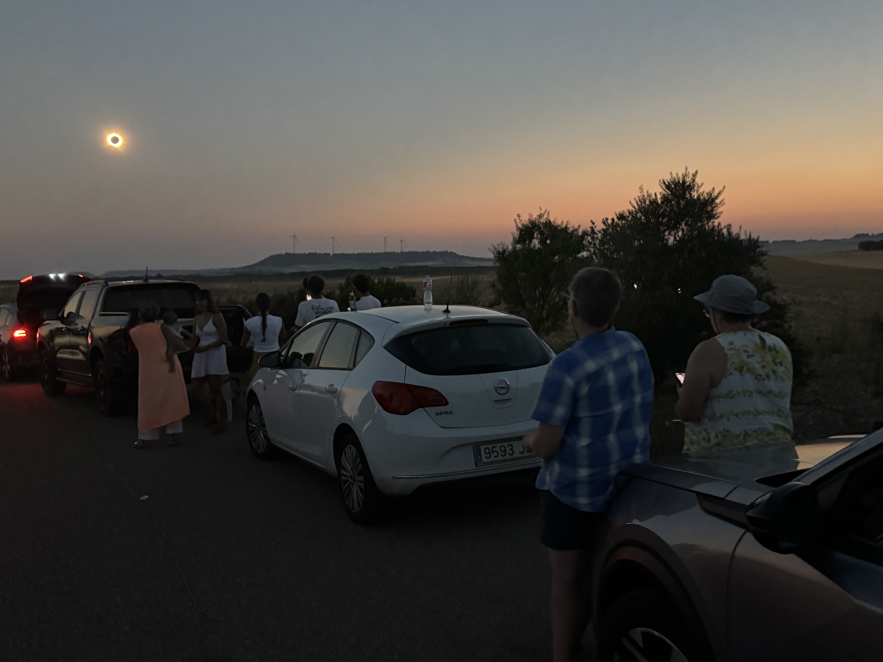
Ed
Bronsdon

Slide 7
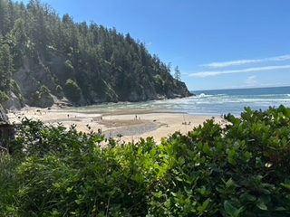
Nancy
Bolin

Slide 8
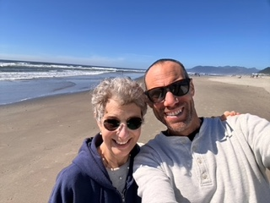
Nancy
Bolin

Slide 9
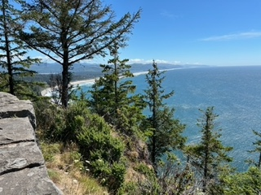
Nancy
Bolin

Slide 10
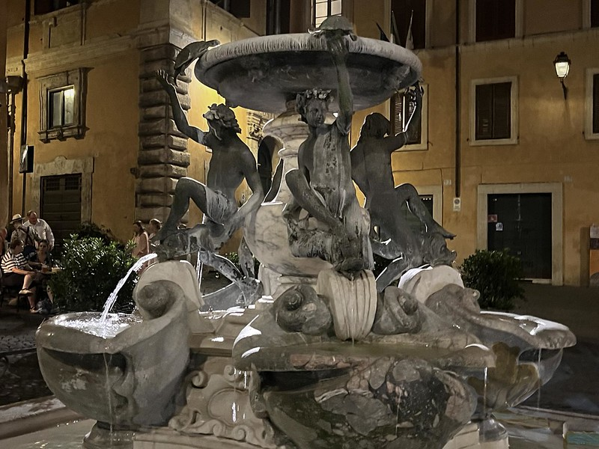
Bruce
Balick

Slide 11
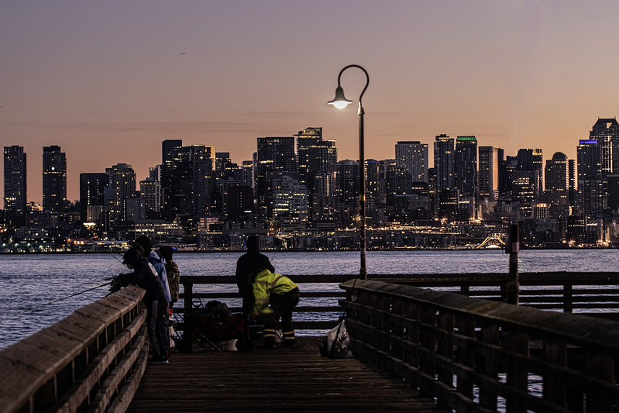
Bruce
Balick

Slide 12
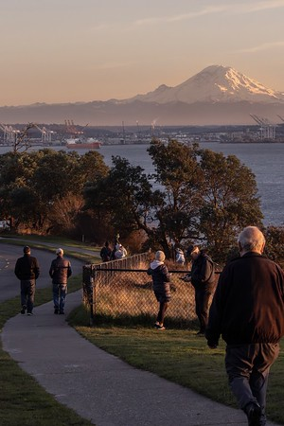
Bruce
Balick

Slide 13
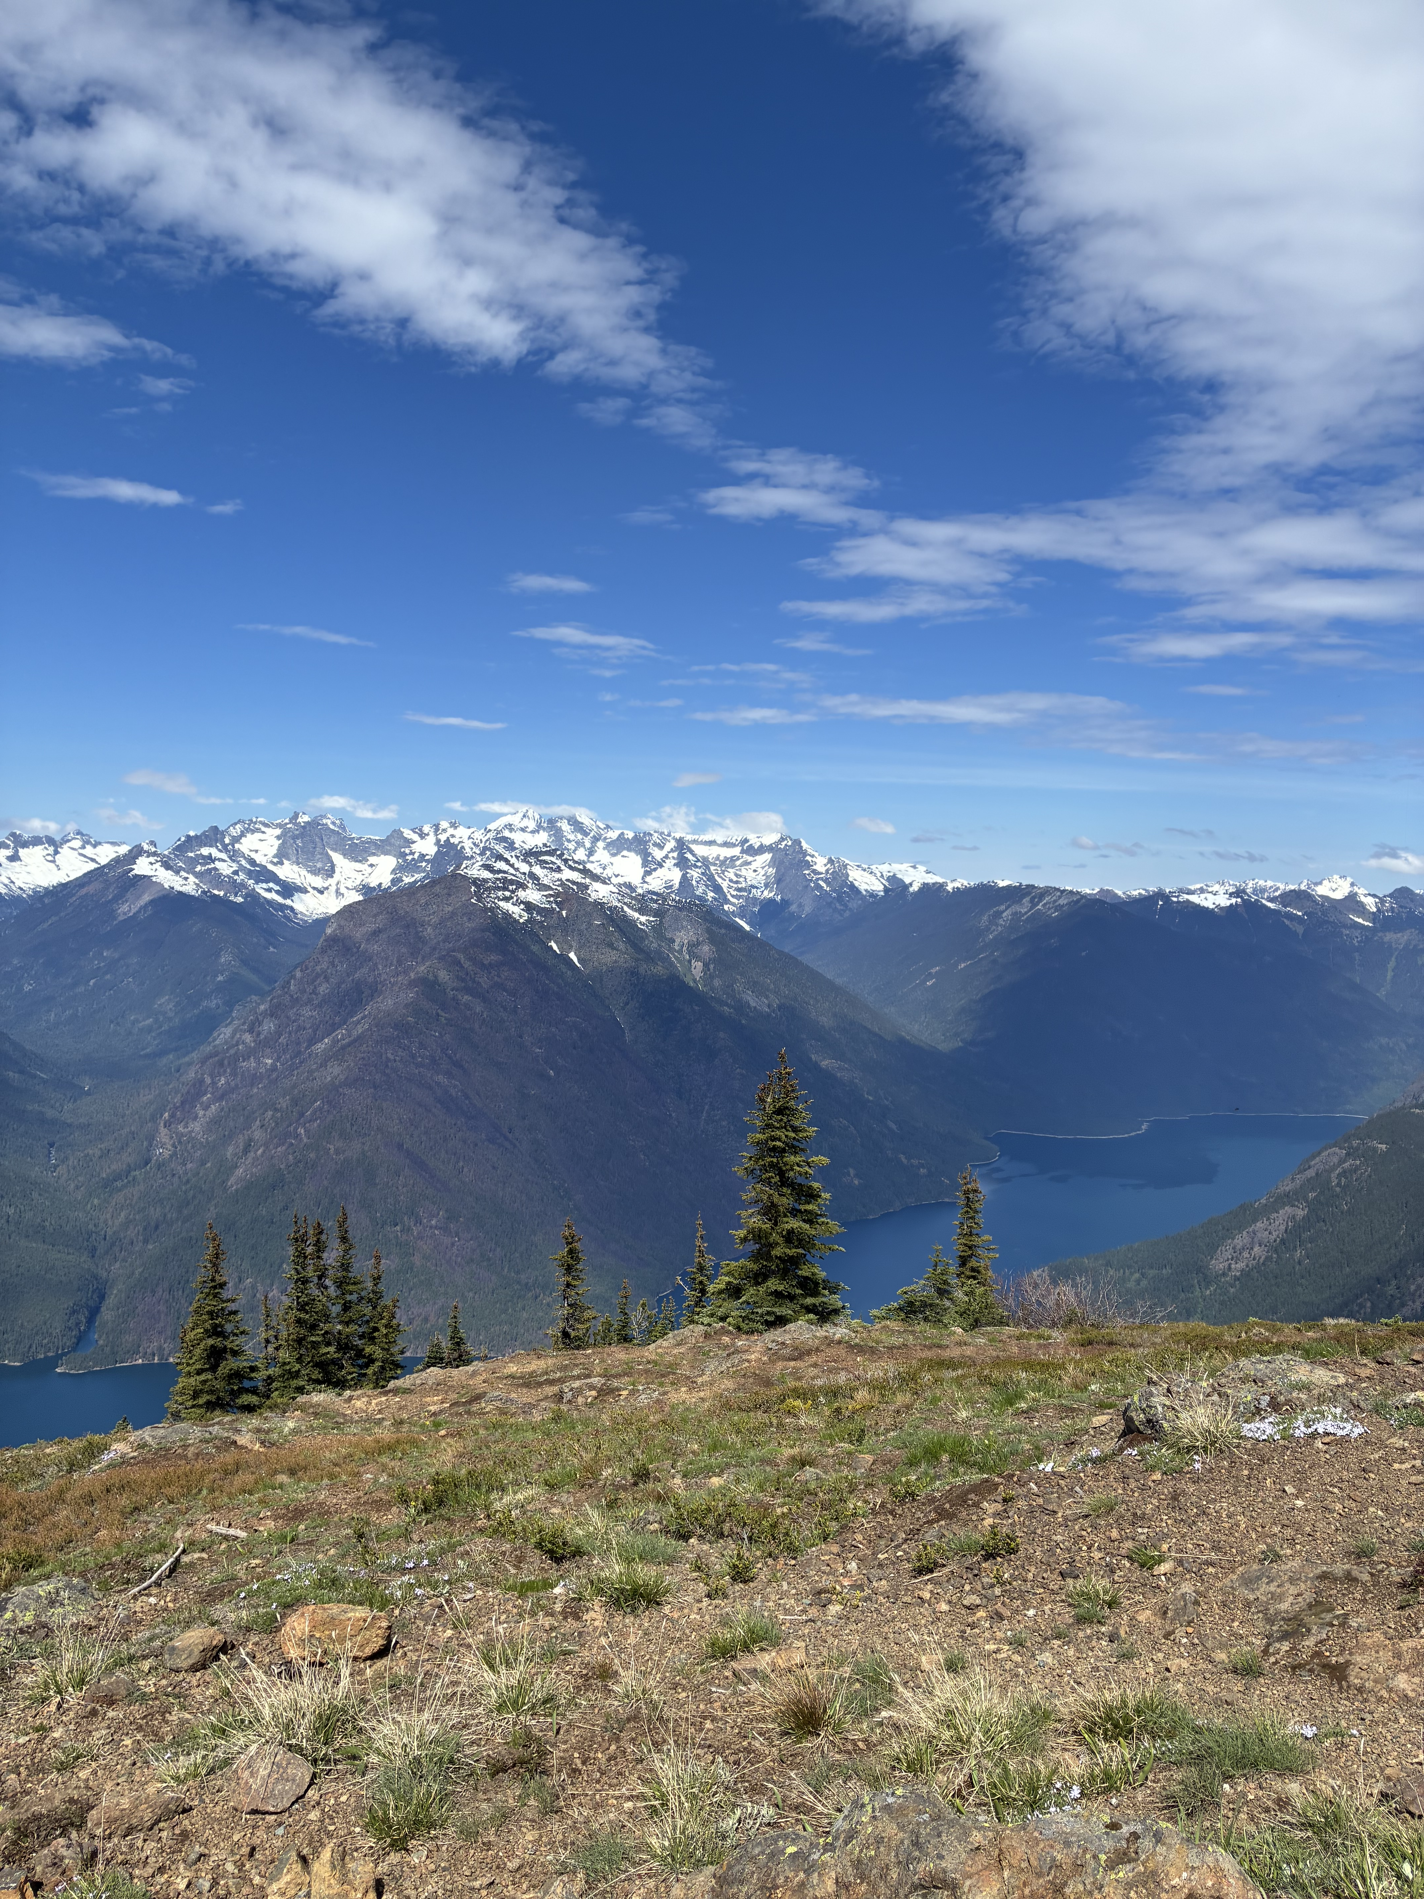
Ryan
Hamilton

Slide 14
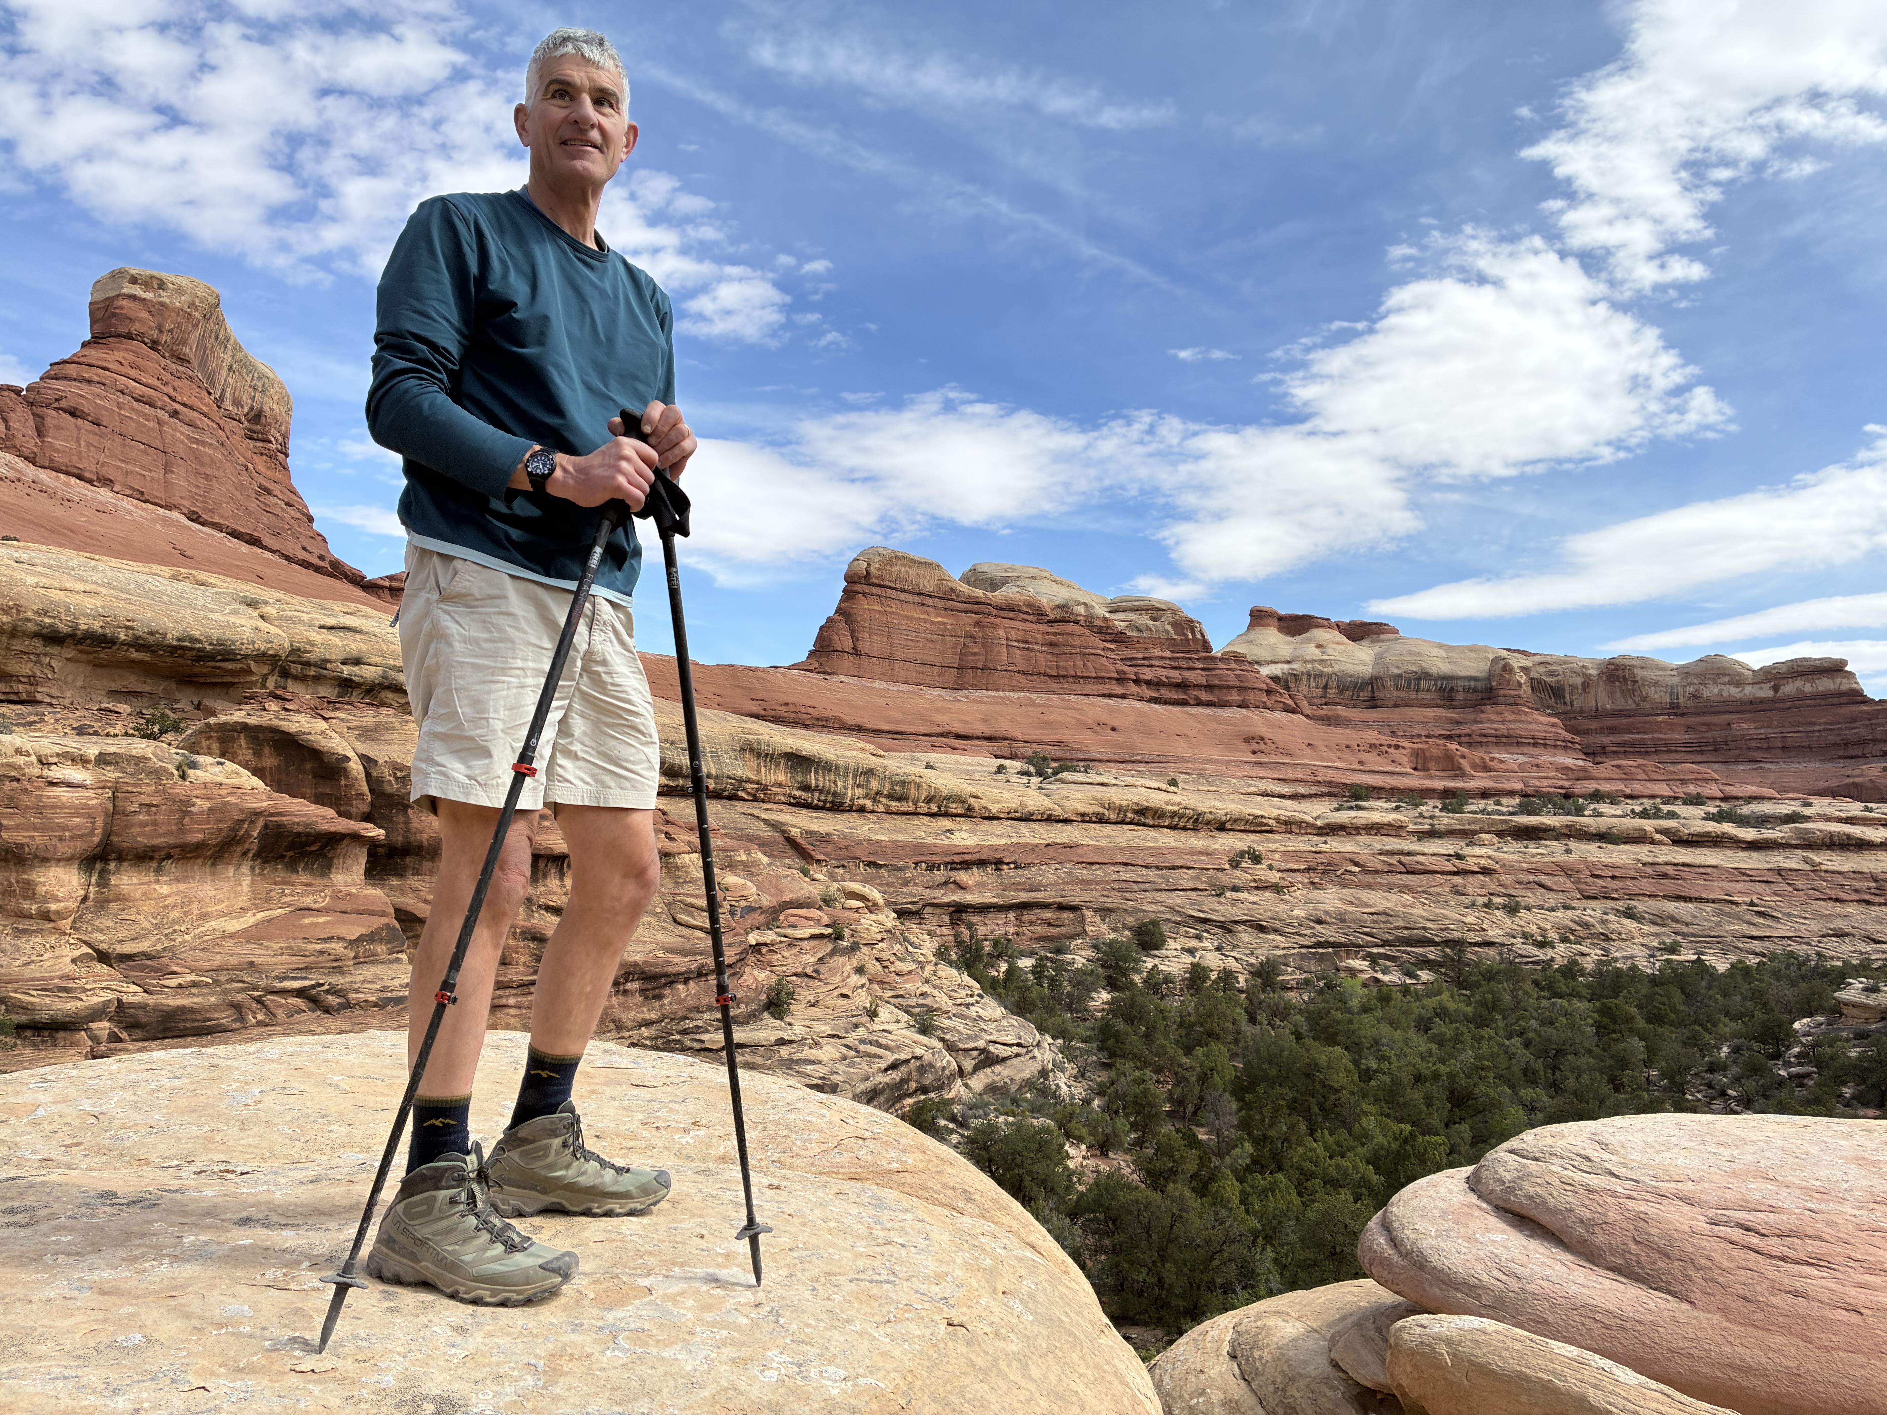
Ryan
Hamilton

Slide 15
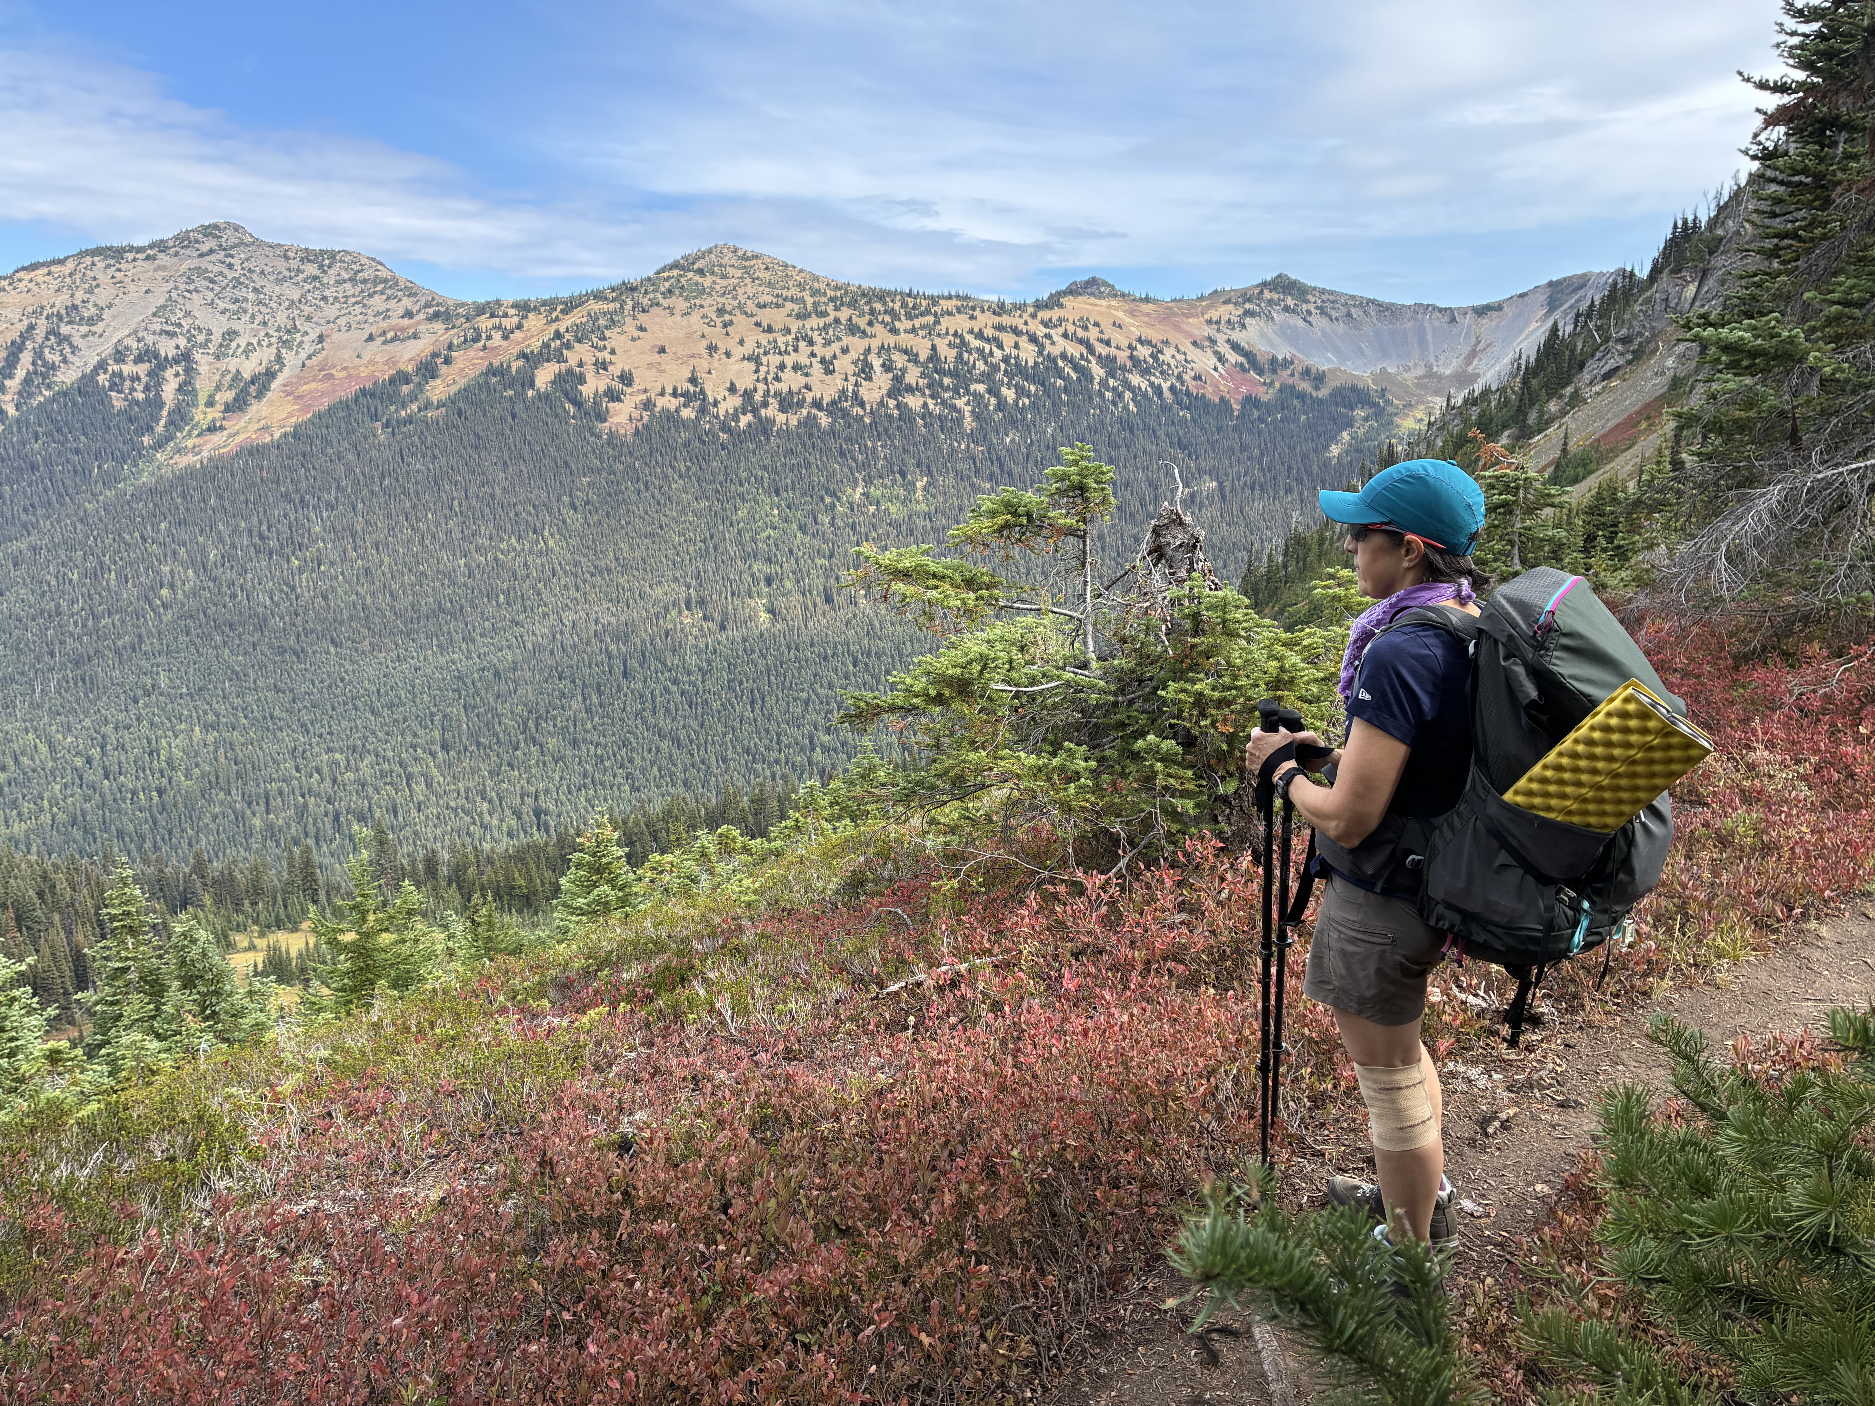
Ryan
Hamilton

Slide 16
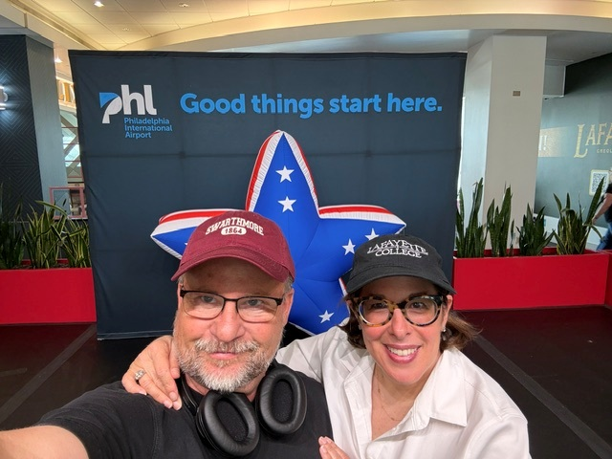
Rebecca
Jansson

Slide 17
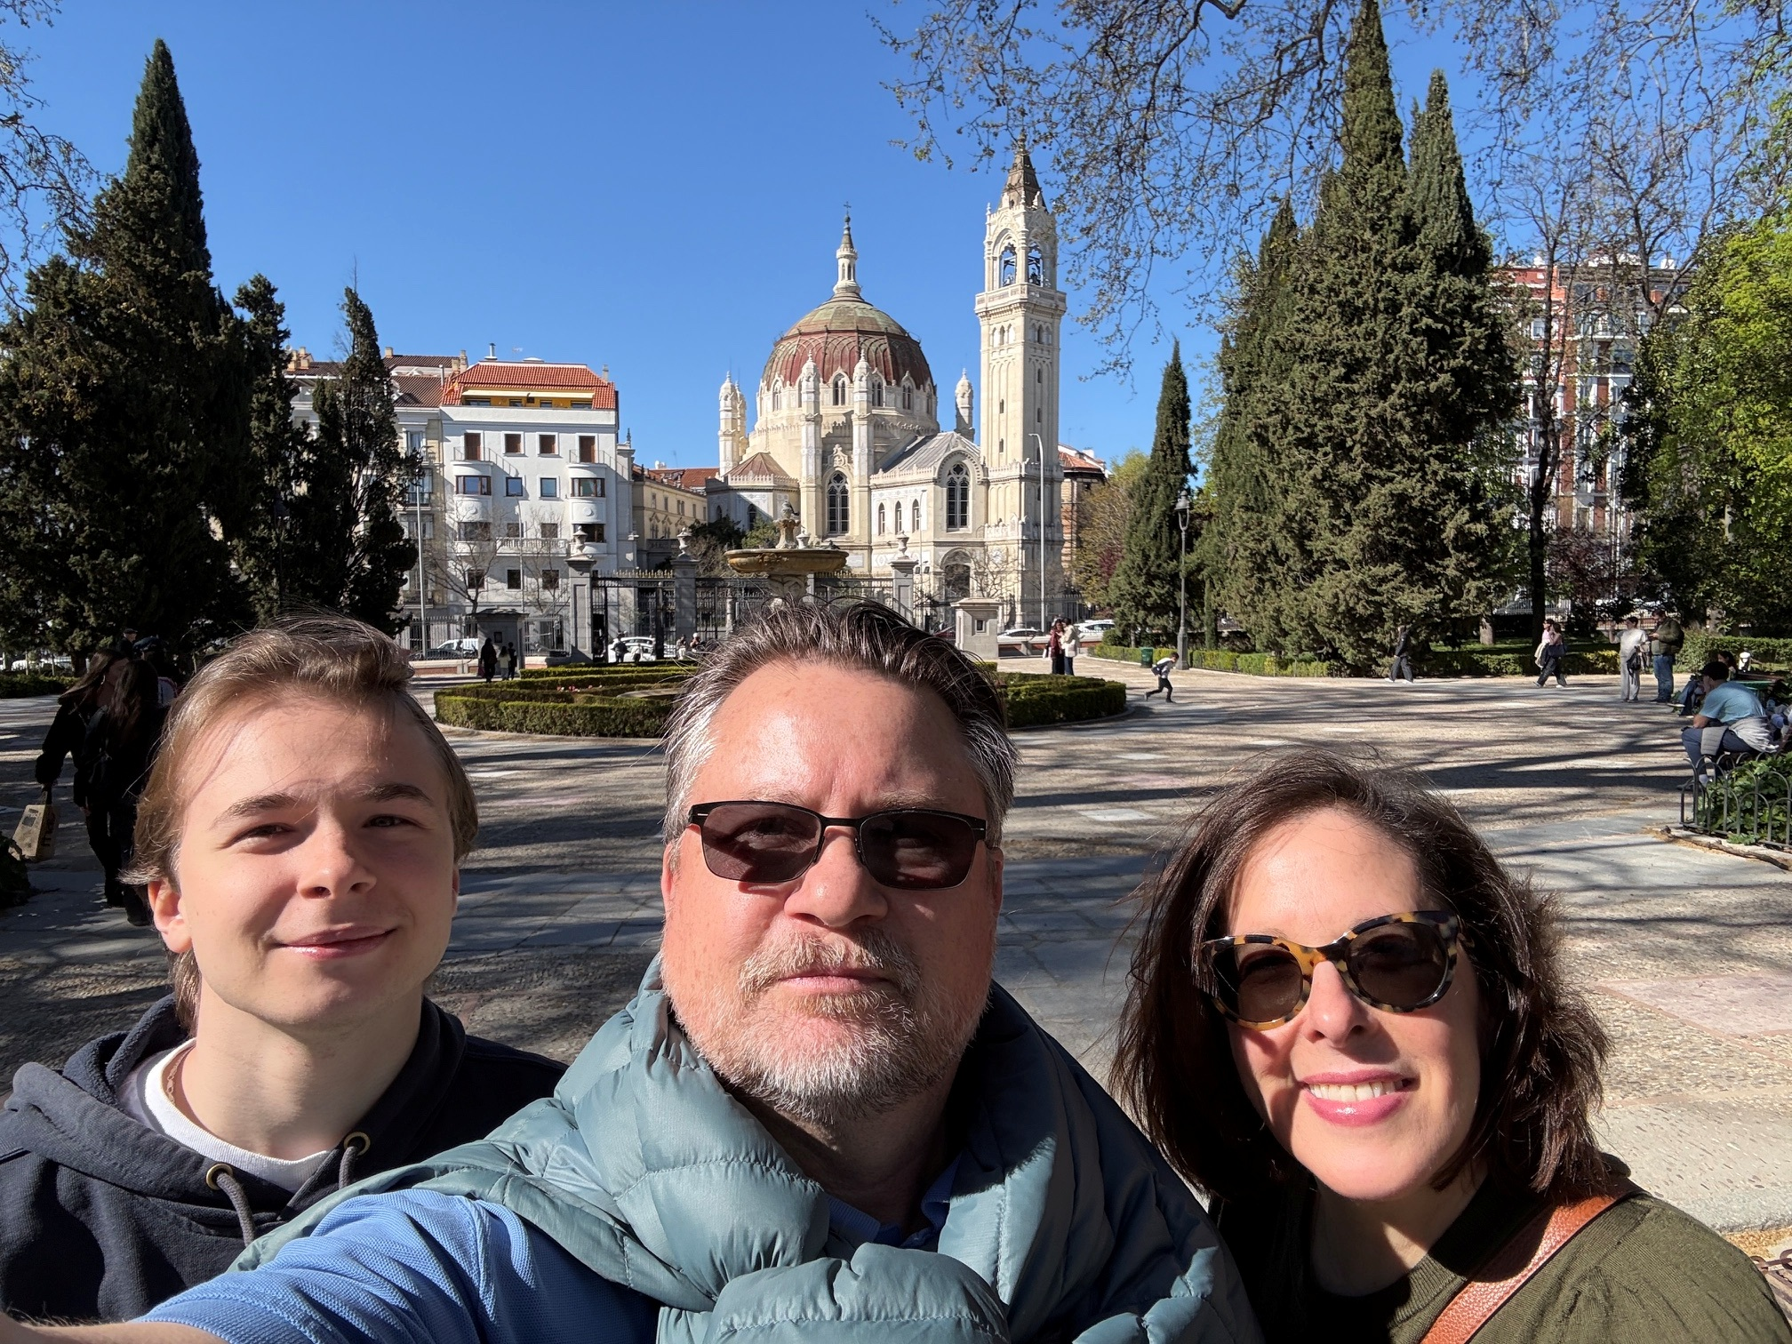
Rebecca
Jansson

Slide 18
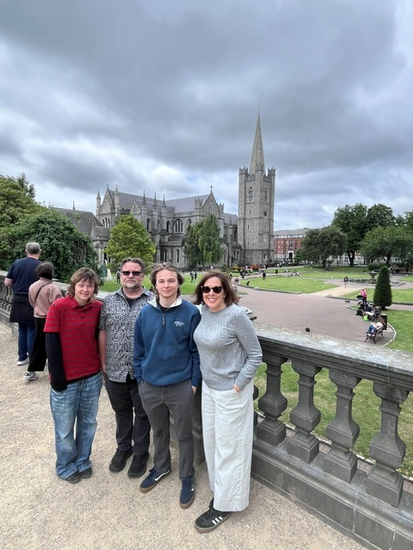
Rebecca
Jansson

Slide 19
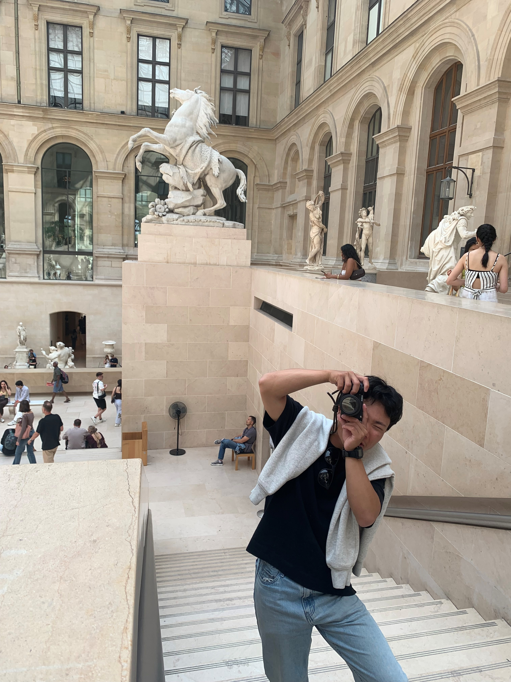
Michelle Lee

Slide 20
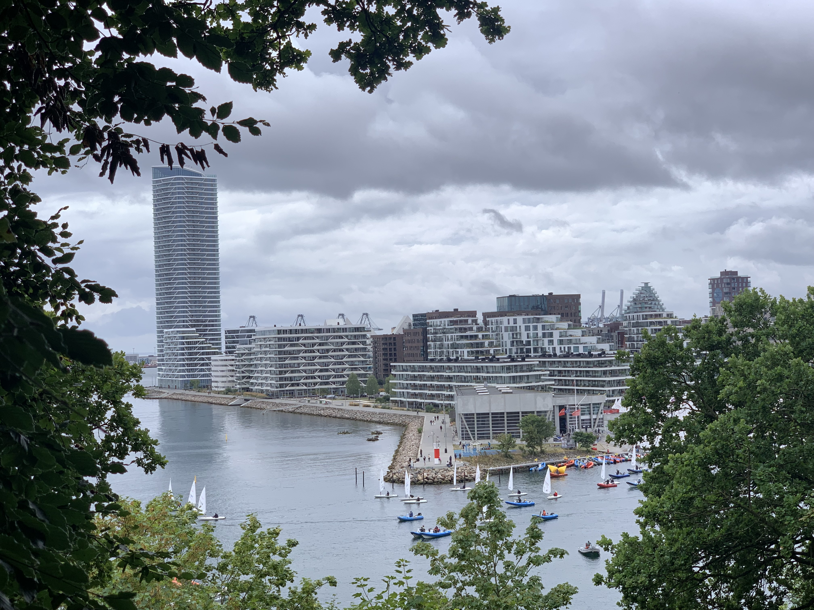
Michelle Lee

Slide 21
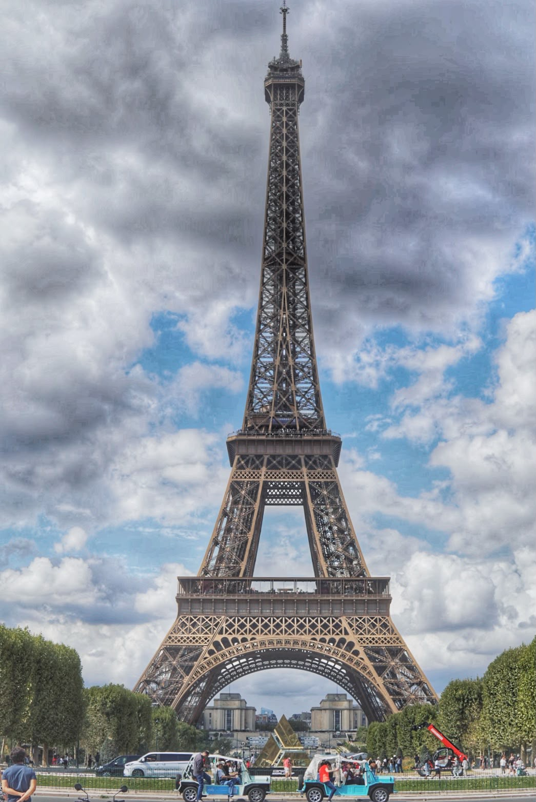
Michelle Lee

Slide 22

Mike
Madden

Slide 23

Mike Madden

Slide 24
Mike
Madden

Slide 25
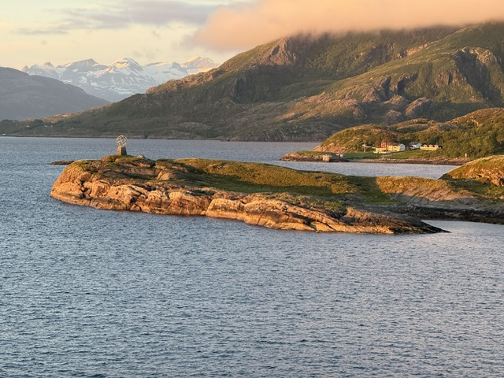
Merrill Mayer

Slide 26
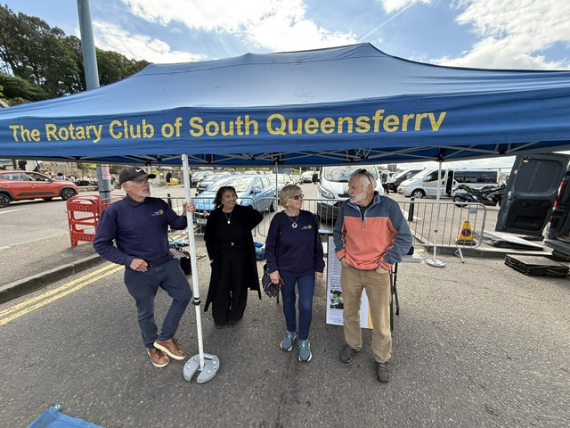
Merrill Mayer

Slide 27
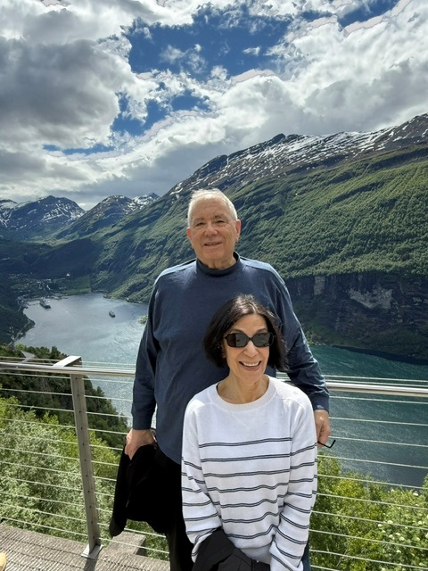
Merrill Mayer

Slide 28
Dave
Mushen

Slide 29
Dave
Mushen

Slide 30
Dave
Mushen

Slide 31
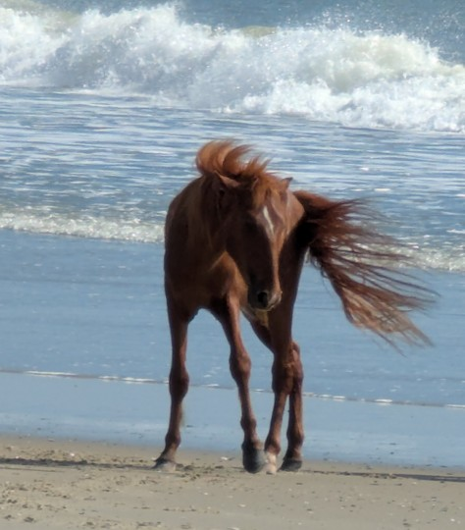
Pam
Mushen

Slide 32
Pam
Mushen

Slide 33
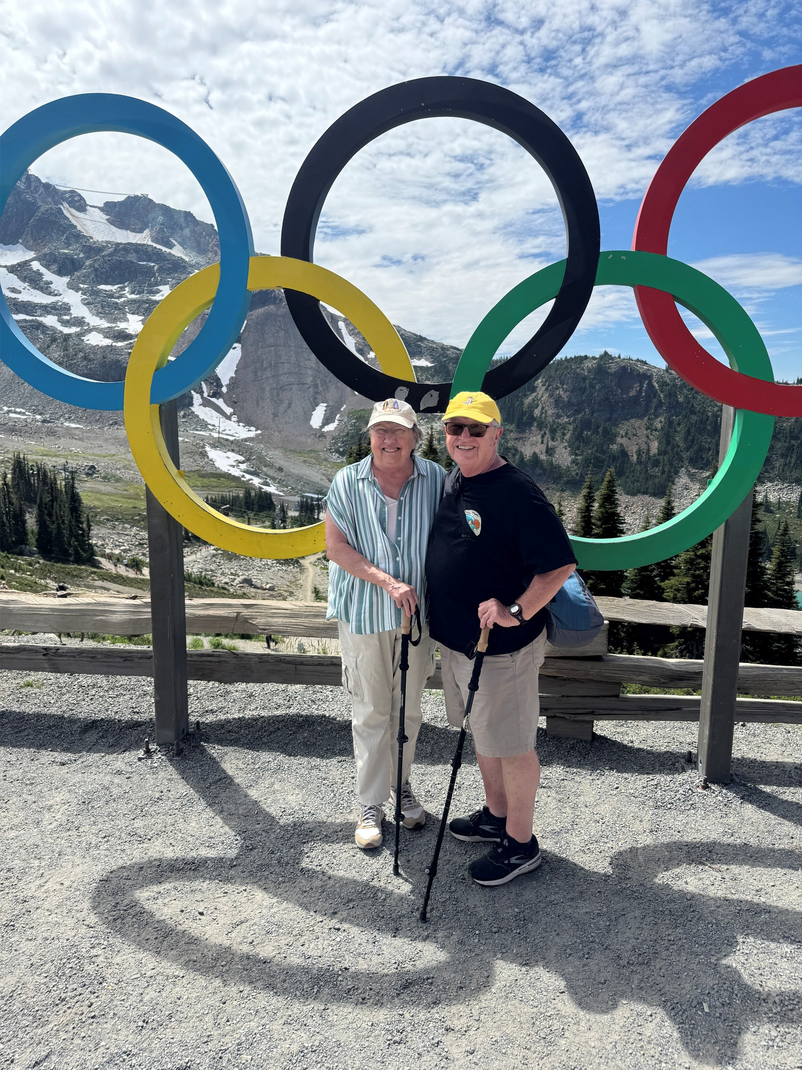
Pam
Mushen

Slide 34
Tom
Ranken

Slide 35
Tom
Ranken

Slide 36
Tom
Ranken

Slide 37
Stuart Webber

Slide 38
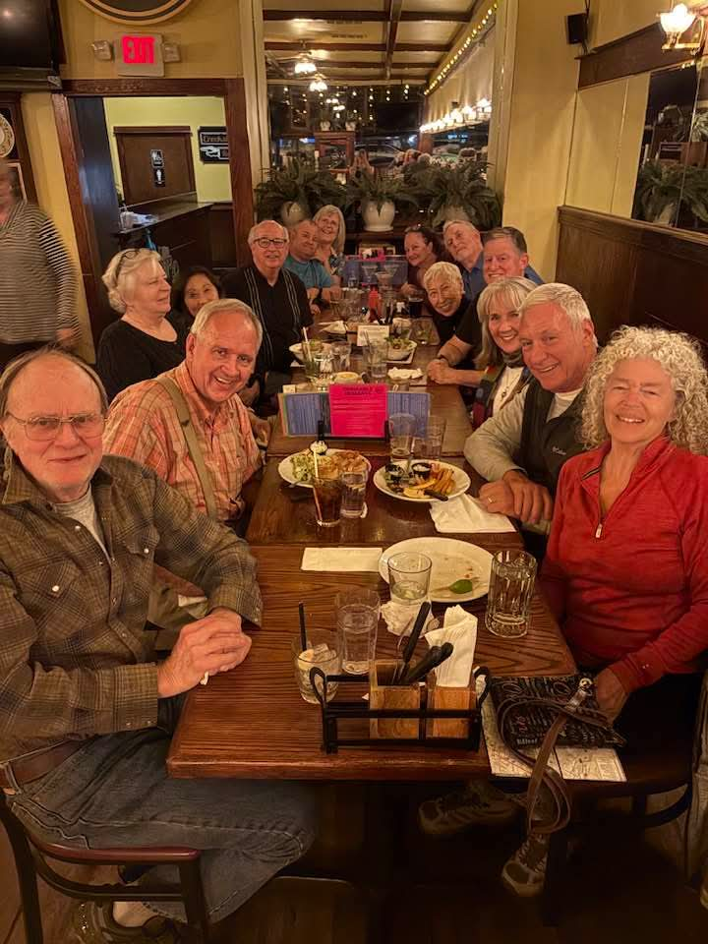
Stuart Webber

Slide 39
Stuart Webber

Slide 40
Paul
Weibel

Slide 41
Paul Weibel

Slide 42
Paul Weibel

Slide 43
Victoria
Wenick

Slide 44
Victoria
Wenick

Slide 45
Victoria
Wenick

